Slide 1
Ferguson Museum Land Trust, Fishers Island NY
Wildfire Risk Assessment of Ferguson Museum Land Trust land parcels on Fishers Island NY
The following pages are maps depicting the wildfire fuels models present on each land trust owned or easement parcel.
The colors of the models represent the level of intensity of wildfires in those fuels and the tables describe the name and characteristics of each fuel model present.
This information is presented from West to East on Fishers Island. All maps are displayed with true North at the top.

Slide 2
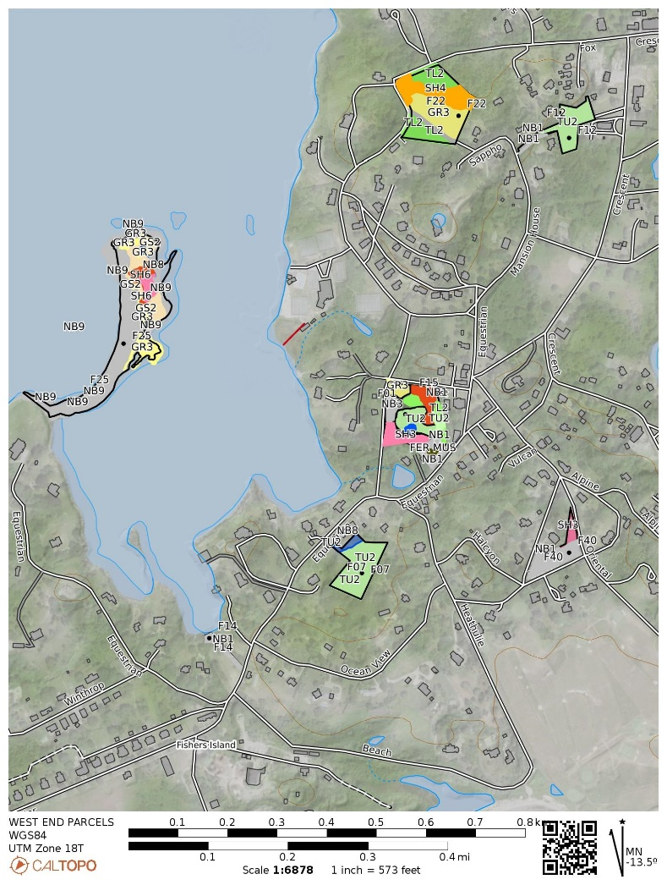
EAST END PARCELS

Slide 3
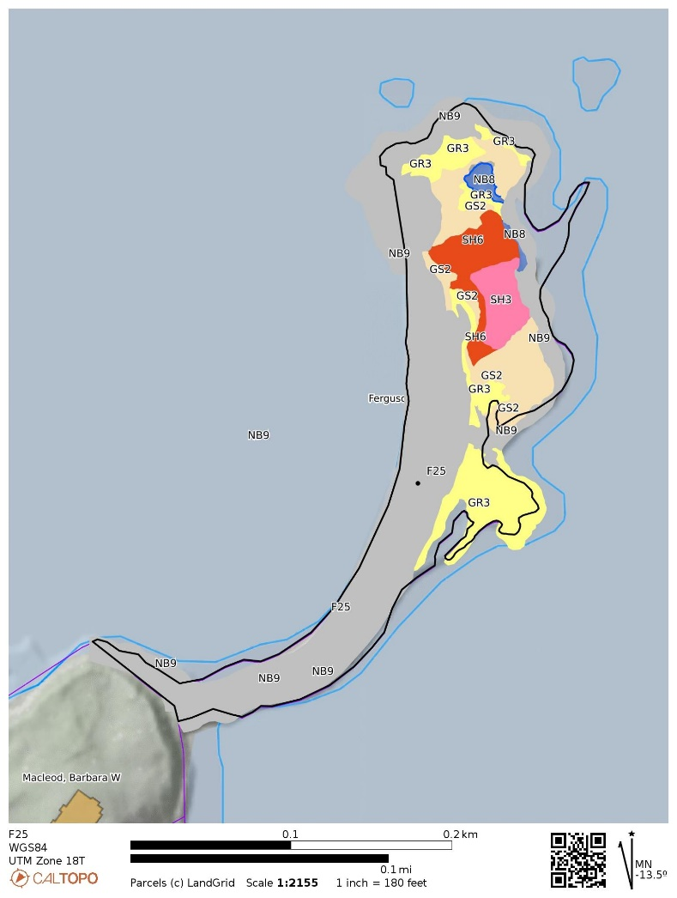
F25
FUEL MODEL | FUEL NAME | DESCRIPTION / CHARACTERISTICS
GR3 | Low Load, Very Course, Humid Climate Grass (Dynamic) | The primary carrier of fire in GR3 is continuous, coarse, humid-climate grass. Grass and herb fuel load is relatively light; fuelbed depth is about 2 feet
GS2 | Moderate Load, Dry Climate Grass-Shrub (Dynamic) | The primary carrier of fire in GS2 is grass and shrubs combined. Shrubs are 1 to 3 feet high, grass load is moderate. Spread rate is high; flame length moderate.
SH3 | Moderate Load, Humid Climate Shrub | The primary carrier of fire in SH3 is woody shrubs and shrub litter. Moderate shrub load, possibly with pine overstory or herbaceous fuel, fuel bed depth 2 to 3 feet. Spread rate is low; flame length low
SH6 | Low Load, Humid Climate Shrub | The primary carrier of fire in SH6 is woody shrubs and shrub litter. Dense shrubs, little or no herbaceous fuel, fuelbed depth about 2 feet. Spread rate is high; flame length high
NB8 | Non-burnable Lake / Open Water | Will not burn
NB9 | Non-burnable Beach / Rock | Will not burn, no continuous fuel.

Slide 4
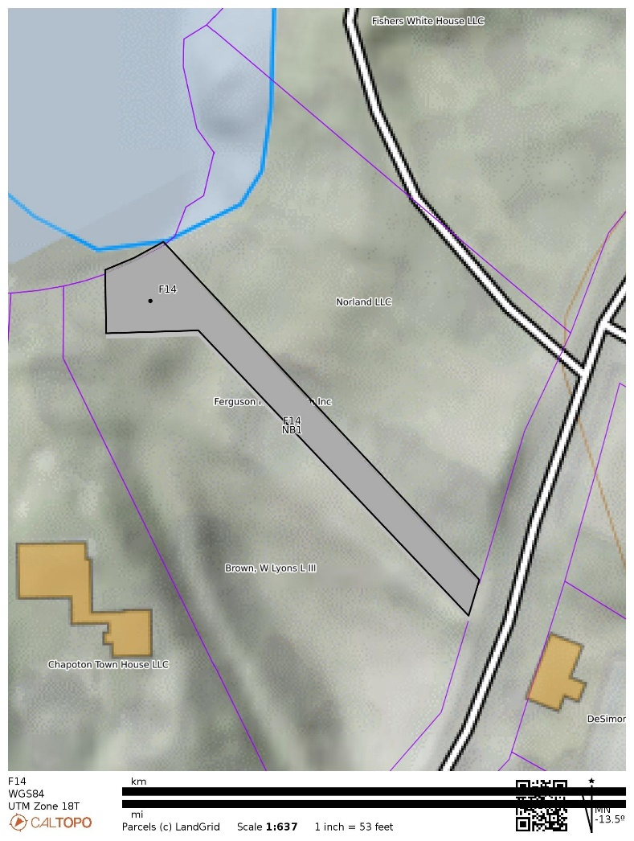
F14
FUEL MODEL | FUEL NAME | DESCRIPTION / CHARACTERISTICS
NB1 | Non-burnable Grass Lawn | Will not burn except during extreme drought

Slide 5
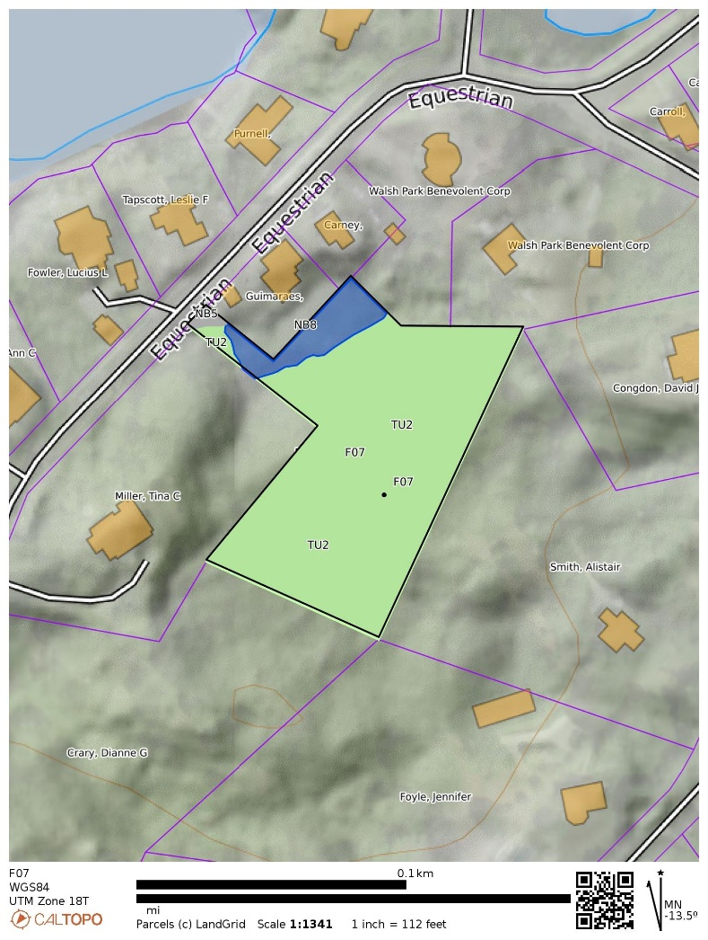
F07
FUEL MODEL | FUEL NAME | DESCRIPTION / CHARACTERISTICS
TU2 | Moderate Load, Humid Climate Timber-Shrub | The primary carrier of fire in TU2 is moderate litter load with shrub component. High extinction moisture. Spread rate is moderate; flame length low.
NB8 | Non-burnable Lake / Open Water | Will not burn

Slide 6
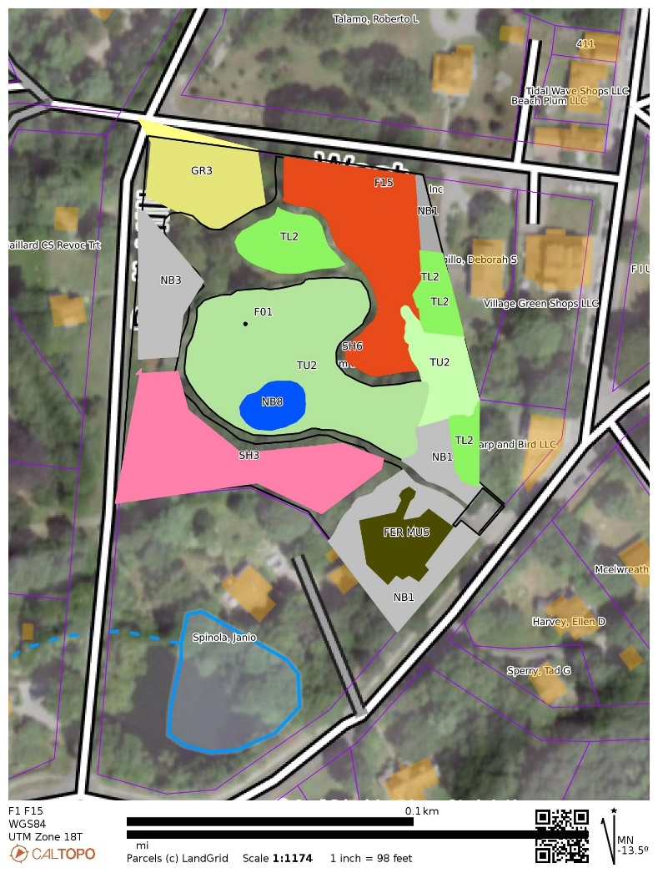

F01- Ferguson Museum & F15
FUEL MODEL | FUEL NAME | DESCRIPTION / CHARACTERISTICS
GR3 | Low Load, Very Course, Humid Climate Grass (Dynamic) | The primary carrier of fire in GR3 is continuous, coarse, humid-climate grass. Grass and herb fuel load is relatively light; fuelbed depth is about 2 feet
TU2 | Moderate Load, Humid Climate Timber-Shrub | The primary carrier of fire in TU2 is moderate litter load with shrub component. High extinction moisture. Spread rate is moderate; flame length low.
TL2 | Low Load Broadleaf Litter | The primary carrier of fire in TL2 is broadleaf (hardwood) litter. Low load, compact broadleaf litter. Spread rate is very low; flame length very low
SH3 | Moderate Load, Humid Climate Shrub | The primary carrier of fire in SH3 is woody shrubs and shrub litter. Moderate shrub load, possibly with pine overstory or herbaceous fuel, fuel bed depth 2 to 3 feet. Spread rate is low; flame length low
SH6 | Low Load, Humid Climate Shrub | The primary carrier of fire in SH6 is woody shrubs and shrub litter. Dense shrubs, little or no herbaceous fuel, fuelbed depth about 2 feet. Spread rate is high; flame length high
NB1 | Non-burnable Grass Lawn | Will not burn except during extreme drought
NB3 | Non-burnable Agriculture | Will not burn if maintained
NB8 | Non-burnable Lake / Open Water | Will not burn

Slide 7
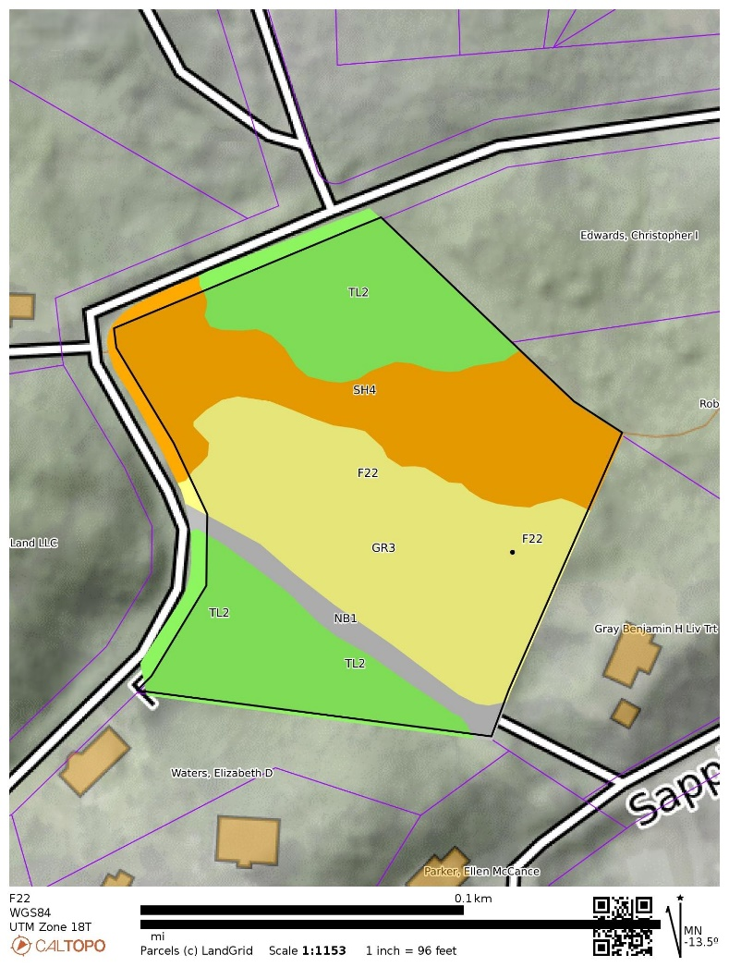
F22
FUEL MODEL | FUEL NAME | DESCRIPTION / CHARACTERISTICS
GR3 | Low Load, Very Course, Humid Climate Grass (Dynamic) | The primary carrier of fire in GR3 is continuous, coarse, humid-climate grass. Grass and herb fuel load is relatively light; fuelbed depth is about 2 feet
TU2 | Moderate Load, Humid Climate Timber-Shrub | The primary carrier of fire in TU2 is moderate litter load with shrub component. High extinction moisture. Spread rate is moderate; flame length low.
SH4 | Low Load, Humid Climate Timber-Shrub | The primary carrier of fire in SH4 is woody shrubs and shrub litter. Low to moderate shrub and litter load, possibly with pine overstory, fuel bed depth about 3 feet. Spread rate is high; flame length moderate.
NB1 | Non-burnable Grass Lawn | Will not burn except during extreme drought

Slide 8
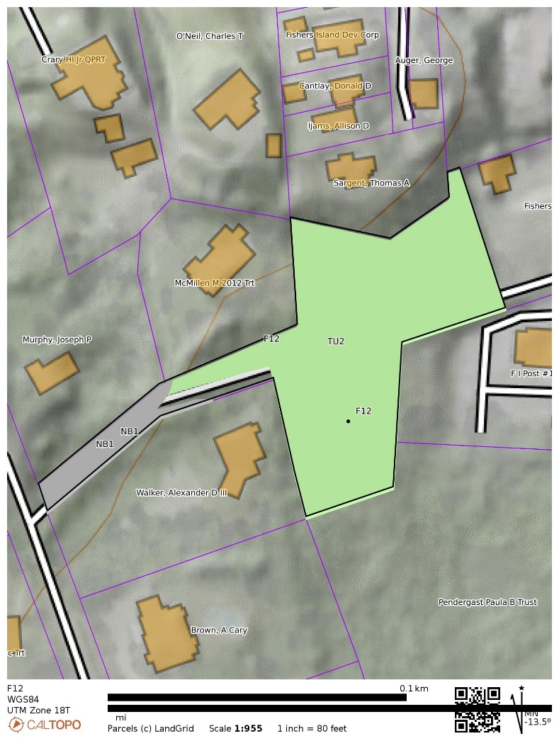
F12
FUEL MODEL | FUEL NAME | DESCRIPTION / CHARACTERISTICS
TU2 | Moderate Load, Humid Climate Timber-Shrub | The primary carrier of fire in TU2 is moderate litter load with shrub component. High extinction moisture. Spread rate is moderate; flame length low.
NB1 | Non-burnable Grass Lawn | Will not burn except during extreme drought

Slide 9
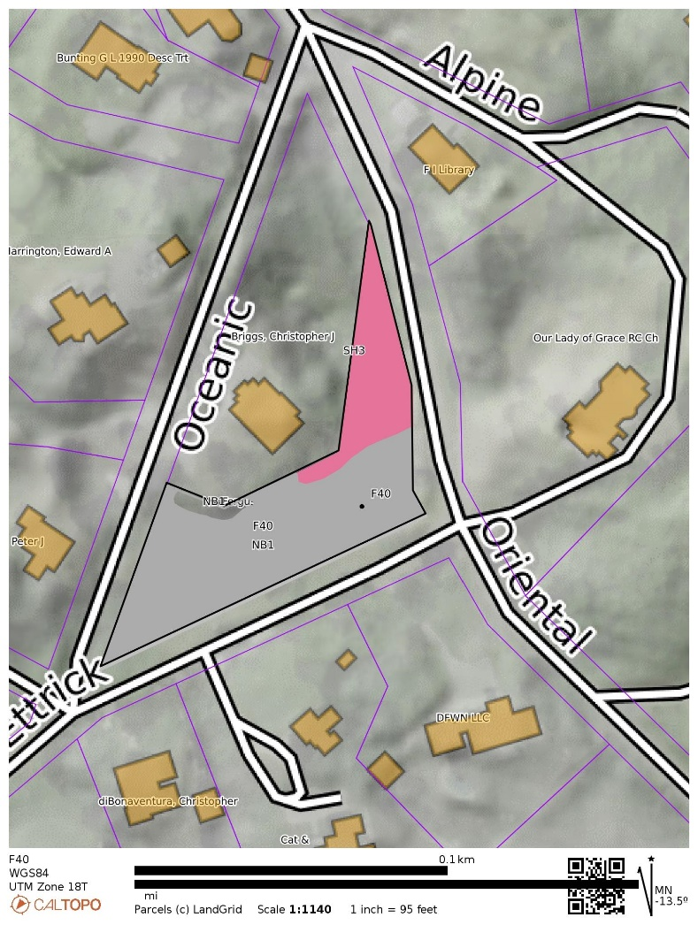
F40
FUEL MODEL | FUEL NAME | DESCRIPTION / CHARACTERISTICS
SH3 | Moderate Load, Humid Climate Shrub | The primary carrier of fire in SH3 is woody shrubs and shrub litter. Moderate shrub load, possibly with pine overstory or herbaceous fuel, fuel bed depth 2 to 3 feet. Spread rate is low; flame length low
NB1 | Non-burnable Grass Lawn | Will not burn except during extreme drought

Slide 10
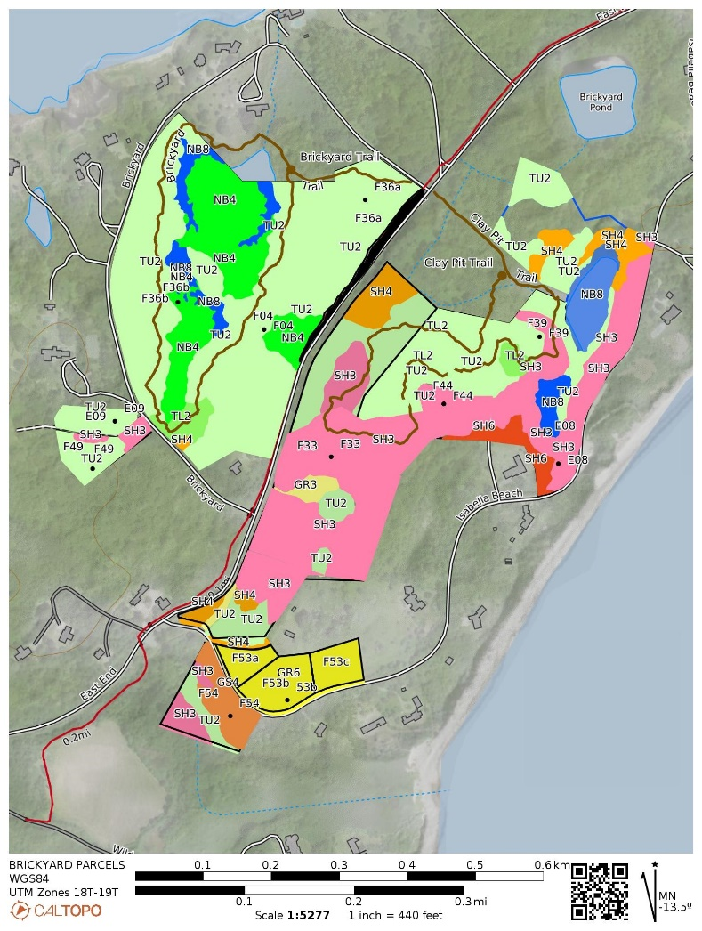
BRICKYARDS NORTH & SOUTH

Slide 11
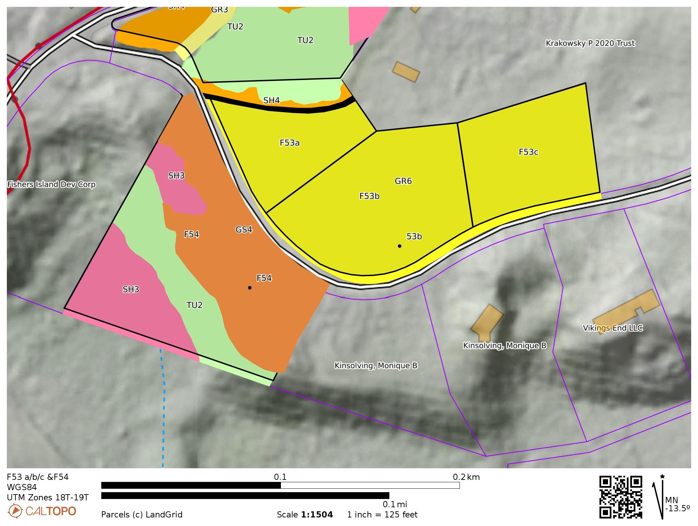
F53 a/b/c & F54
FUEL MODEL | FUEL NAME | DESCRIPTION / CHARACTERISTICS
GR6 | Moderate Load, Humid Climate Grass (Dynamic) | The primary carrier of fire in GR6 is continuous humid-climate grass.
GS4 | High Load, Humid Climate Grass-Shrub (Dynamic) | The primary carrier of fire in GS4 is grass and shrubs combined. Heavy grass/shrub load, depth greater than 2 feet. Spread rate high; flame length very high.
TU2 | Moderate Load, Humid Climate Timber-Shrub | The primary carrier of fire in TU2 is moderate litter load with shrub component. High extinction moisture. Spread rate is moderate; flame length low.
SH3 | Moderate Load, Humid Climate Shrub | The primary carrier of fire in SH3 is woody shrubs and shrub litter. Moderate shrub load, possibly with pine overstory or herbaceous fuel, fuel bed depth 2 to 3 feet. Spread rate is low; flame length low
NB3 | Nonburnable Agriculture | Will not burn if maintained

Slide 12
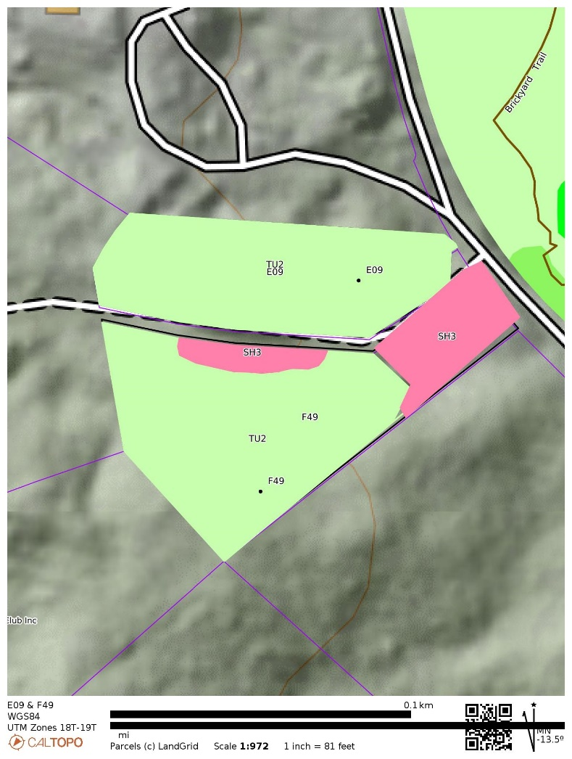

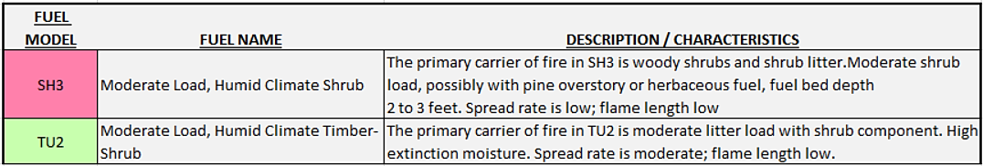
E09 & F49

Slide 13
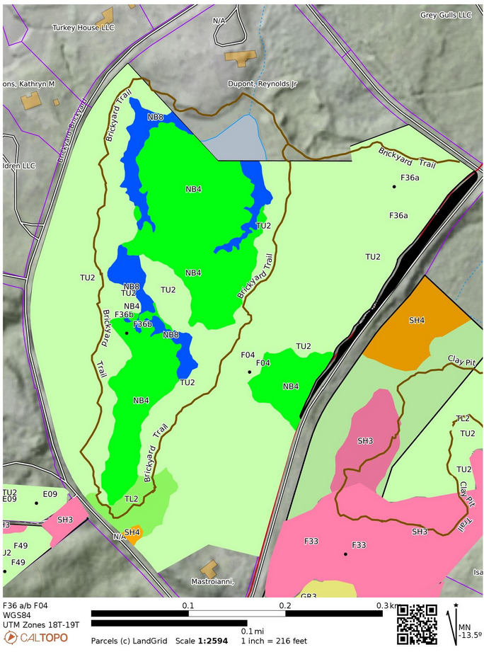

F36 a/b & F04
Brickyards North
FUEL MODEL | FUEL NAME | DESCRIPTION / CHARACTERISTICS
SH4 | Low Load, Humid Climate Timber-Shrub | The primary carrier of fire in SH4 is woody shrubs and shrub litter. Low to moderate shrub and litter load, possibly with pine overstory, fuel bed depth about 3 feet. Spread rate is high; flame length moderate.
TL2 | Low Load Broadleaf Litter | The primary carrier of fire in TL2 is broadleaf (hardwood) litter. Low load, compact broadleaf litter. Spread rate is very low; flame length very low
TU2 | Moderate Load, Humid Climate Timber-Shrub | The primary carrier of fire in TU2 is moderate litter load with shrub component. High extinction moisture. Spread rate is moderate; flame length low.
NB4 | Nonburnable Swamp / Marsh / Vineland | Will not burn except during extreme drought
NB8 | Nonburnable Lake / Open Water | Will not burn

Slide 14
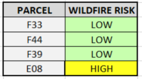
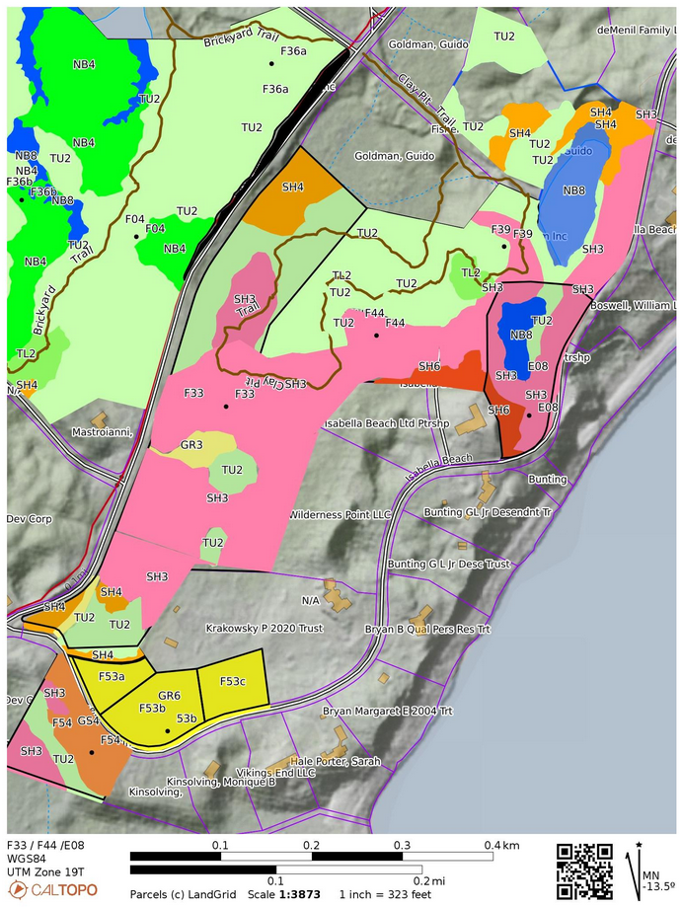
F33 / F44 / F39 / E08
Brickyards South
FUEL MODEL | FUEL NAME | DESCRIPTION / CHARACTERISTICS
GR3 | Low Load, Very Course, Humid Climate Grass (Dynamic) | The primary carrier of fire in GR3 is continuous, coarse, humid-climate grass. Grass and herb fuel load is relatively light; fuelbed depth is about 2 feet
SH3 | Moderate Load, Humid Climate Shrub | The primary carrier of fire in SH3 is woody shrubs and shrub litter.. Moderate shrub load, possibly with pine overstory or herbaceous fuel, fuel bed depth 2 to 3 feet. Spread rate is low; flame length low
SH4 | Low Load, Humid Climate Timber-Shrub | The primary carrier of fire in SH4 is woody shrubs and shrub litter. Low to moderate shrub and litter load, possibly with pine overstory, fuel bed depth about 3 feet. Spread rate is high; flame length moderate.
SH6 | Low Load, Humid Climate Shrub | The primary carrier of fire in SH6 is woody shrubs and shrub litter. Dense shrubs, little or no herbaceous fuel, fuelbed depth about 2 feet. Spread rate is high; flame length high
TL2 | Low Load Broadleaf Litter | The primary carrier of fire in TL2 is broadleaf (hardwood) litter. Low load, compact broadleaf litter. Spread rate is very low; flame length very low
TU2 | Moderate Load, Humid Climate Timber-Shrub | The primary carrier of fire in TU2 is moderate litter load with shrub component. High extinction moisture. Spread rate is moderate; flame length low.
NB4 | Nonburnable Swamp / Marsh / Vineland | Will not burn except during extreme drought
NB8 | Nonburnable Lake / Open Water | Will not burn

Slide 15
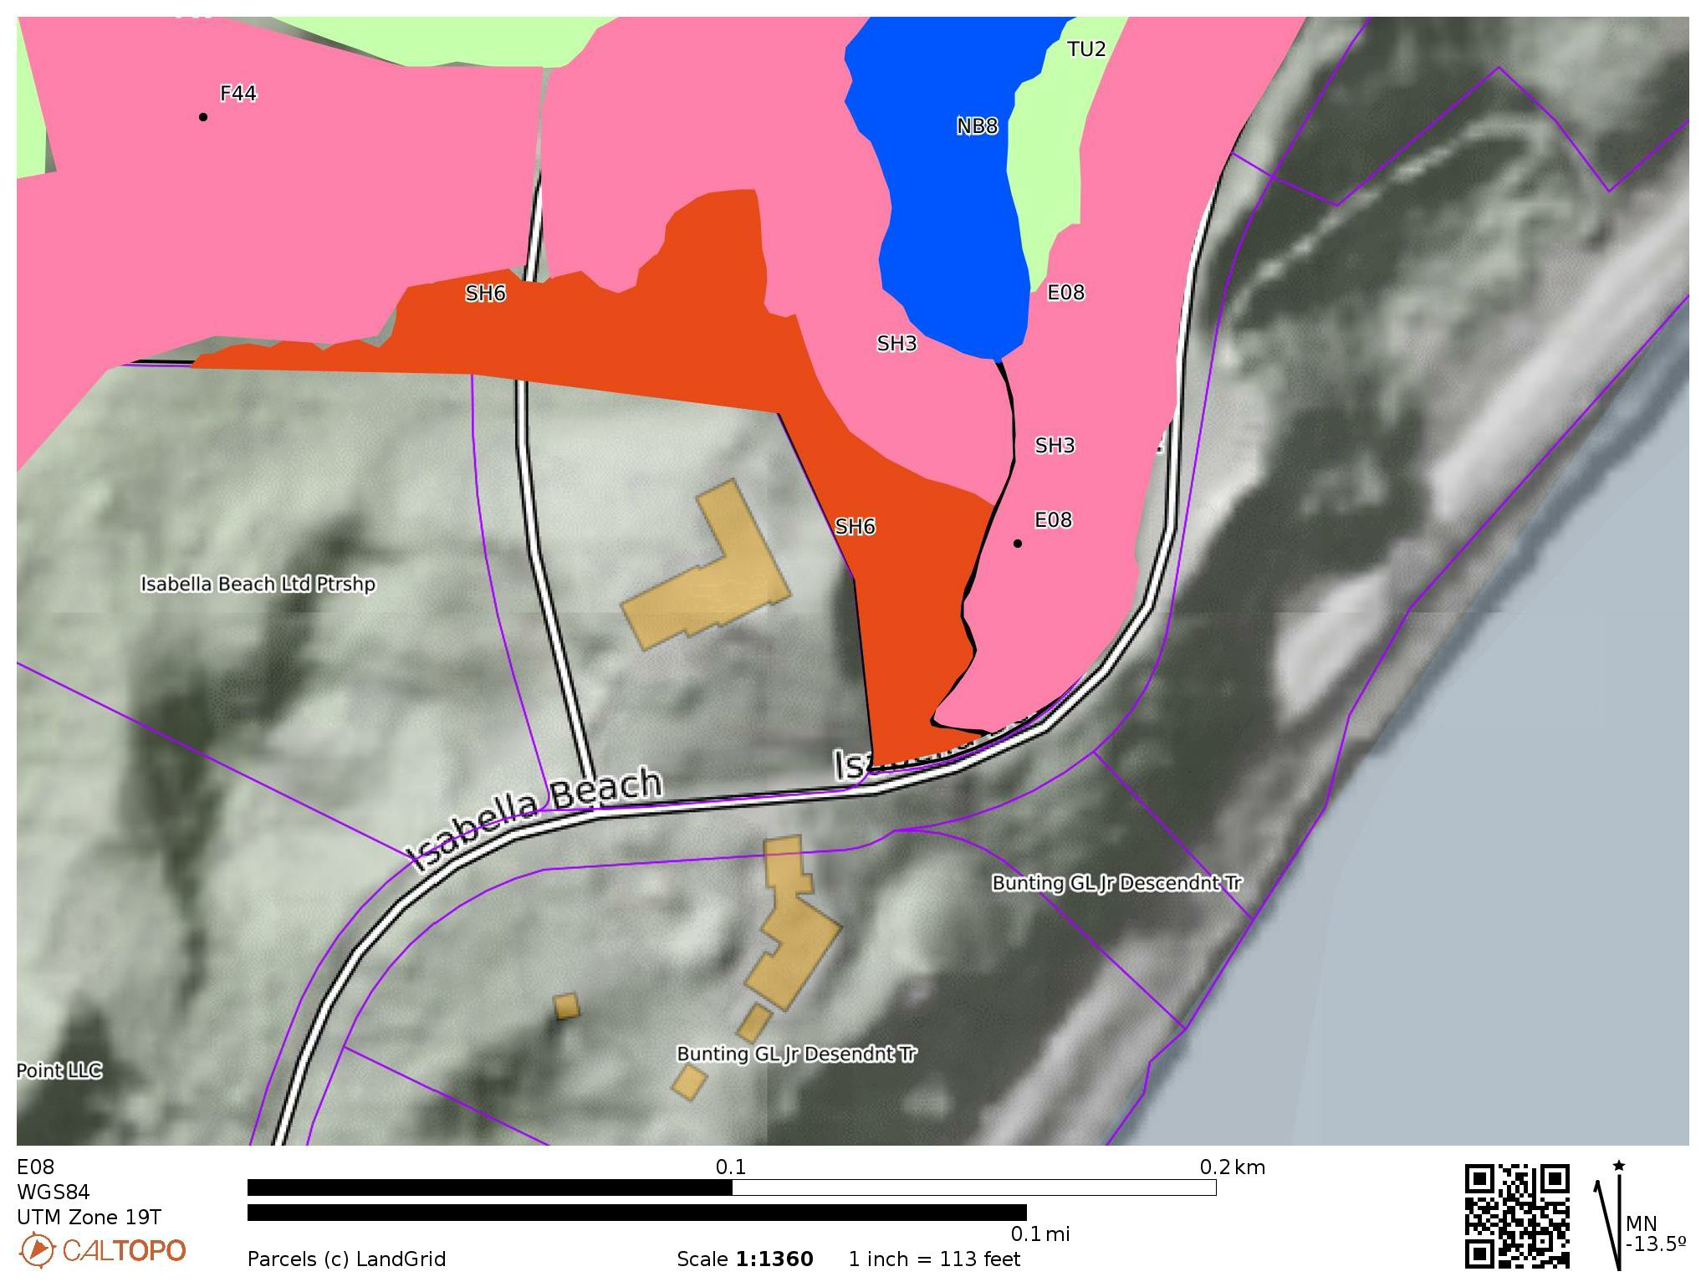

E08
FUEL MODEL | FUEL NAME | DESCRIPTION / CHARACTERISTICS
SH3 | Moderate Load, Humid Climate Shrub | The primary carrier of fire in SH3 is woody shrubs and shrub litter. Moderate shrub load, possibly with pine overstory or herbaceous fuel, fuel bed depth 2 to 3 feet. Spread rate is low; flame length low
SH6 | Low Load, Humid Climate Shrub | The primary carrier of fire in SH6 is woody shrubs and shrub litter. Dense shrubs, little or no herbaceous fuel, fuelbed depth about 2 feet. Spread rate is high; flame length high
TU2 | Moderate Load, Humid Climate Timber-Shrub | The primary carrier of fire in TU2 is moderate litter load with shrub component. High extinction moisture. Spread rate is moderate; flame length low.
NB8 | Nonburnable Lake / Open Water | Will not burn

Slide 16
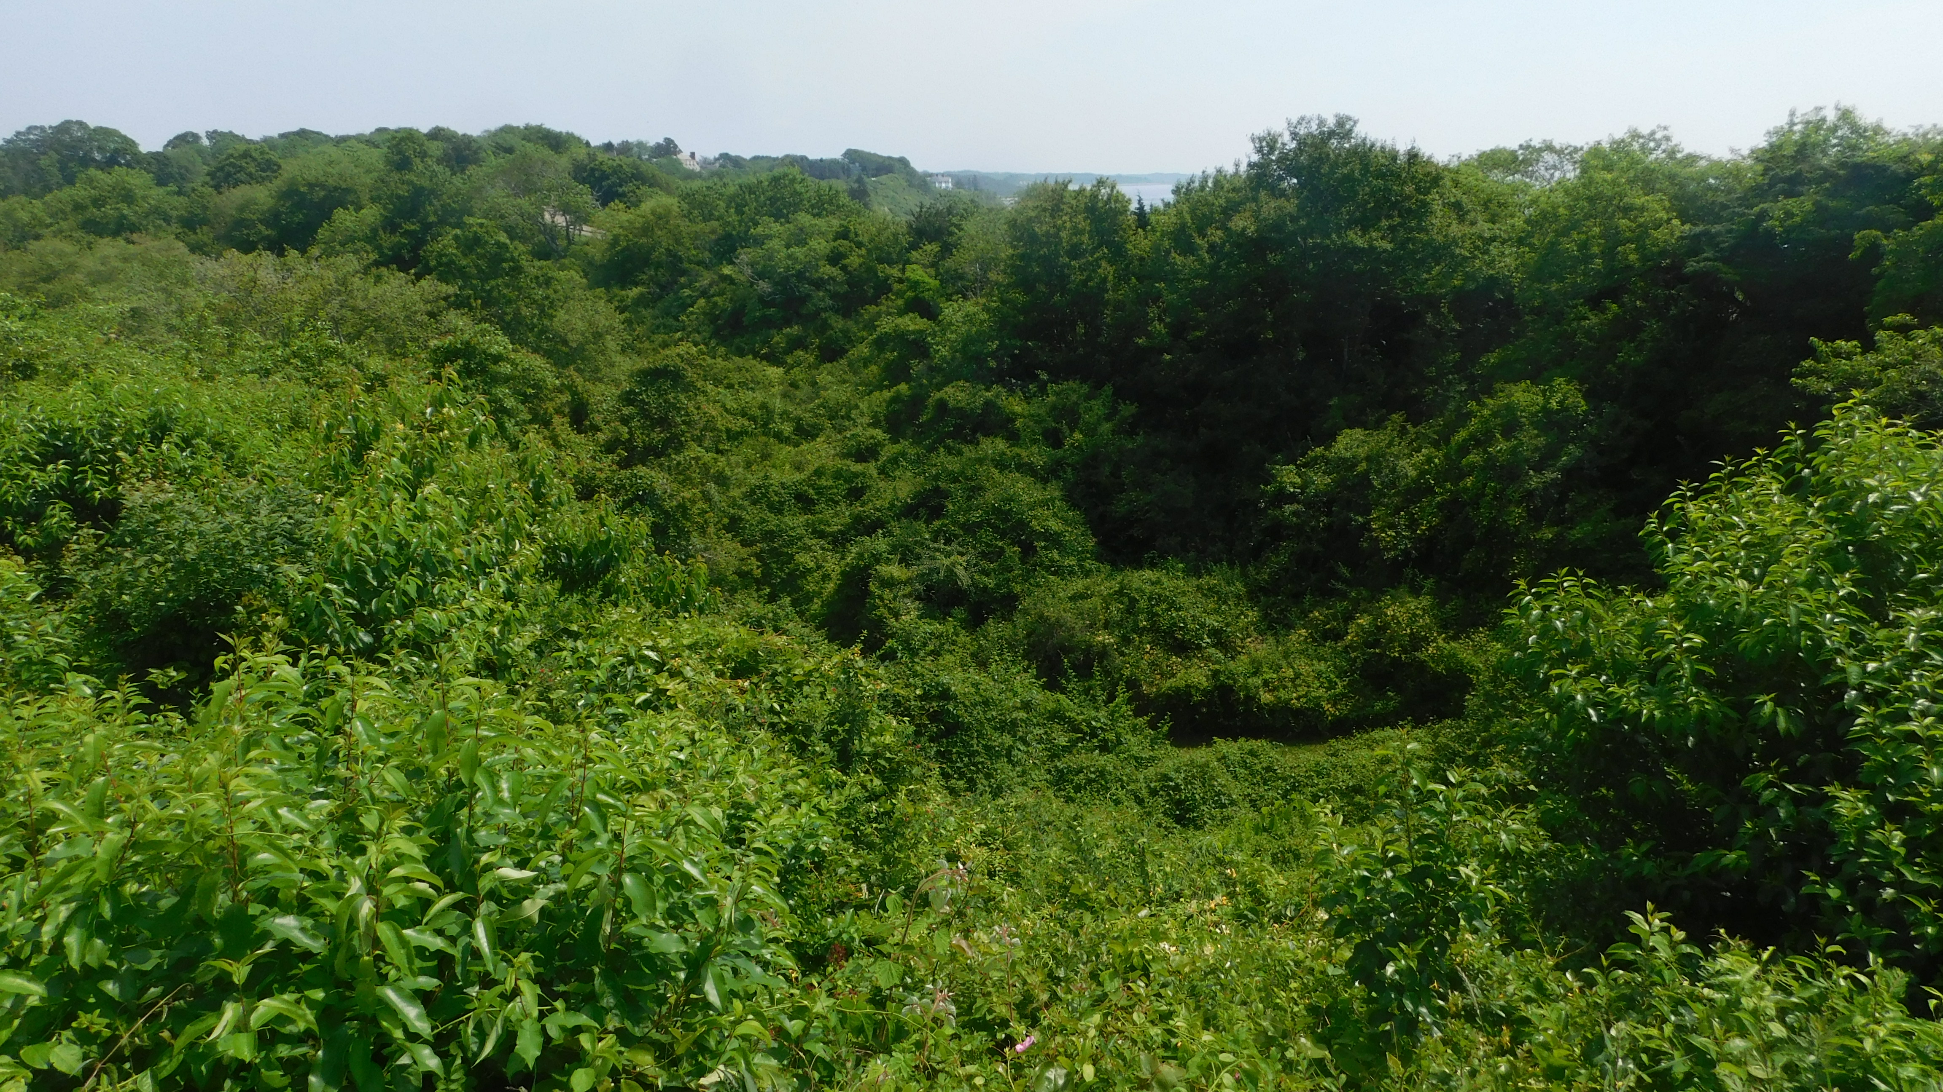
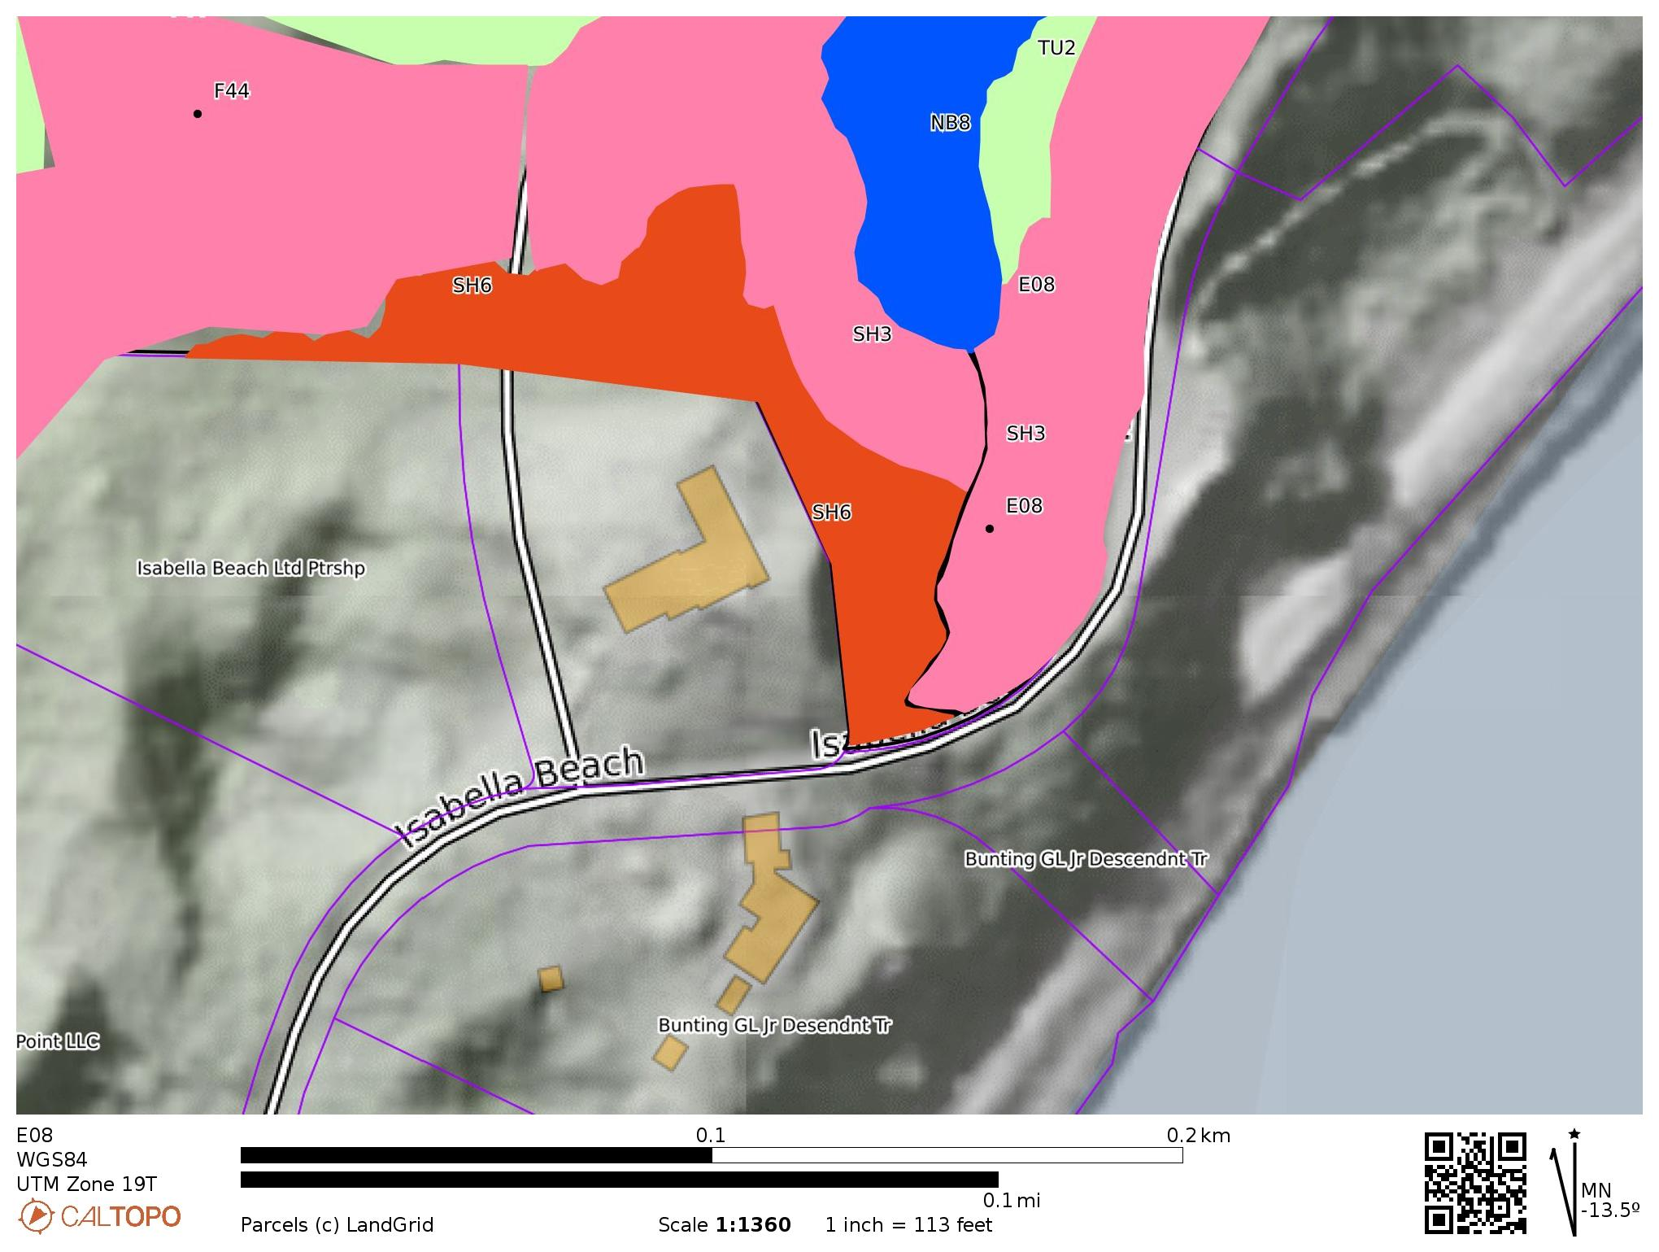
E08 with SH6 Fuels North & East at top of Ravine
Good Defensive Space with Lawn Between Edge of Ravine Fuels and House
Ravine is out of alignment for late afternoon solar heating and prevailing winds

Slide 17
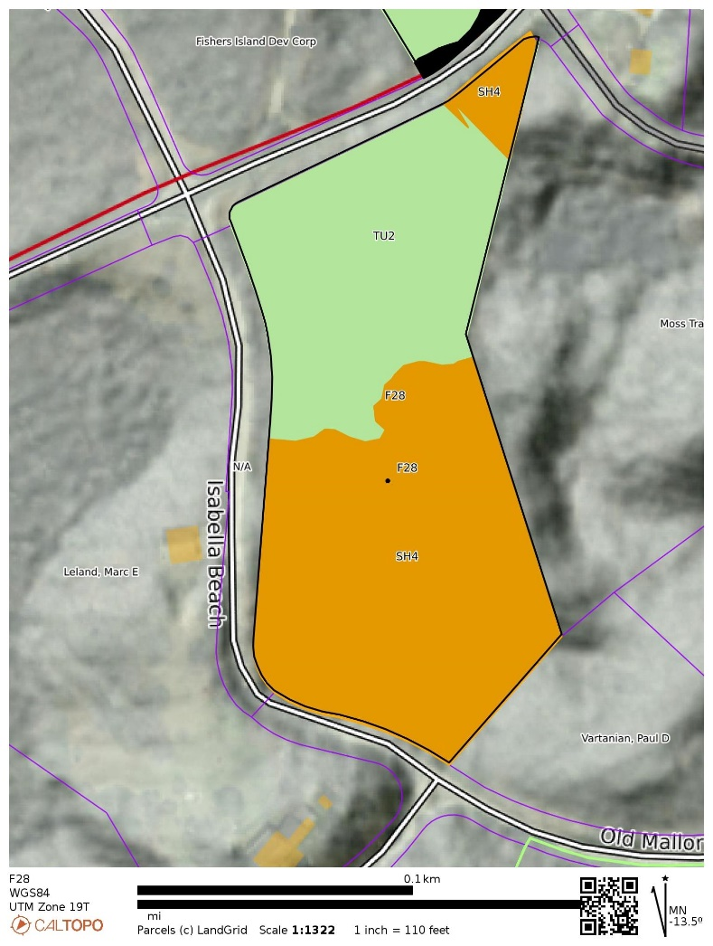
F28
FUEL MODEL | FUEL NAME | DESCRIPTION / CHARACTERISTICS
TU2 | Moderate Load, Humid Climate Timber-Shrub | The primary carrier of fire in TU2 is moderate litter load with shrub component. High extinction moisture. Spread rate is moderate; flame length low.
SH4 | Low Load, Humid Climate Timber-Shrub | The primary carrier of fire in SH4 is woody shrubs and shrub litter. Low to moderate shrub and litter load, possibly with pine overstory, fuel bed depth about 3 feet. Spread rate is high; flame length moderate.

Slide 18
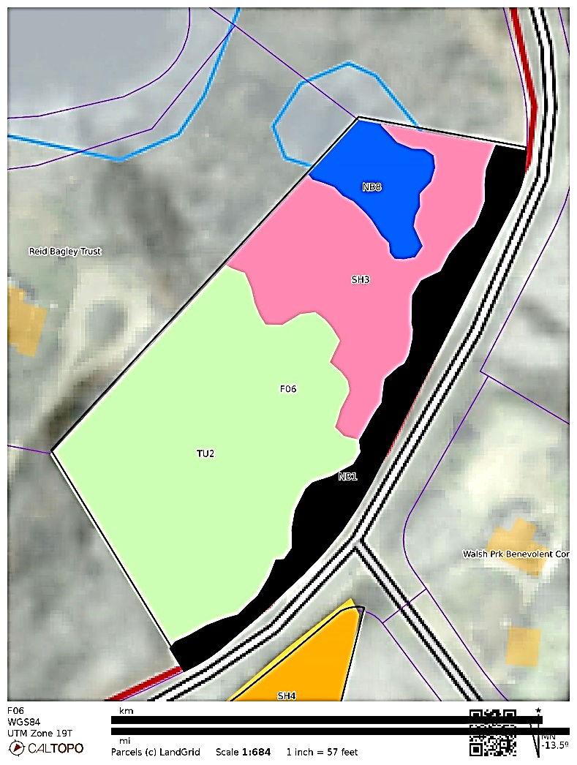

F06
FUEL MODEL | FUEL NAME | DESCRIPTION / CHARACTERISTICS
TU2 | Moderate Load, Humid Climate Timber-Shrub | The primary carrier of fire in TU2 is moderate litter load with shrub component. High extinction moisture. Spread rate is moderate; flame length low.
SH3 | Moderate Load, Humid Climate Shrub | The primary carrier of fire in SH3 is woody shrubs and shrub litter. Moderate shrub load, possibly with pine overstory or herbaceous fuel, fuel bed depth 2 to 3 feet. Spread rate is low; flame length low
NB1 | Nonburnable Paved Path | Will not burn.
NB8 | Nonburnable Lake / Open Water | Will not burn

Slide 19
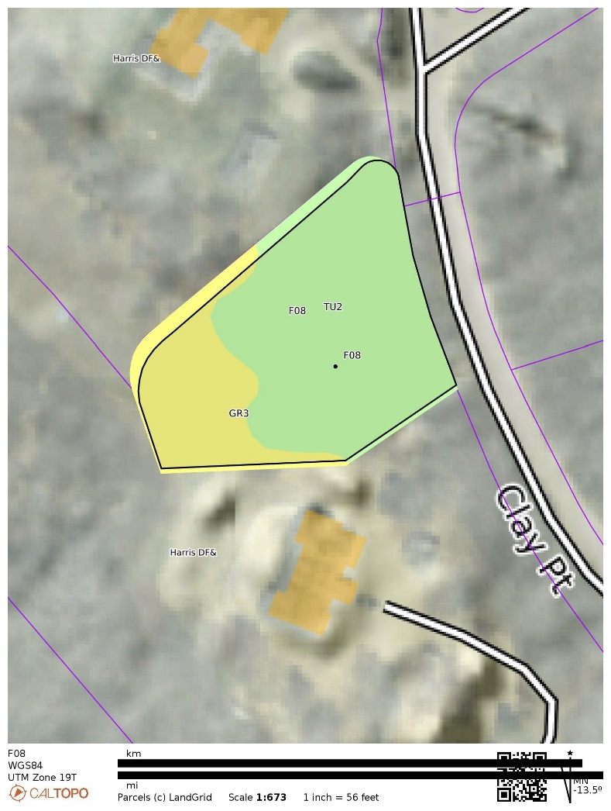
F08
FUEL MODEL | FUEL NAME | DESCRIPTION / CHARACTERISTICS
GR3 | Low Load, Very Course, Humid Climate Grass (Dynamic) | The primary carrier of fire in GR3 is continuous, coarse, humid-climate grass. Grass and herb fuel load is relatively light; fuelbed depth is about 2 feet
TU2 | Moderate Load, Humid Climate Timber-Shrub | The primary carrier of fire in TU2 is moderate litter load with shrub component. High extinction moisture. Spread rate is moderate; flame length low.

Slide 20
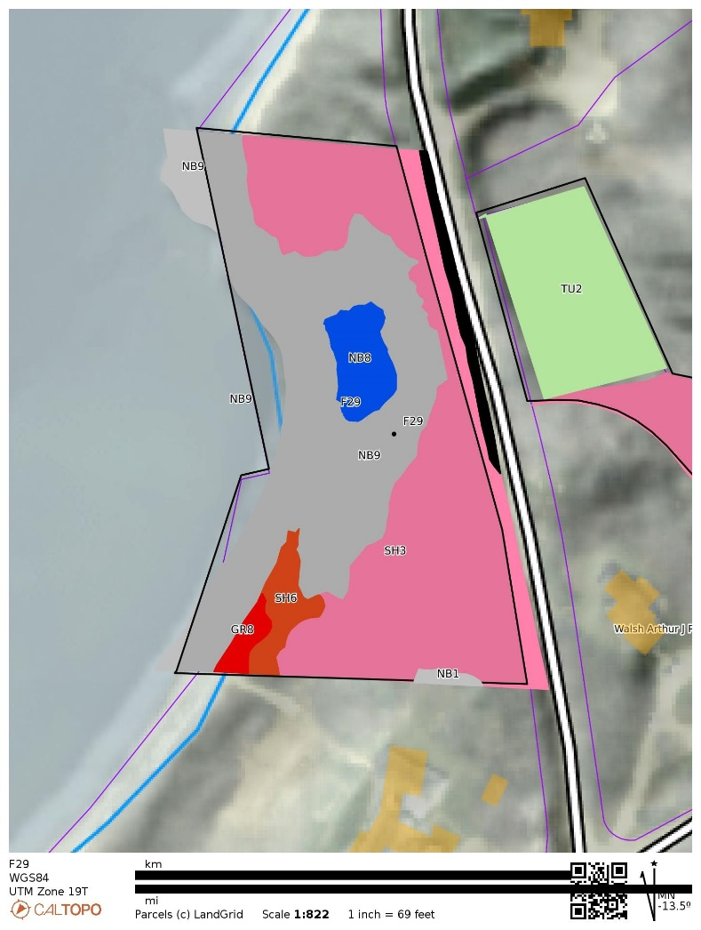

F29
FUEL MODEL | FUEL NAME | DESCRIPTION / CHARACTERISTICS
GR8 | High Load, Very Coarse, Humid Climate Grass (Dynamic) | This is Phragmites patch. The primary carrier of fire in GR8 is continuous, very coarse, humid- climate grass. Load and depth are greater than GR6. Spread rate and flame length can be extreme if grass is fully cured
SH3 | Moderate Load, Humid Climate Shrub | The primary carrier of fire in SH3 is woody shrubs and shrub litter. Moderate shrub load, possibly with pine overstory or herbaceous fuel, fuel bed depth 2 to 3 feet. Spread rate is low; flame length low
SH6 | Low Load, Humid Climate Shrub | The primary carrier of fire in SH6 is woody shrubs and shrub litter. Dense shrubs, little or no herbaceous fuel, fuelbed depth about 2 feet. Spread rate is high; flame length high
NB1 | Nonburnable Grass Lawn | Will not burn except during extreme drought
NB8 | Nonburnable Lake / Open Water | Will not burn
NB9 | Nonburnable Beach / Rock | Will not burn, no fuel.

Slide 21
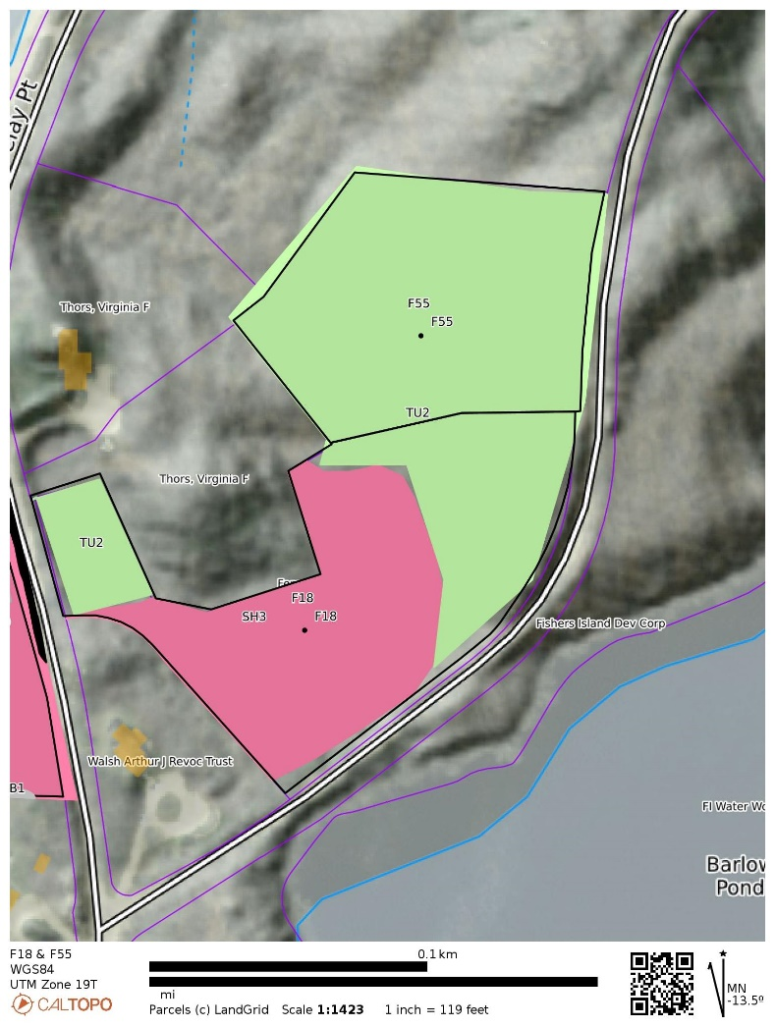

F18 & F55
FUEL MODEL | FUEL NAME | DESCRIPTION / CHARACTERISTICS
TU2 | Moderate Load, Humid Climate Timber-Shrub | The primary carrier of fire in TU2 is moderate litter load with shrub component. High extinction moisture. Spread rate is moderate; flame length low.
SH3 | Moderate Load, Humid Climate Shrub | The primary carrier of fire in SH3 is woody shrubs and shrub litter. Moderate shrub load, possibly with pine overstory or herbaceous fuel, fuel bed depth 2 to 3 feet. Spread rate is low; flame length low

Slide 22
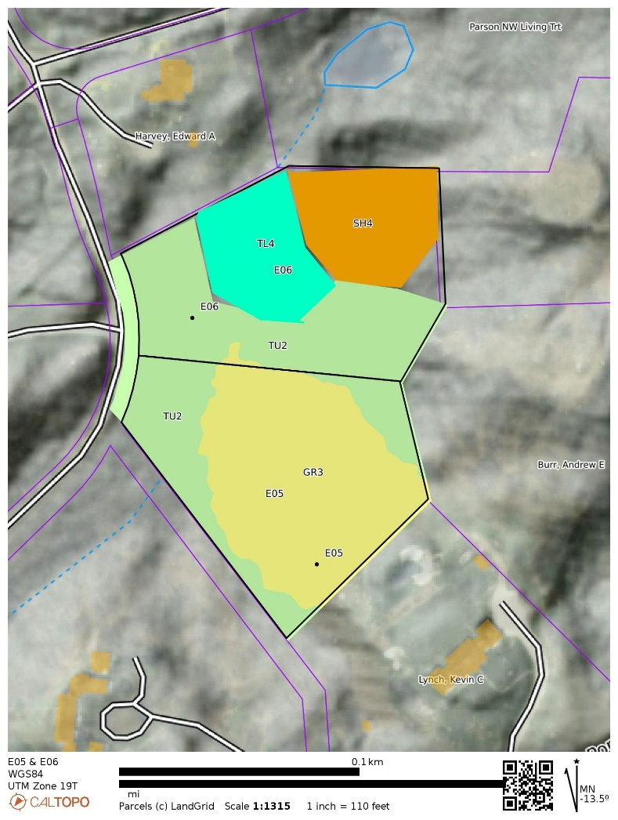
E05 & E06
FUEL MODEL | FUEL NAME | DESCRIPTION / CHARACTERISTICS
GR3 | Low Load, Very Course, Humid Climate Grass (Dynamic) | The primary carrier of fire in GR3 is continuous, coarse, humid-climate grass. Grass and herb fuel load is relatively light; fuelbed depth is about 2 feet
TL4 | Small downed logs | The primary carrier of fire in TL4 is moderate load of fine litter and coarse fuels. Includes small diameter downed logs. Spread rate is low; flame length low
TU2 | Moderate Load, Humid Climate Timber-Shrub | The primary carrier of fire in TU2 is moderate litter load with shrub component. High extinction moisture. Spread rate is moderate; flame length low.
SH4 | Low Load, Humid Climate Timber-Shrub | The primary carrier of fire in SH4 is woody shrubs and shrub litter. Low to moderate shrub and litter load, possibly with pine overstory, fuel bed depth about 3 feet. Spread rate is high; flame length moderate.

Slide 23
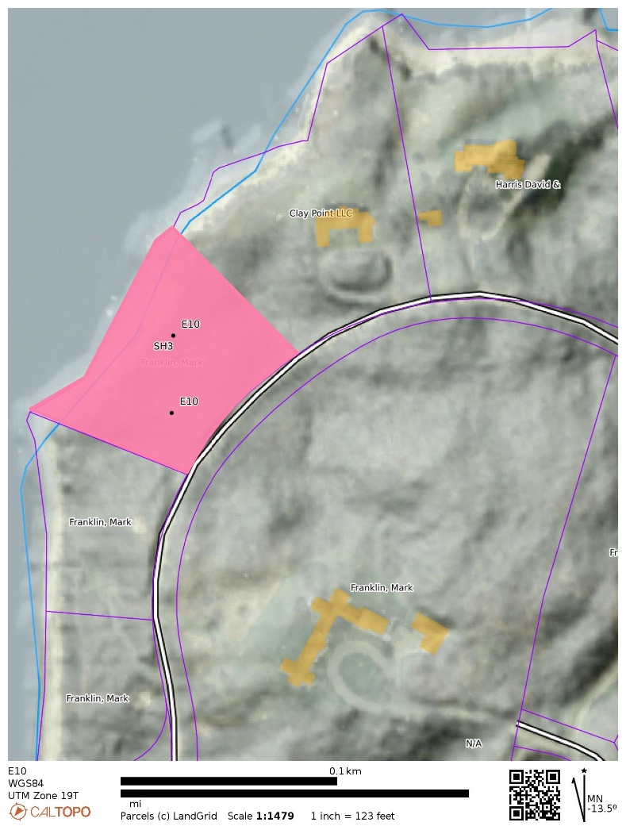
E10
FUEL MODEL | FUEL NAME | DESCRIPTION / CHARACTERISTICS
SH3 | Moderate Load, Humid Climate Shrub | The primary carrier of fire in SH3 is woody shrubs and shrub litter. Moderate shrub load, possibly with pine overstory or herbaceous fuel, fuel bed depth 2 to 3 feet. Spread rate is low; flame length low

Slide 24
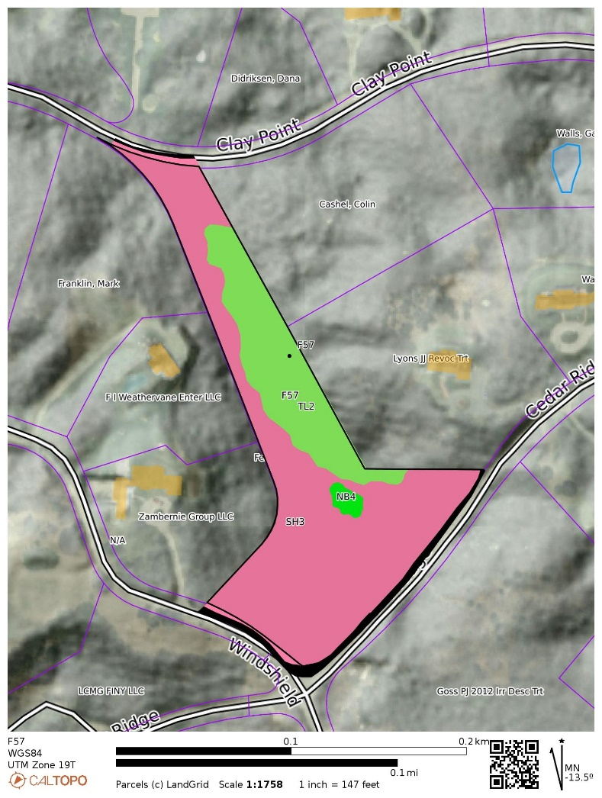
F57
FUEL MODEL | FUEL NAME | DESCRIPTION / CHARACTERISTICS
TL2 | Low Load Broadleaf Litter | The primary carrier of fire in TL2 is broadleaf (hardwood) litter. Low load, compact broadleaf litter. Spread rate is very low; flame length very low
SH3 | Moderate Load, Humid Climate Shrub | The primary carrier of fire in SH3 is woody shrubs and shrub litter.Moderate shrub load, possibly with pine overstory or herbaceous fuel, fuel bed depth 2 to 3 feet. Spread rate is low; flame length low
NB4 | Nonburnable Swamp / Marsh / Vineland | Will not burn except during extreme drought

Slide 25
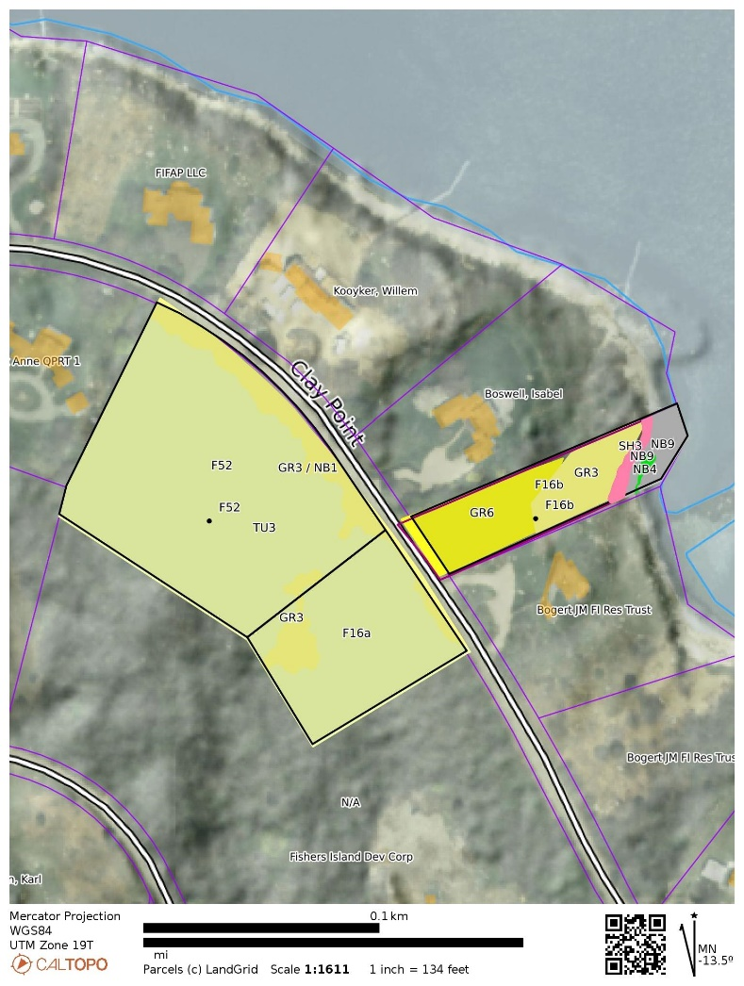
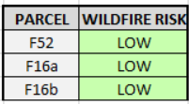
F52 & F16 a/b
FUEL MODEL | FUEL NAME | DESCRIPTION / CHARACTERISTICS
GR3 | Low Load, Very Course, Humid Climate Grass (Dynamic) | The primary carrier of fire in GR3 is continuous, coarse, humid-climate grass. Grass and herb fuel load is relatively light; fuelbed depth is about 2 feet
GR6 | Moderate Load, Humid Climate Grass (Dynamic) | The primary carrier of fire in GR6 is continuous humid-climate grass.
TU3 | Moderate Load, Humid Climate Timber-Grass-Shrub (Dynamic) | The primary carrier of fire in TU3 is moderate forest litter with grass and shrub components. Extinction moisture is high. Spread rate is high; flame length moderate
SH3 | Moderate Load, Humid Climate Shrub | The primary carrier of fire in SH3 is woody shrubs and shrub litter. Moderate shrub load, possibly with pine overstory or herbaceous fuel, fuel bed depth 2 to 3 feet. Spread rate is low; flame length low
NB1 | Nonburnable Grass Lawn | Will not burn except during extreme drought
NB4 | Nonburnable Swamp / Marsh / Vineland | Will not burn except during extreme drought
NB9 | Nonburnable Beach / Rock | Will not burn, no fuel.

Slide 26
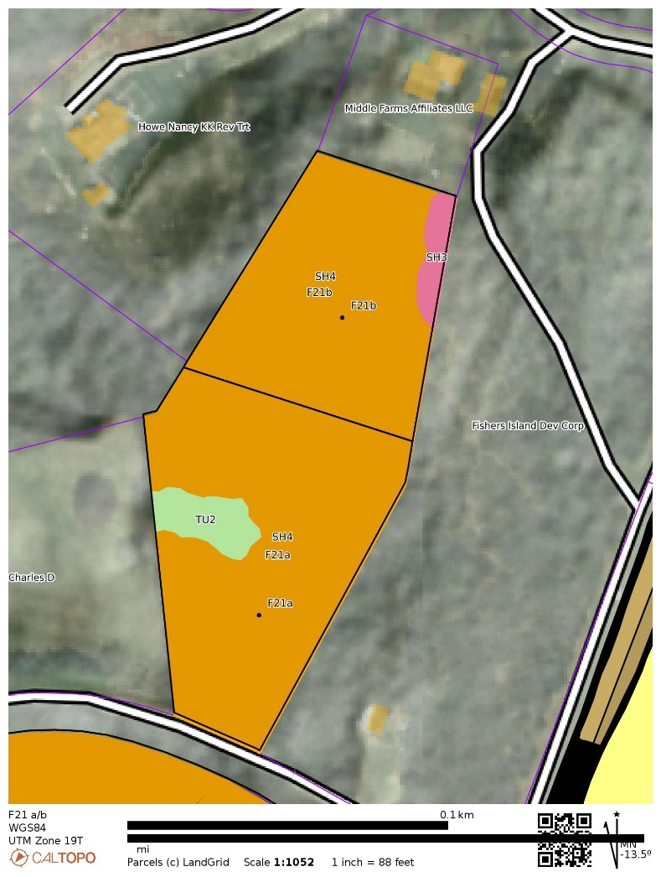
F21 a/b
FUEL MODEL | FUEL NAME | DESCRIPTION / CHARACTERISTICS
TU2 | Moderate Load, Humid Climate Timber-Shrub | The primary carrier of fire in TU2 is moderate litter load with shrub component. High extinction moisture. Spread rate is moderate; flame length low.
SH3 | Moderate Load, Humid Climate Shrub | The primary carrier of fire in SH3 is woody shrubs and shrub litter.Moderate shrub load, possibly with pine overstory or herbaceous fuel, fuel bed depth 2 to 3 feet. Spread rate is low; flame length low
SH4 | Low Load, Humid Climate Timber-Shrub | The primary carrier of fire in SH4 is woody shrubs and shrub litter. Low to moderate shrub and litter load, possibly with pine overstory, fuel bed depth about 3 feet. Spread rate is high; flame length moderate.

Slide 27
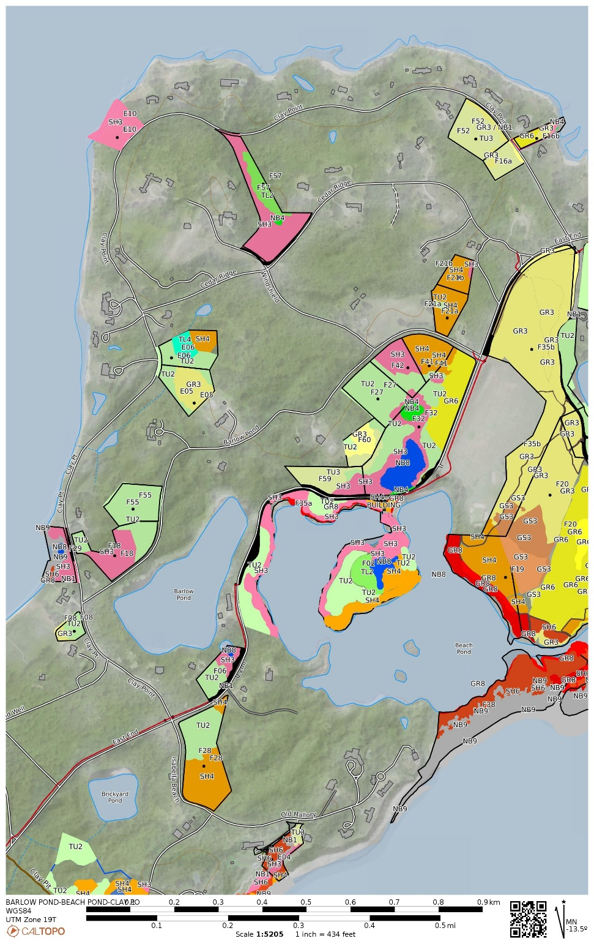
BARLOW POND
BEACH POND AND CLAY POINT ROAD PARCELS

Slide 28
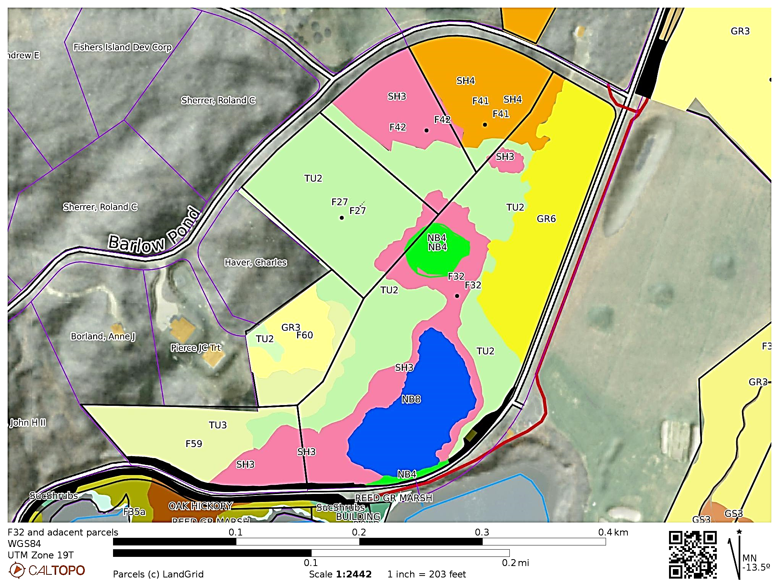
F32/F41/F42/F27/F60/F59
FUEL MODEL | FUEL NAME | DESCRIPTION / CHARACTERISTICS
GR3 | Low Load, Very Course, Humid Climate Grass (Dynamic) | The primary carrier of fire in GR3 is continuous, coarse, humid-climate grass. Grass and herb fuel load is relatively light; fuelbed depth is about 2 feet
GR6 | Moderate Load, Humid Climate Grass (Dynamic) | The primary carrier of fire in GR6 is continuous humid-climate grass.
TU2 | Moderate Load, Humid Climate Timber-Shrub | The primary carrier of fire in TU2 is moderate litter load with shrub component. High extinction moisture. Spread rate is moderate; flame length low.
TU3 | Moderate Load, Humid Climate Timber-Grass-Shrub (Dynamic) | The primary carrier of fire in TU3 is moderate forest litter with grass and shrub components. Extinction moisture is high. Spread rate is high; flame length moderate
SH3 | Moderate Load, Humid Climate Shrub | The primary carrier of fire in SH3 is woody shrubs and shrub litter. Moderate shrub load, possibly with pine overstory or herbaceous fuel, fuel bed depth 2 to 3 feet. Spread rate is low; flame length low
SH4 | Low Load, Humid Climate Timber-Shrub | The primary carrier of fire in SH4 is woody shrubs and shrub litter. Low to moderate shrub and litter load, possibly with pine overstory, fuel bed depth about 3 feet. Spread rate is high; flame length moderate.
NB4 | Nonburnable Swamp / Marsh / Vineland | Will not burn except during extreme drought
NB8 | Nonburnable Lake / Open Water | Will not burn

Slide 29
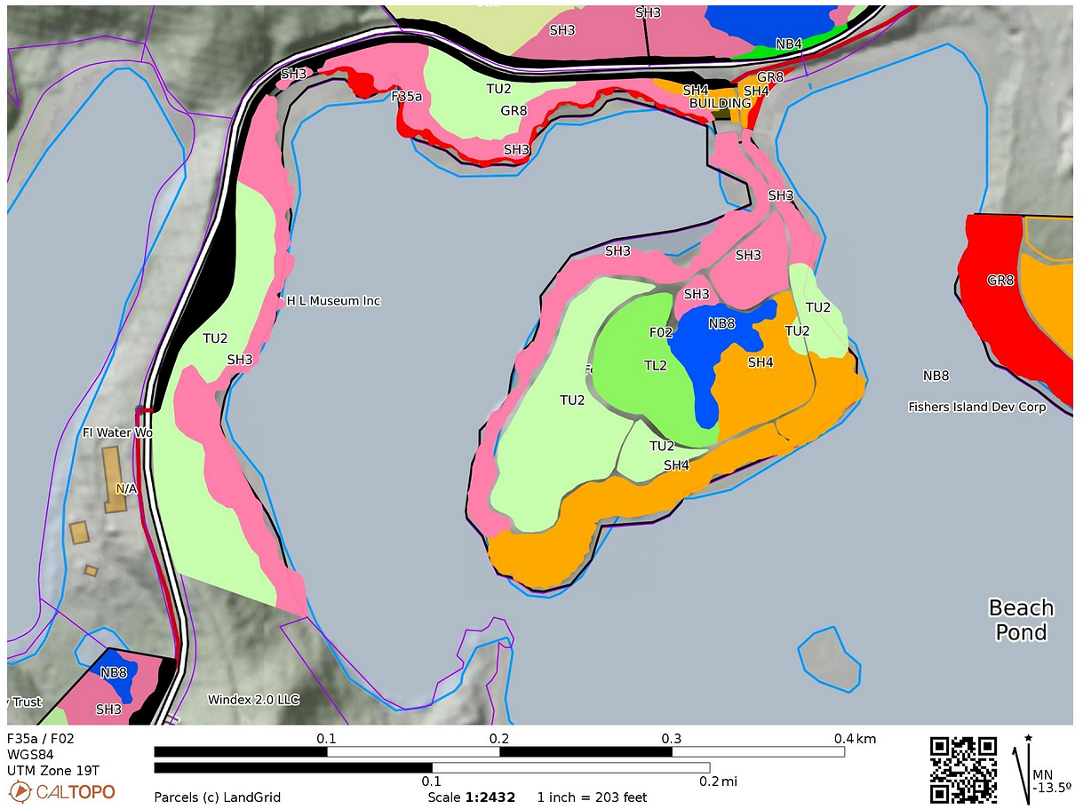
F35a / F02
PARCEL | WILDFIRE RISK
F35a | LOW
F02 | LOW
FUEL MODEL | FUEL NAME | DESCRIPTION / CHARACTERISTICS
GR8 | High Load, Very Coarse, Humid Climate Grass (Dynamic) | The primary carrier of fire in GR8 is continuous, very coarse, humid-climate grass. Load and depth are greater than GR6. Spread rate and flame length can be extreme if grass is fully cured
SH3 | Moderate Load, Humid Climate Shrub | The primary carrier of fire in SH3 is woody shrubs and shrub litter. Moderate shrub load, possibly with pine overstory or herbaceous fuel, fuel bed depth 2 to 3 feet. Spread rate is low; flame length low
SH4 | Low Load, Humid Climate Timber-Shrub | The primary carrier of fire in SH4 is woody shrubs and shrub litter. Low to moderate shrub and litter load, possibly with pine overstory, fuel bed depth about 3 feet. Spread rate is high; flame length moderate.
SH6 | Low Load, Humid Climate Shrub | The primary carrier of fire in SH6 is woody shrubs and shrub litter. Dense shrubs, little or no herbaceous fuel, fuelbed depth about 2 feet. Spread rate is high; flame length high
TL2 | Low Load Broadleaf Litter | The primary carrier of fire in TL2 is broadleaf (hardwood) litter. Low load, compact broadleaf litter. Spread rate is very low; flame length very low
TU2 | Moderate Load, Humid Climate Timber-Shrub | The primary carrier of fire in TU2 is moderate litter load with shrub component. High extinction moisture. Spread rate is moderate; flame length low.
NB8 | Nonburnable Lake / Open Water | Will not burn

Slide 30
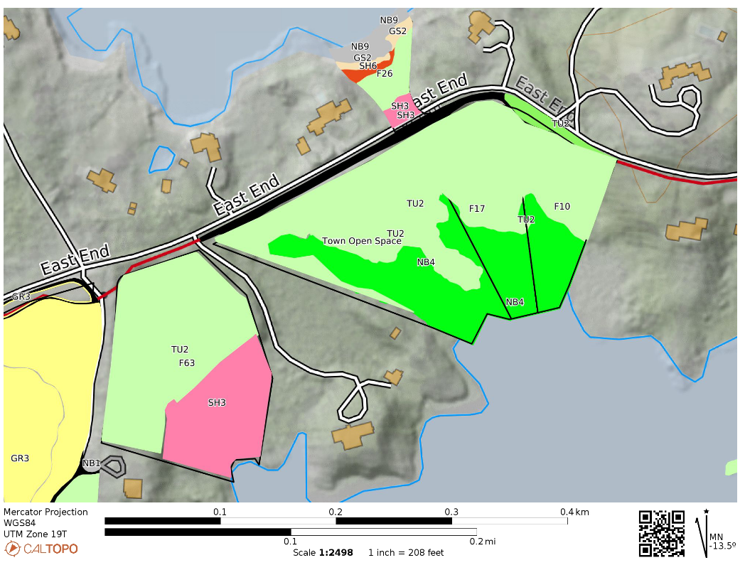
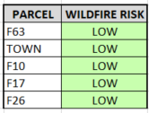
F63 / TOWN / F17 / F10 / F26
FUEL MODEL | FUEL NAME | DESCRIPTION / CHARACTERISTICS
SH3 | Moderate Load, Humid Climate Shrub | The primary carrier of fire in SH3 is woody shrubs and shrub litter. Moderate shrub load, possibly with pine over story or herbaceous fuel, fuel bed depth 2 to 3 feet. Spread rate is low; flame length low
SH6 | Low Load, Humid Climate Shrub | The primary carrier of fire in SH6 is woody shrubs and shrub litter. Dense shrubs, little or no herbaceous fuel, fuel bed depth about 2 feet. Spread rate is high; flame length high
TU2 | Moderate Load, Humid Climate Timber-Shrub | The primary carrier of fire in TU2 is moderate litter load with shrub component. High extinction moisture. Spread rate is moderate; flame length low.
NB4 | Nonburnable Swamp / Marsh / Vineland | Will not burn except during extreme drought

Slide 31
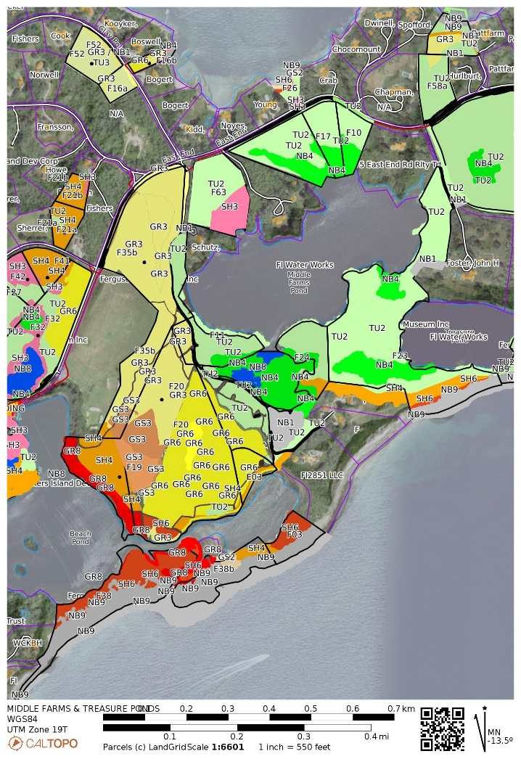
MIDDLE FARMS POND AND TREASURE POND PARCELS

Slide 32
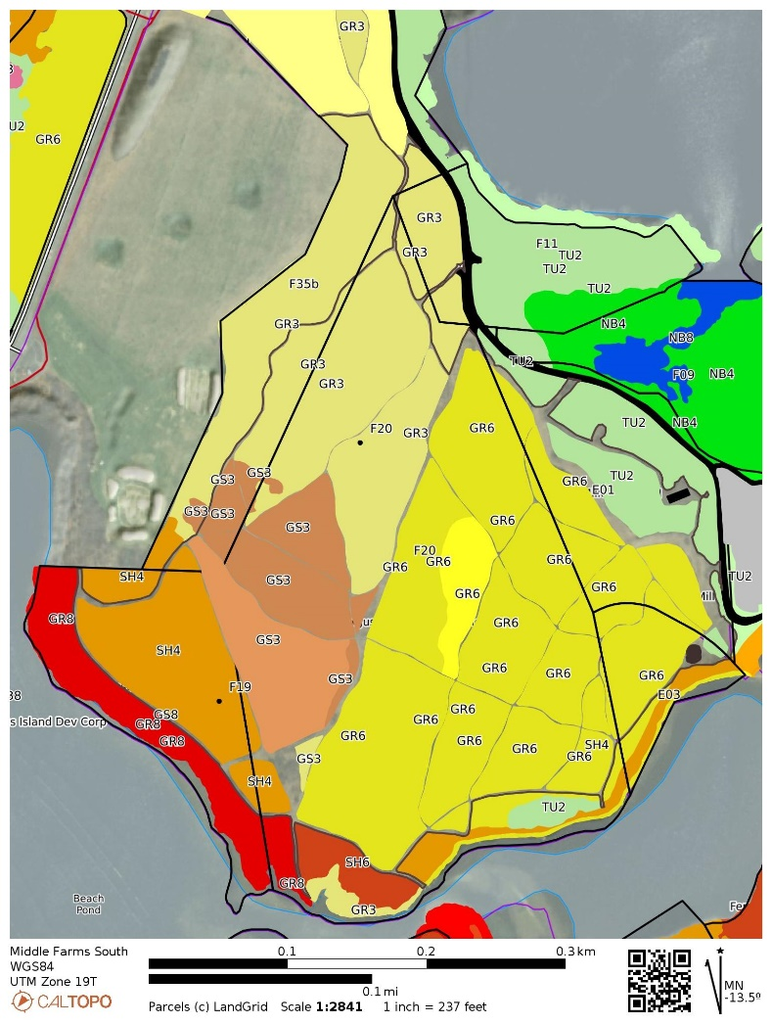
Middle Farms South
Parcels F19 / F20 / F35b / E01 / E03
FUEL MODEL | FUEL NAME | DESCRIPTION / CHARACTERISTICS
GR3 | Low Load, Very Course, Humid Climate Grass (Dynamic) | The primary carrier of fire in GR3 is continuous, coarse, humid-climate grass. Grass and herb fuel load is relatively light; fuelbed depth is about 2 feet
GR6 | Moderate Load, Humid Climate Grass (Dynamic) | The primary carrier of fire in GR6 is continuous humid-climate grass.
GS3 | Moderate Load, Humid Climate Grass-Shrub (Dynamic) | The primary carrier of fire in GS3 is grass and shrubs combined. Moderate grass/shrub load, average grass/shrub depth less than 2 feet. Spread rateis high; flame length moderate. Moisture of extinction is high
GR8 | High Load, Very Coarse, Humid Climate Grass (Dynamic) | The primary carrier of fire in GR8 is continuous, very coarse, humid- climate grass. Load and depth are greater than GR6. Spread rate and flame length can be extreme if grass is fully cured. This fuel here is Phragmities.
TU2 | Moderate Load, Humid Climate Timber-Shrub | The primary carrier of fire in TU2 is moderate litter load with shrub component. High extinction moisture. Spread rate is moderate; flame length low.
SH3 | Moderate Load, Humid Climate Shrub | The primary carrier of fire in SH3 is woody shrubs and shrub litter.Moderate shrub load, possibly with pine overstory or herbaceous fuel, fuel bed depth 2 to 3 feet. Spread rate is low; flame length low
SH4 | Low Load, Humid Climate Timber-Shrub | The primary carrier of fire in SH4 is woody shrubs and shrub litter. Low to moderate shrub and litter load, possibly with pine overstory, fuel bed depth about 3 feet. Spread rate is high; flame length moderate.

Slide 33
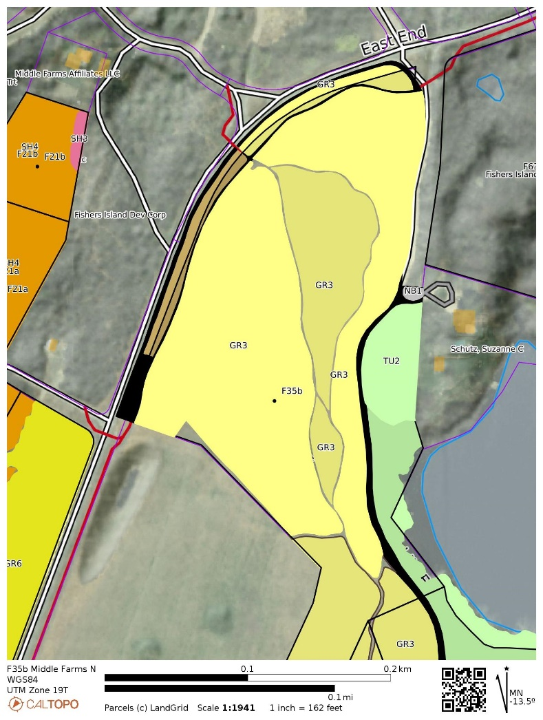
F35b Middle Farms North
FUEL MODEL | FUEL NAME | DESCRIPTION / CHARACTERISTICS
GR3 | Low Load, Very Course, Humid Climate Grass (Dynamic) | The primary carrier of fire in GR3 is continuous, coarse, humid-climate grass. Grass and herb fuel load is relatively light; fuelbed depth is about 2 feet
TU2 | Moderate Load, Humid Climate Timber-Shrub | The primary carrier of fire in TU2 is moderate litter load with shrub component. High extinction moisture. Spread rate is moderate; flame length low.

Slide 34
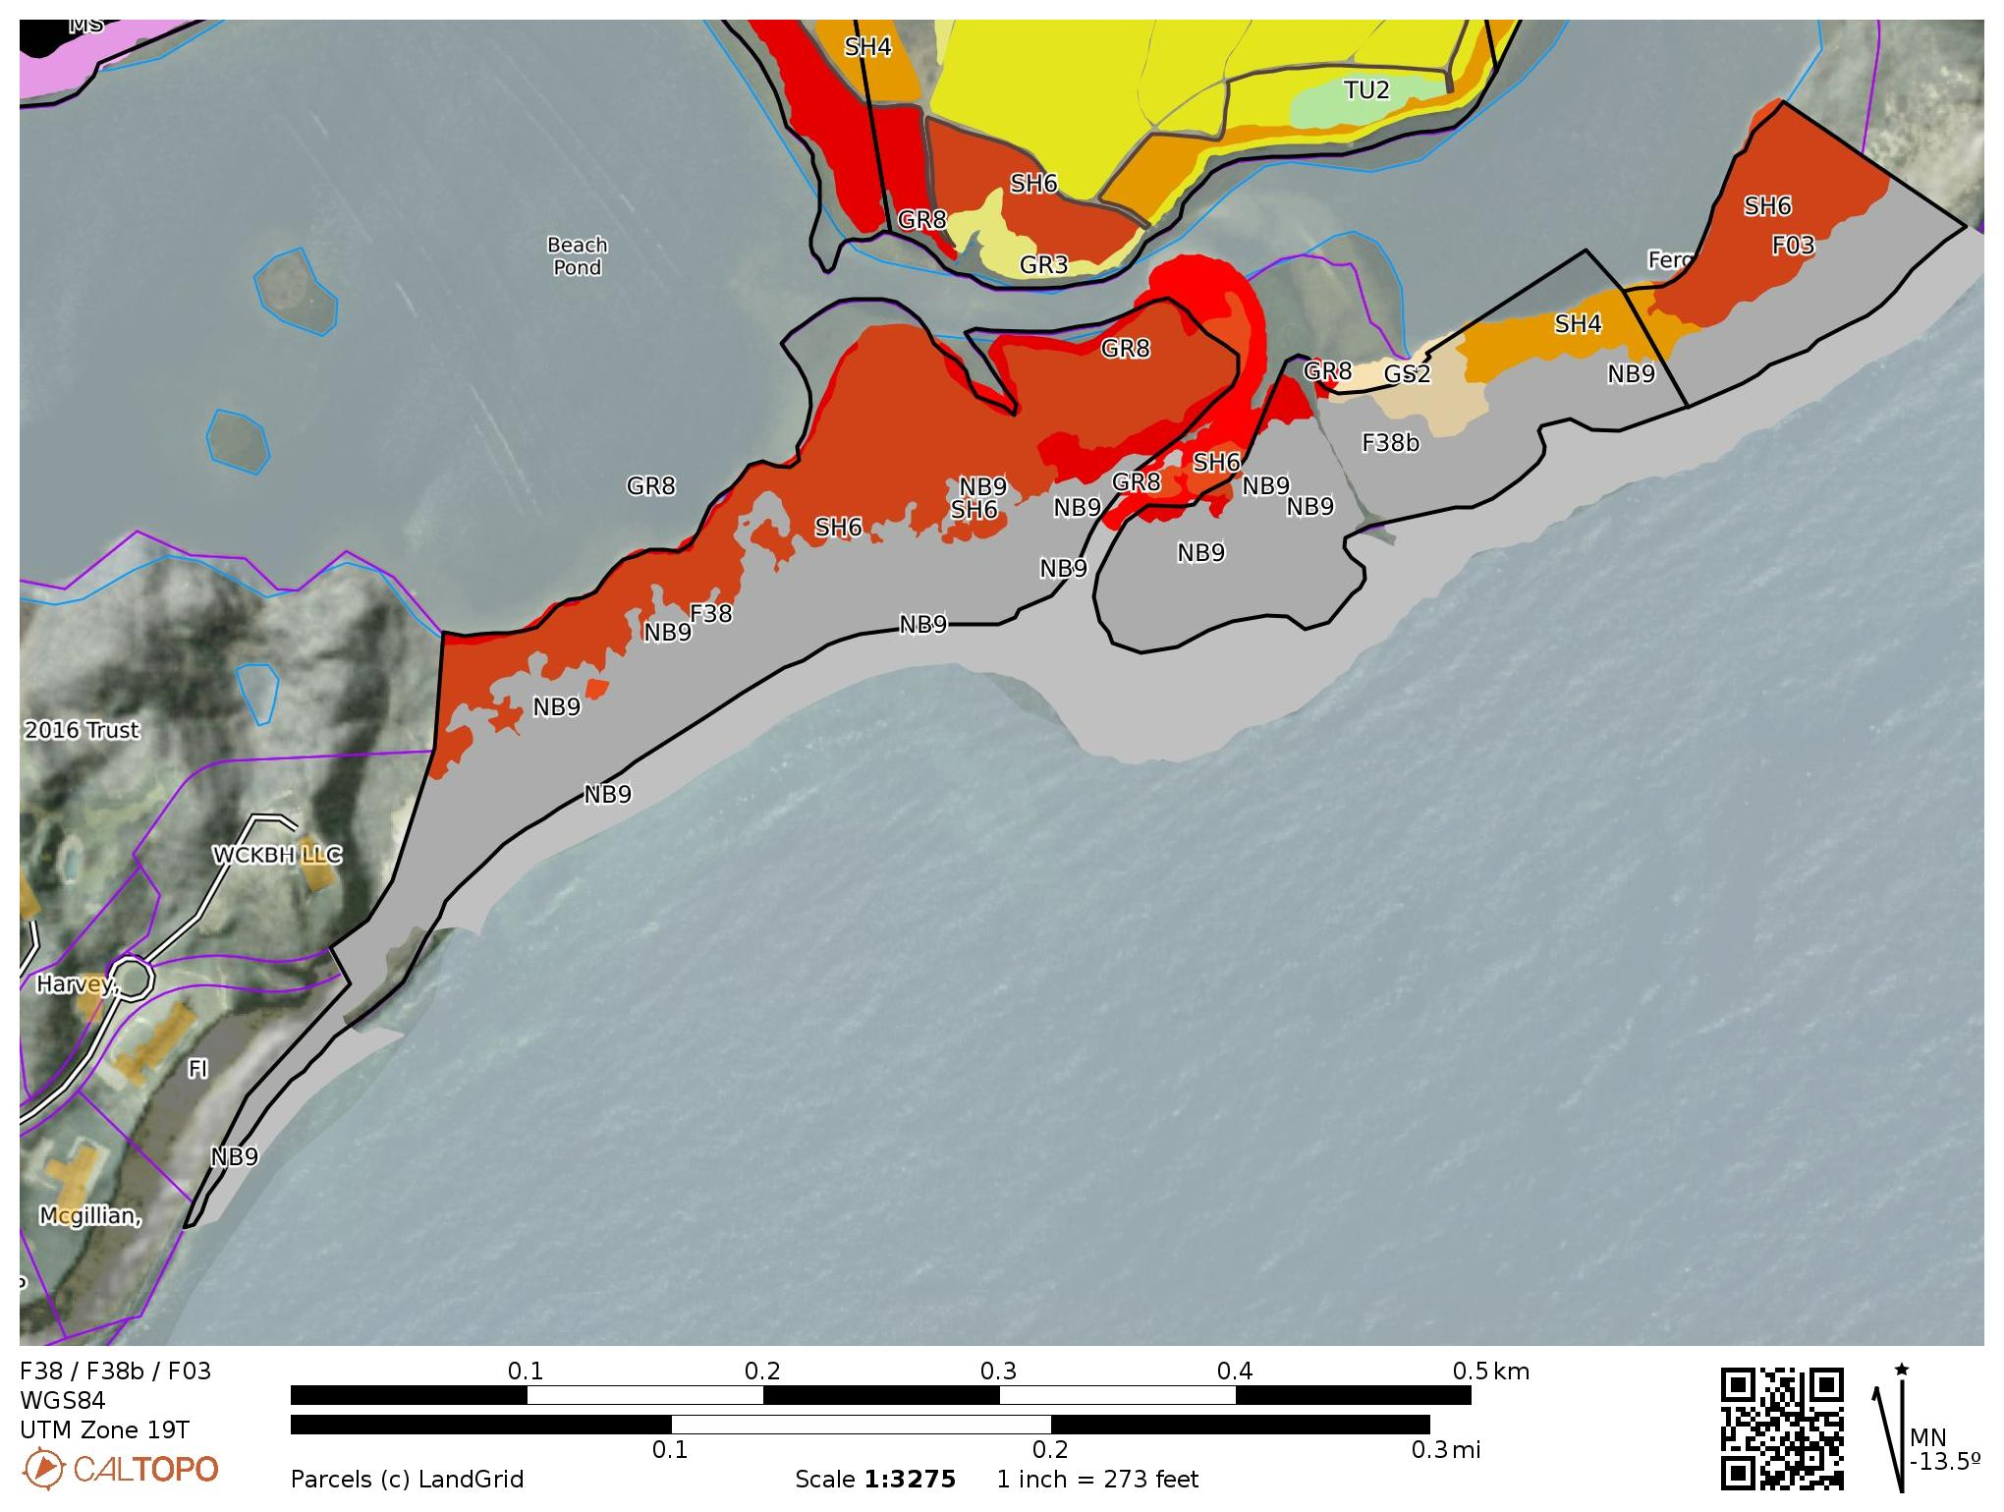
F38 / F38b / F03
FUEL MODEL | FUEL NAME | DESCRIPTION / CHARACTERISTICS
GS2 | Moderate Load, Dry Climate Grass-Shrub (Dynamic) | The primary carrier of fire in GS2 is grass and shrubs combined. Shrubs are 1 to 3 feet high, grass load is moderate. Spread rate is high; flame length moderate.
GR8 | High Load, Very Coarse, Humid Climate Grass (Dynamic) | The primary carrier of fire in GR8 is continuous, very coarse, humid- climate grass. Load and depth are greater than GR6. Spread rate and flame length can be extreme if grass is fully cured
SH4 | Low Load, Humid Climate Timber-Shrub | The primary carrier of fire in SH4 is woody shrubs and shrub litter. Low to moderate shrub and litter load, possibly with pine overstory, fuel bed depth about 3 feet. Spread rate is high; flame length moderate.
SH6 | Low Load, Humid Climate Shrub | The primary carrier of fire in SH6 is woody shrubs and shrub litter. Dense shrubs, little or no herbaceous fuel, fuelbed depth about 2 feet. Spread rate is high; flame length high
NB9 | Nonburnable Beach / Rock | Will not burn, no fuel.

Slide 35
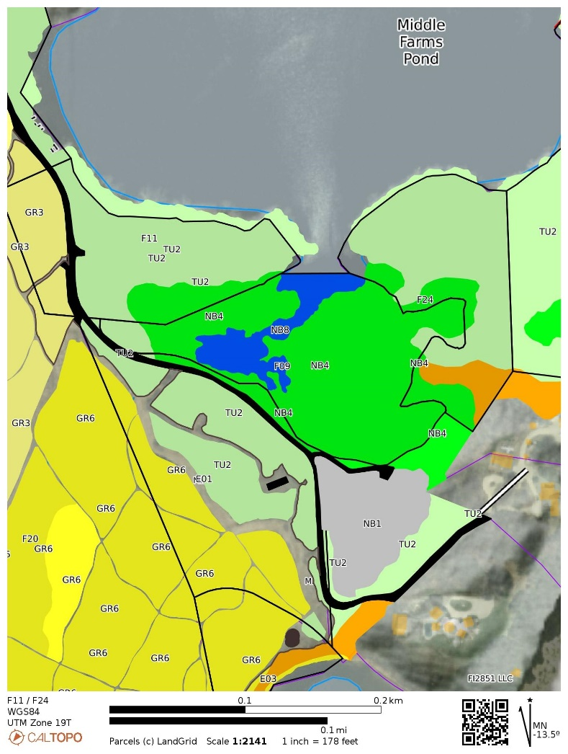
F11 / F09 / F24 / E01
FUEL MODEL | FUEL NAME | DESCRIPTION / CHARACTERISTICS
TU2 | Moderate Load, Humid Climate Timber-Shrub | The primary carrier of fire in TU2 is moderate litter load with shrub component. High extinction moisture. Spread rate is moderate; flame length low.
SH4 | Low Load, Humid Climate Timber-Shrub | The primary carrier of fire in SH4 is woody shrubs and shrub litter. Low to moderate shrub and litter load, possibly with pine overstory, fuel bed depth about 3 feet. Spread rate is high; flame length moderate.
NB1 | Nonburnable Grass Lawn | Will not burn except during extreme drought
NB4 | Nonburnable Swamp / Marsh / Vineland | Will not burn except during extreme drought
NB8 | Nonburnable Lake / Open Water | Will not burn

Slide 36
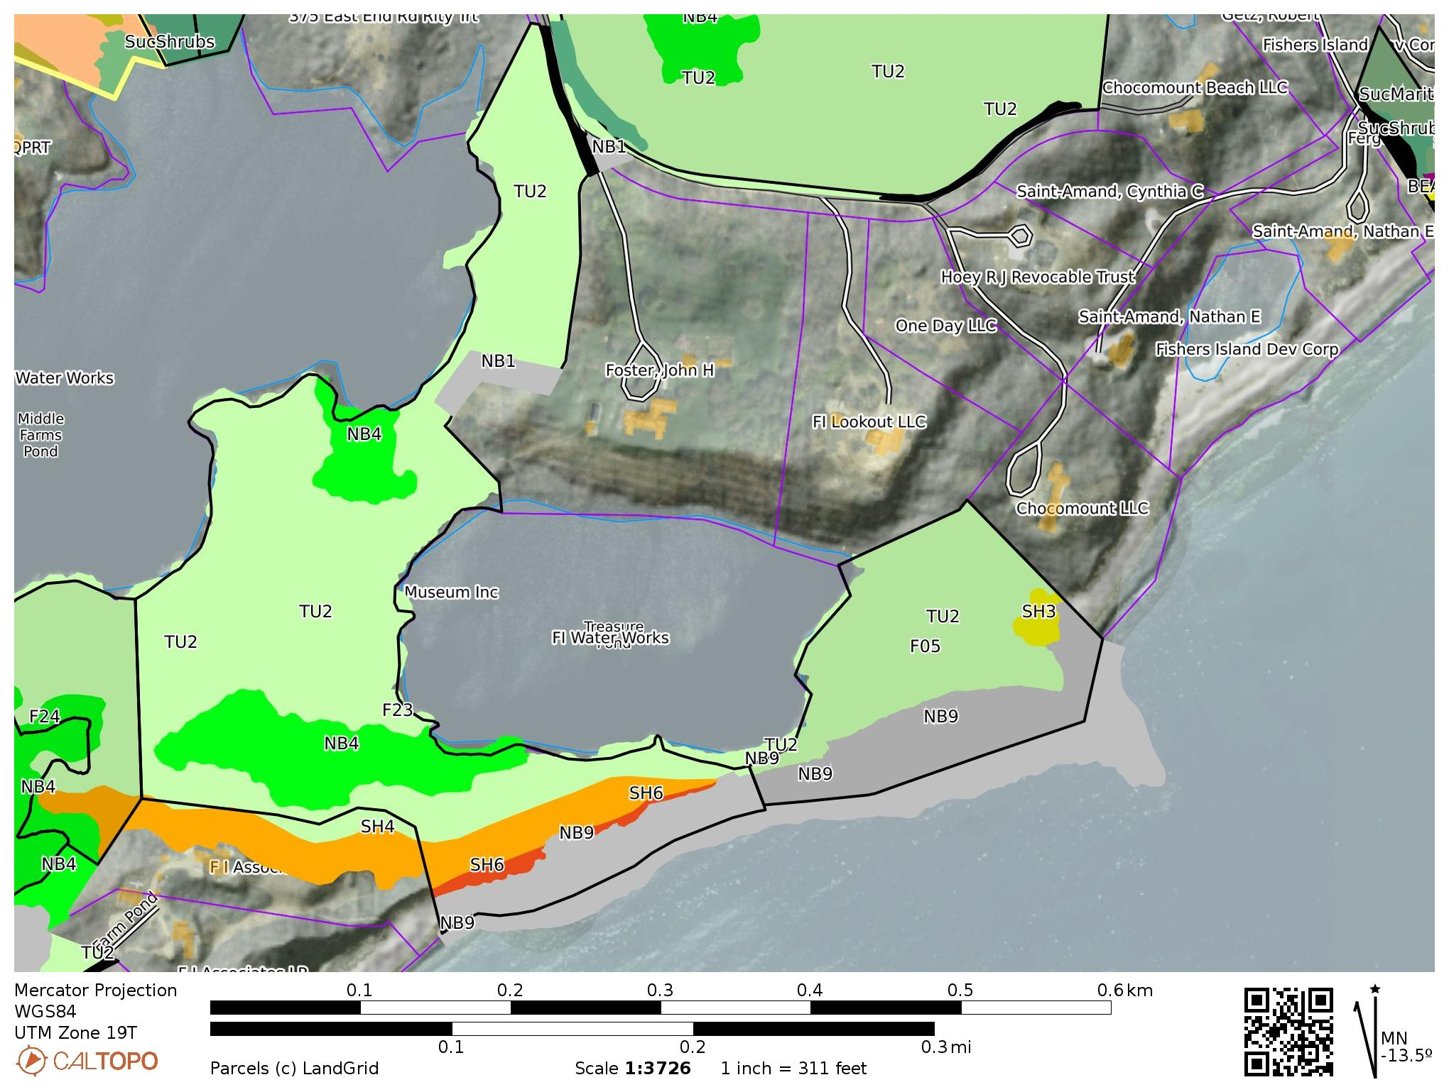
F23 / F05
FUEL MODEL | FUEL NAME | DESCRIPTION / CHARACTERISTICS
TU2 | Moderate Load, Humid Climate Timber-Shrub | The primary carrier of fire in TU2 is moderate litter load with shrub component. High extinction moisture. Spread rate is moderate; flame length low.
SH4 | Low Load, Humid Climate Timber-Shrub | The primary carrier of fire in SH4 is woody shrubs and shrub litter. Low to moderate shrub and litter load, possibly with pine overstory, fuel bed depth about 3 feet. Spread rate is high; flame length moderate.
SH6 | Low Load, Humid Climate Shrub | The primary carrier of fire in SH6 is woody shrubs and shrub litter. Dense shrubs, little or no herbaceous fuel, fuelbed depth about 2 feet. Spread rate is high; flame length high
NB1 | Nonburnable Grass Lawn | Will not burn except during extreme drought
NB4 | Nonburnable Swamp / Marsh / Vineland | Will not burn except during extreme drought
NB9 | Nonburnable Beach / Rock | Will not burn, no fuel.

Slide 37
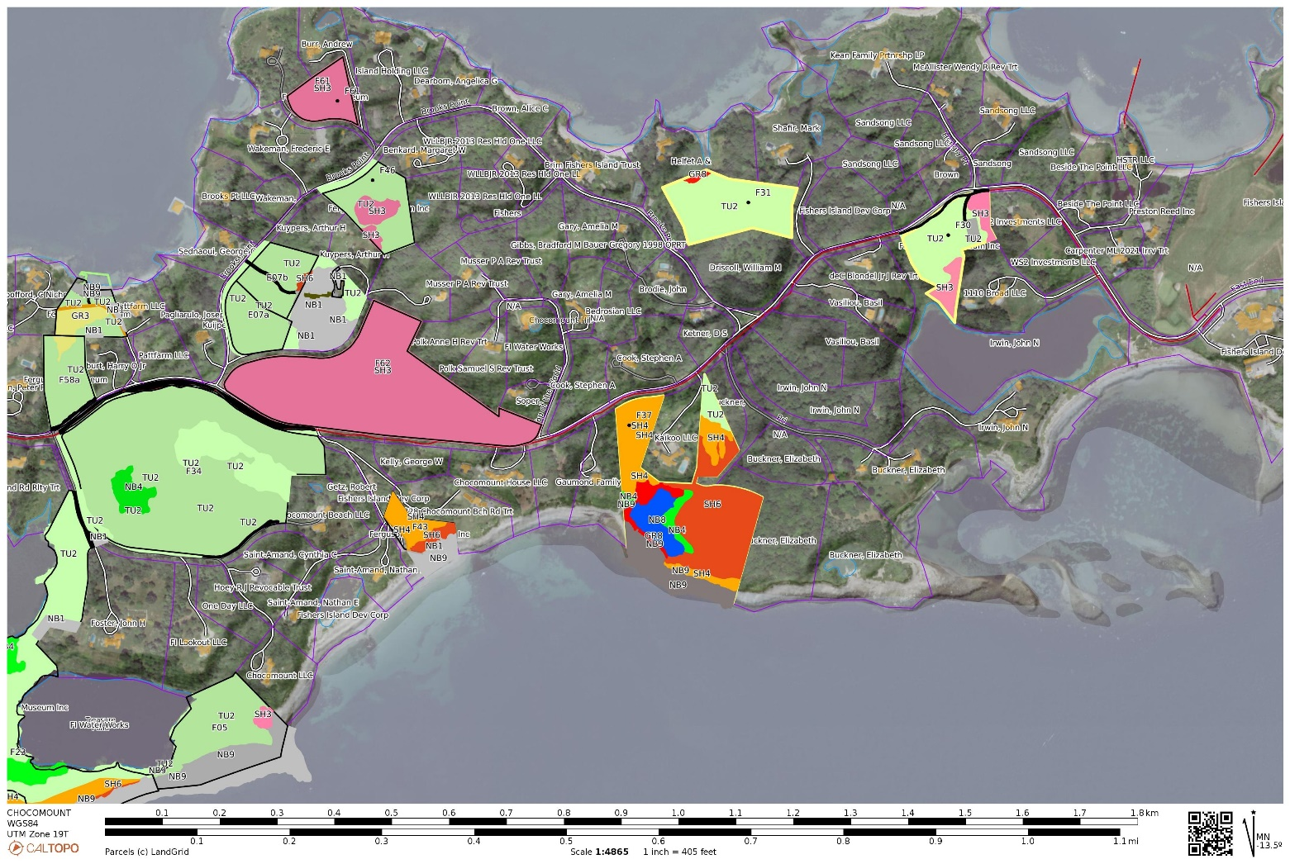
CHOCOMOUNT
AND COASTAL POND PARCELS

Slide 38
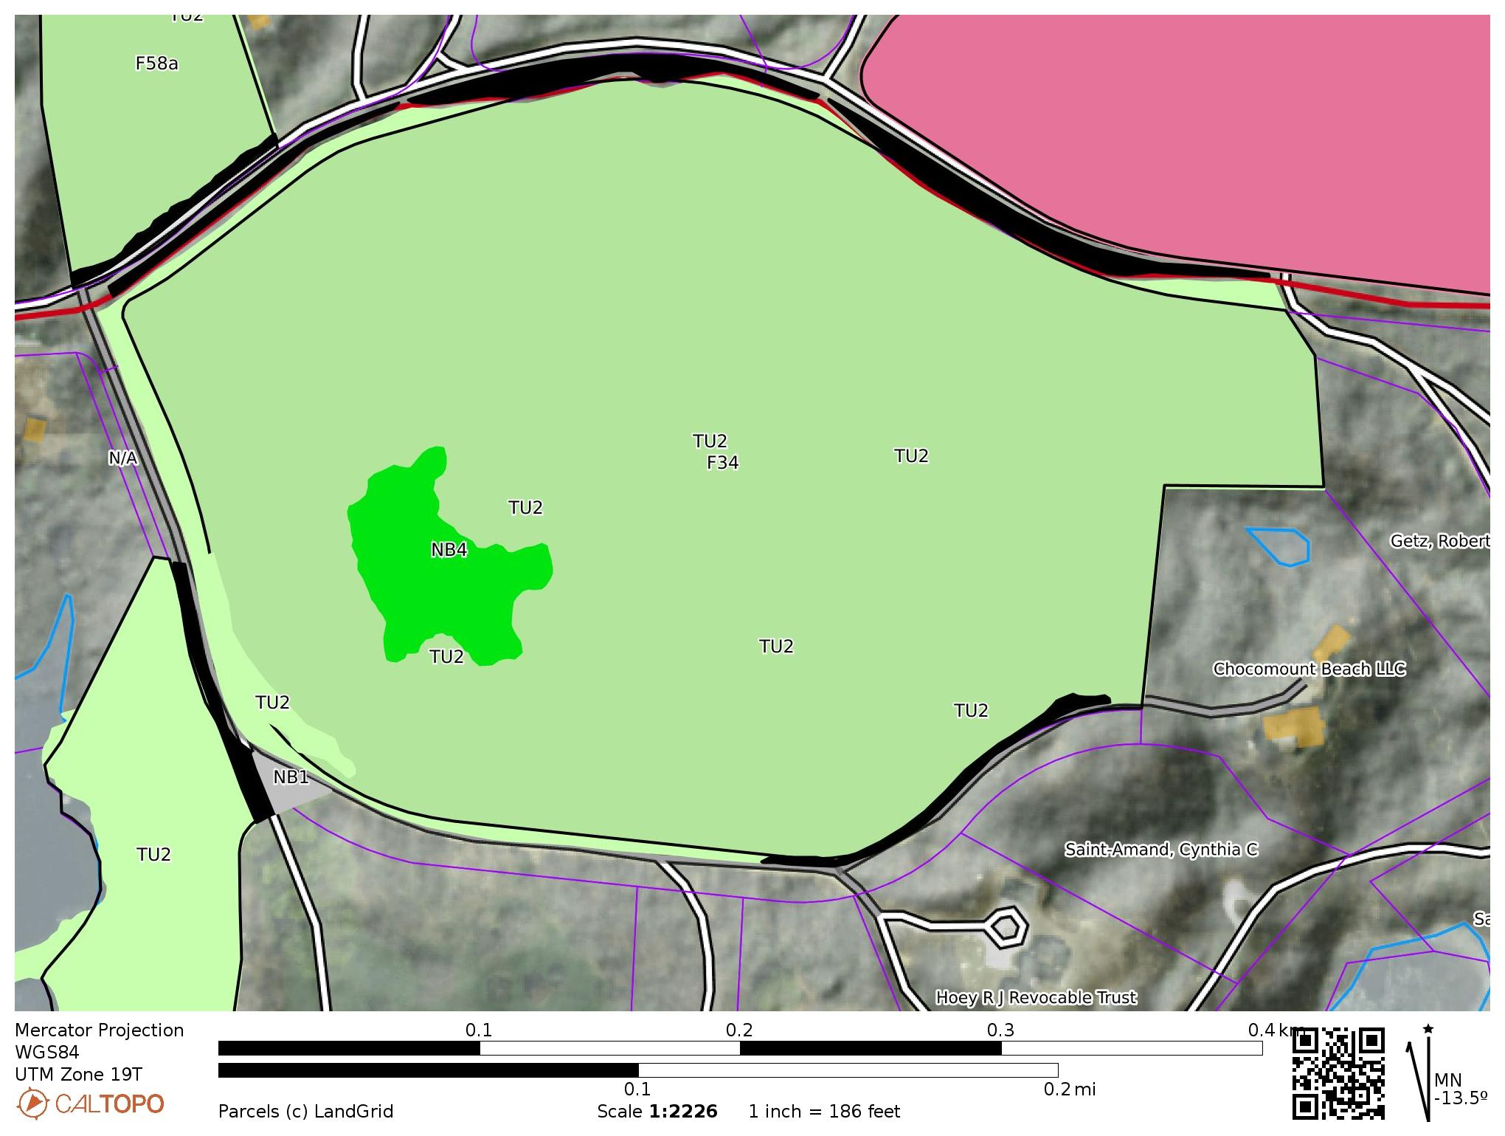

F34
FUEL MODEL | FUEL NAME | DESCRIPTION / CHARACTERISTICS
TU2 | Moderate Load, Humid Climate Timber-Shrub | The primary carrier of fire in TU2 is moderate litter load with shrub component. High extinction moisture. Spread rate is moderate; flame length low.
NB1 | Nonburnable Grass Lawn | Will not burn except during extreme drought
NB4 | Nonburnable Swamp / Marsh / Vineland | Will not burn except during extreme drought

Slide 39
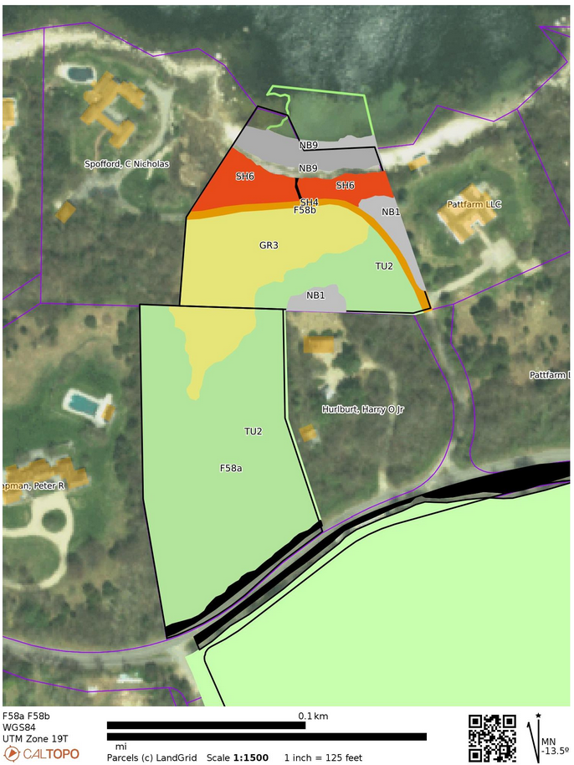

F58a / F58b
FUEL MODEL | FUEL NAME | DESCRIPTION / CHARACTERISTICS
GR3 | Low Load, Very Course, Humid Climate Grass (Dynamic) | The primary carrier of fire in GR3 is continuous, coarse, humid-climate grass. Grass and herb fuel load is relatively light; fuelbed depth is about 2 feet
SH4 | Low Load, Humid Climate Timber-Shrub | The primary carrier of fire in SH4 is woody shrubs and shrub litter.
 |  | Low to moderate shrub and litter load, possibly with pine overstory, fuel bed depth about 3 feet. Spread rate is high; flame length moderate.
SH6 | Low Load, Humid Climate Shrub | The primary carrier of fire in SH6 is woody shrubs and shrub litter. Dense shrubs, little or no herbaceous fuel, fuelbed depth about 2 feet. Spread rate is high; flame length high
TU2 | Moderate Load, Humid Climate Timber-Shrub | The primary carrier of fire in TU2 is moderate litter load with shrub component. High extinction moisture. Spread rate is moderate; flame length low.
NB1 | Nonburnable Grass Lawn | Will not burn except during extreme drought
NB9 | Nonburnable Beach / Rock | Will not burn, no fuel.

Slide 40
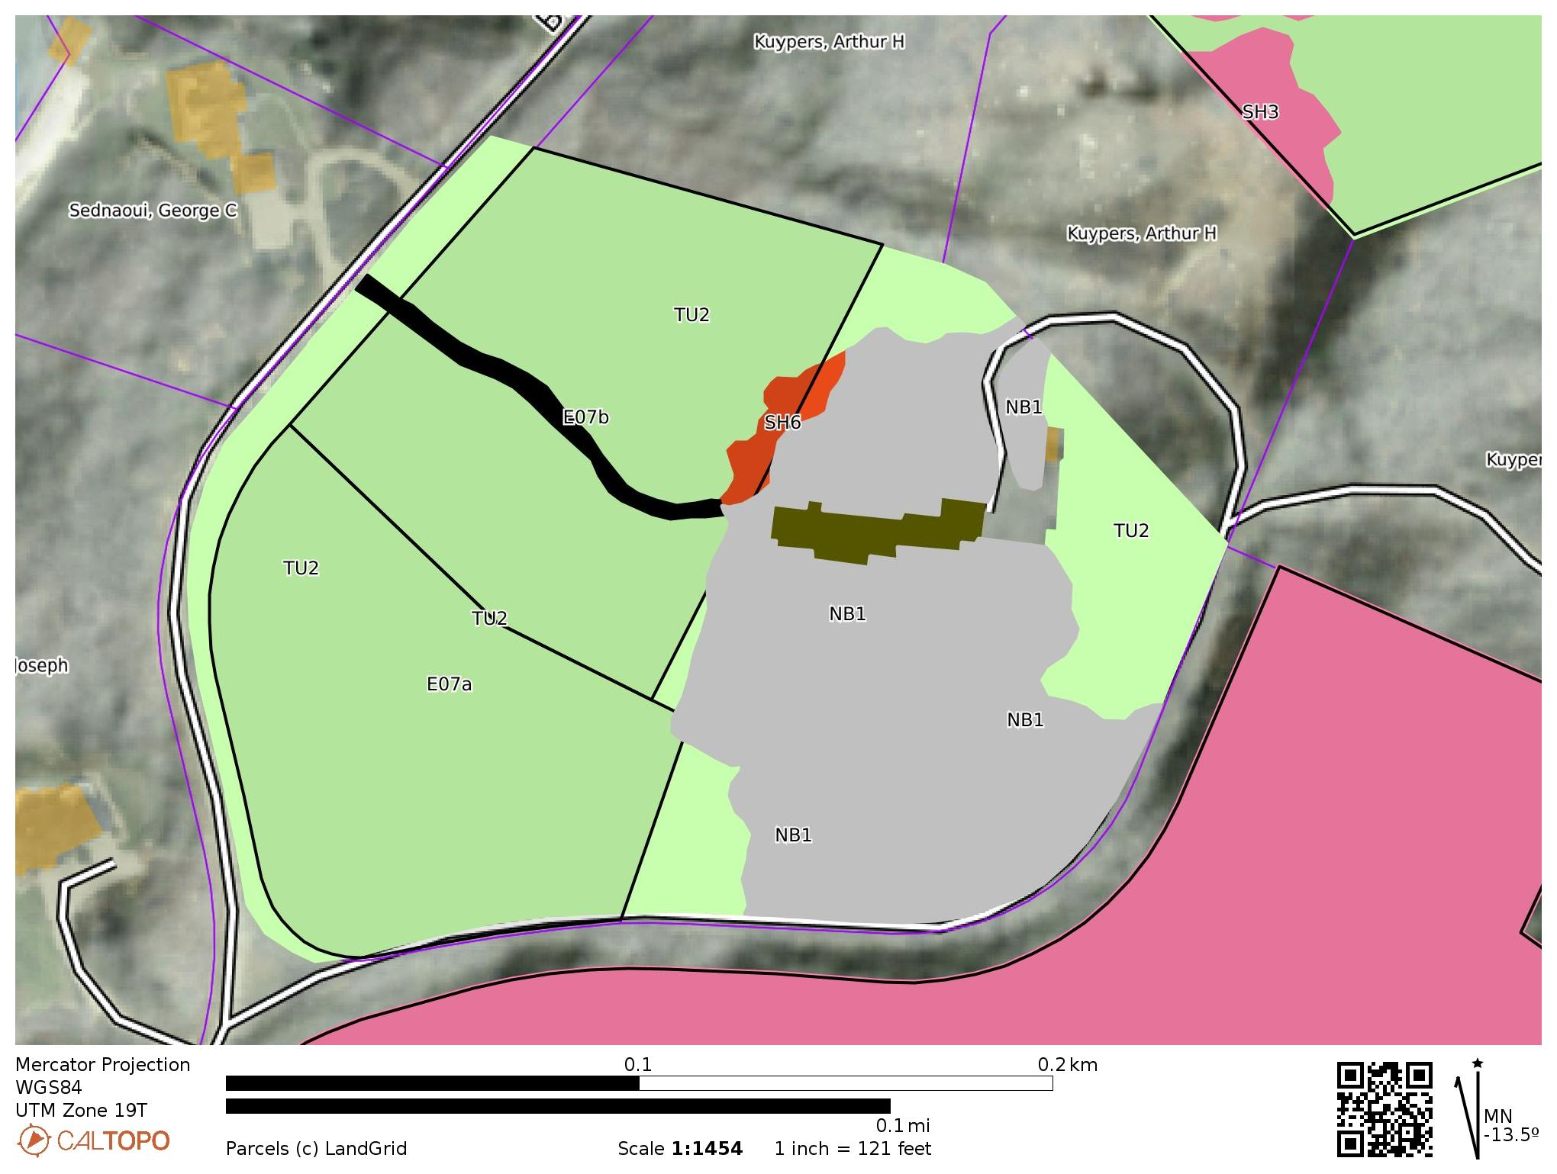

E07a / E07b
FUEL MODEL | FUEL NAME | DESCRIPTION / CHARACTERISTICS
TU2 | Moderate Load, Humid Climate Timber-Shrub | The primary carrier of fire in TU2 is moderate litter load with shrub component. High extinction moisture. Spread rate is moderate; flame length low.
SH6 | Low Load, Humid Climate Shrub | The primary carrier of fire in SH6 is woody shrubs and shrub litter. Dense shrubs, little or no herbaceous fuel, fuelbed depth about 2 feet. Spread rate is high; flame length high
NB1 | Nonburnable Grass Lawn | Will not burn except during extreme drought

Slide 41
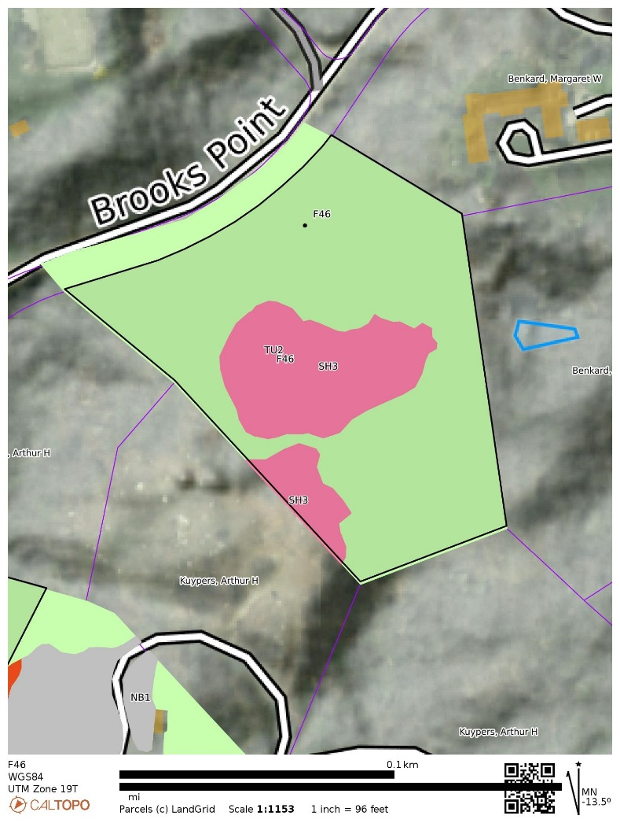

F46
FUEL MODEL | FUEL NAME | DESCRIPTION / CHARACTERISTICS
TU2 | Moderate Load, Humid Climate Timber-Shrub | The primary carrier of fire in TU2 is moderate litter load with shrub component. High extinction moisture. Spread rate is moderate; flame length low.
SH3 | Moderate Load, Humid Climate Shrub | The primary carrier of fire in SH3 is woody shrubs and shrub litter. Moderate shrub load, possibly with pine overstory or herbaceous fuel, fuel bed depth 2 to 3 feet. Spread rate is low; flame length low

Slide 42
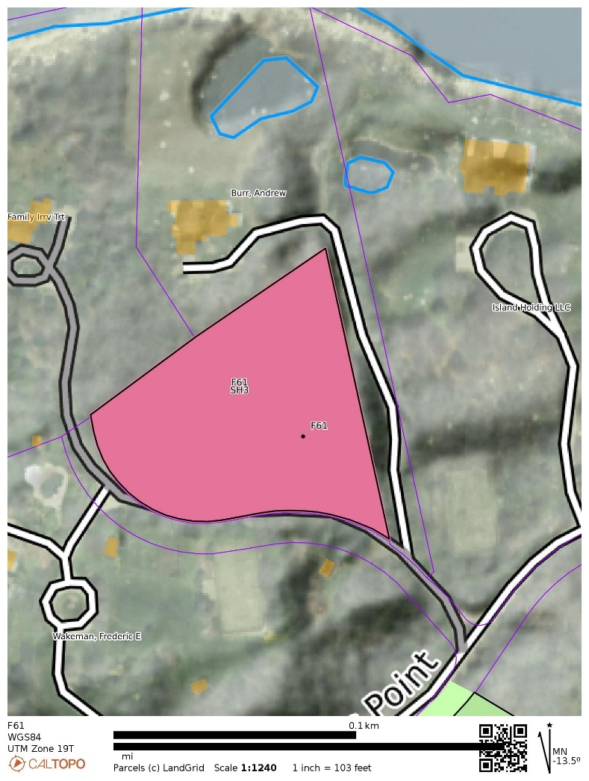

F61
FUEL MODEL | FUEL NAME | DESCRIPTION / CHARACTERISTICS
SH3 | Moderate Load, Humid Climate Shrub | The primary carrier of fire in SH3 is woody shrubs and shrub litter. Moderate shrub load, possibly with pine overstory or herbaceous fuel, fuel bed depth 2 to 3 feet. Spread rate is low; flame length low

Slide 43
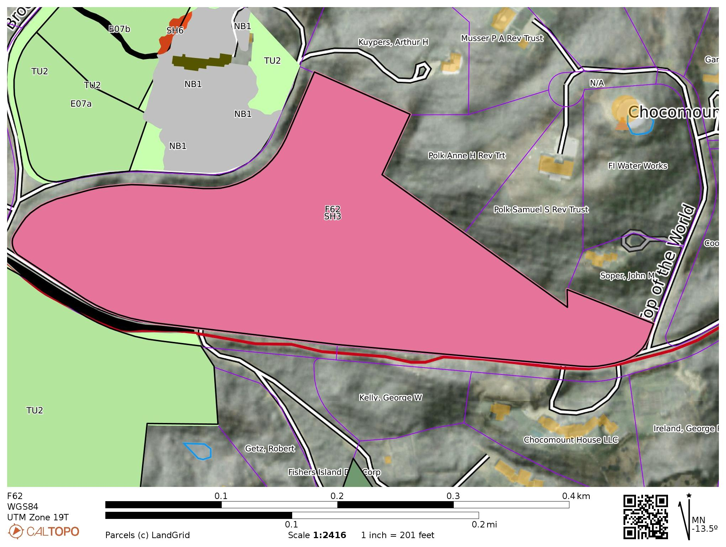

F62
FUEL MODEL | FUEL NAME | DESCRIPTION / CHARACTERISTICS
SH3 | Moderate Load, Humid Climate Shrub | The primary carrier of fire in SH3 is woody shrubs and shrub litter. Moderate shrub load, possibly with pine overstory or herbaceous fuel, fuel bed depth 2 to 3 feet. Spread rate is low; flame length low

Slide 44
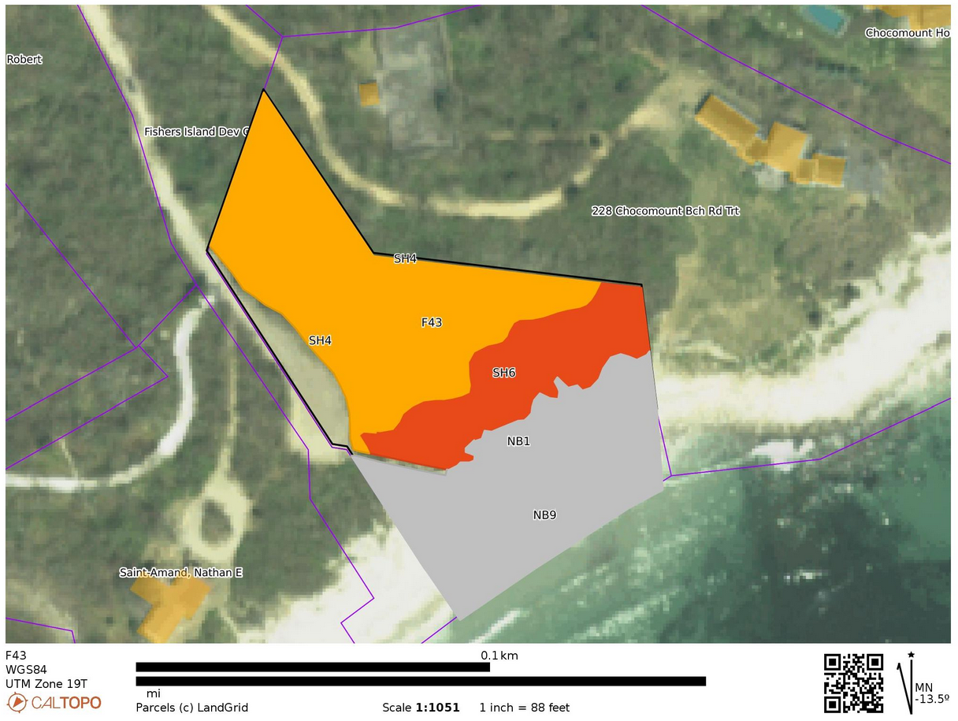

F43
FUEL MODEL | FUEL NAME | DESCRIPTION / CHARACTERISTICS
SH4 | Low Load, Humid Climate Timber-Shrub | The primary carrier of fire in SH4 is woody shrubs and shrub litter. Low to moderate shrub and litter load, possibly with pine overstory, fuel bed depth about 3 feet. Spread rate is high; flame length moderate.
SH6 | Low Load, Humid Climate Shrub | The primary carrier of fire in SH6 is woody shrubs and shrub litter. Dense shrubs, little or no herbaceous fuel, fuelbed depth about 2 feet. Spread rate is high; flame length high
NB1 | Nonburnable Grass Lawn | Will not burn except during extreme drought
NB9 | Nonburnable Beach / Rock | Will not burn, no fuel.

Slide 45
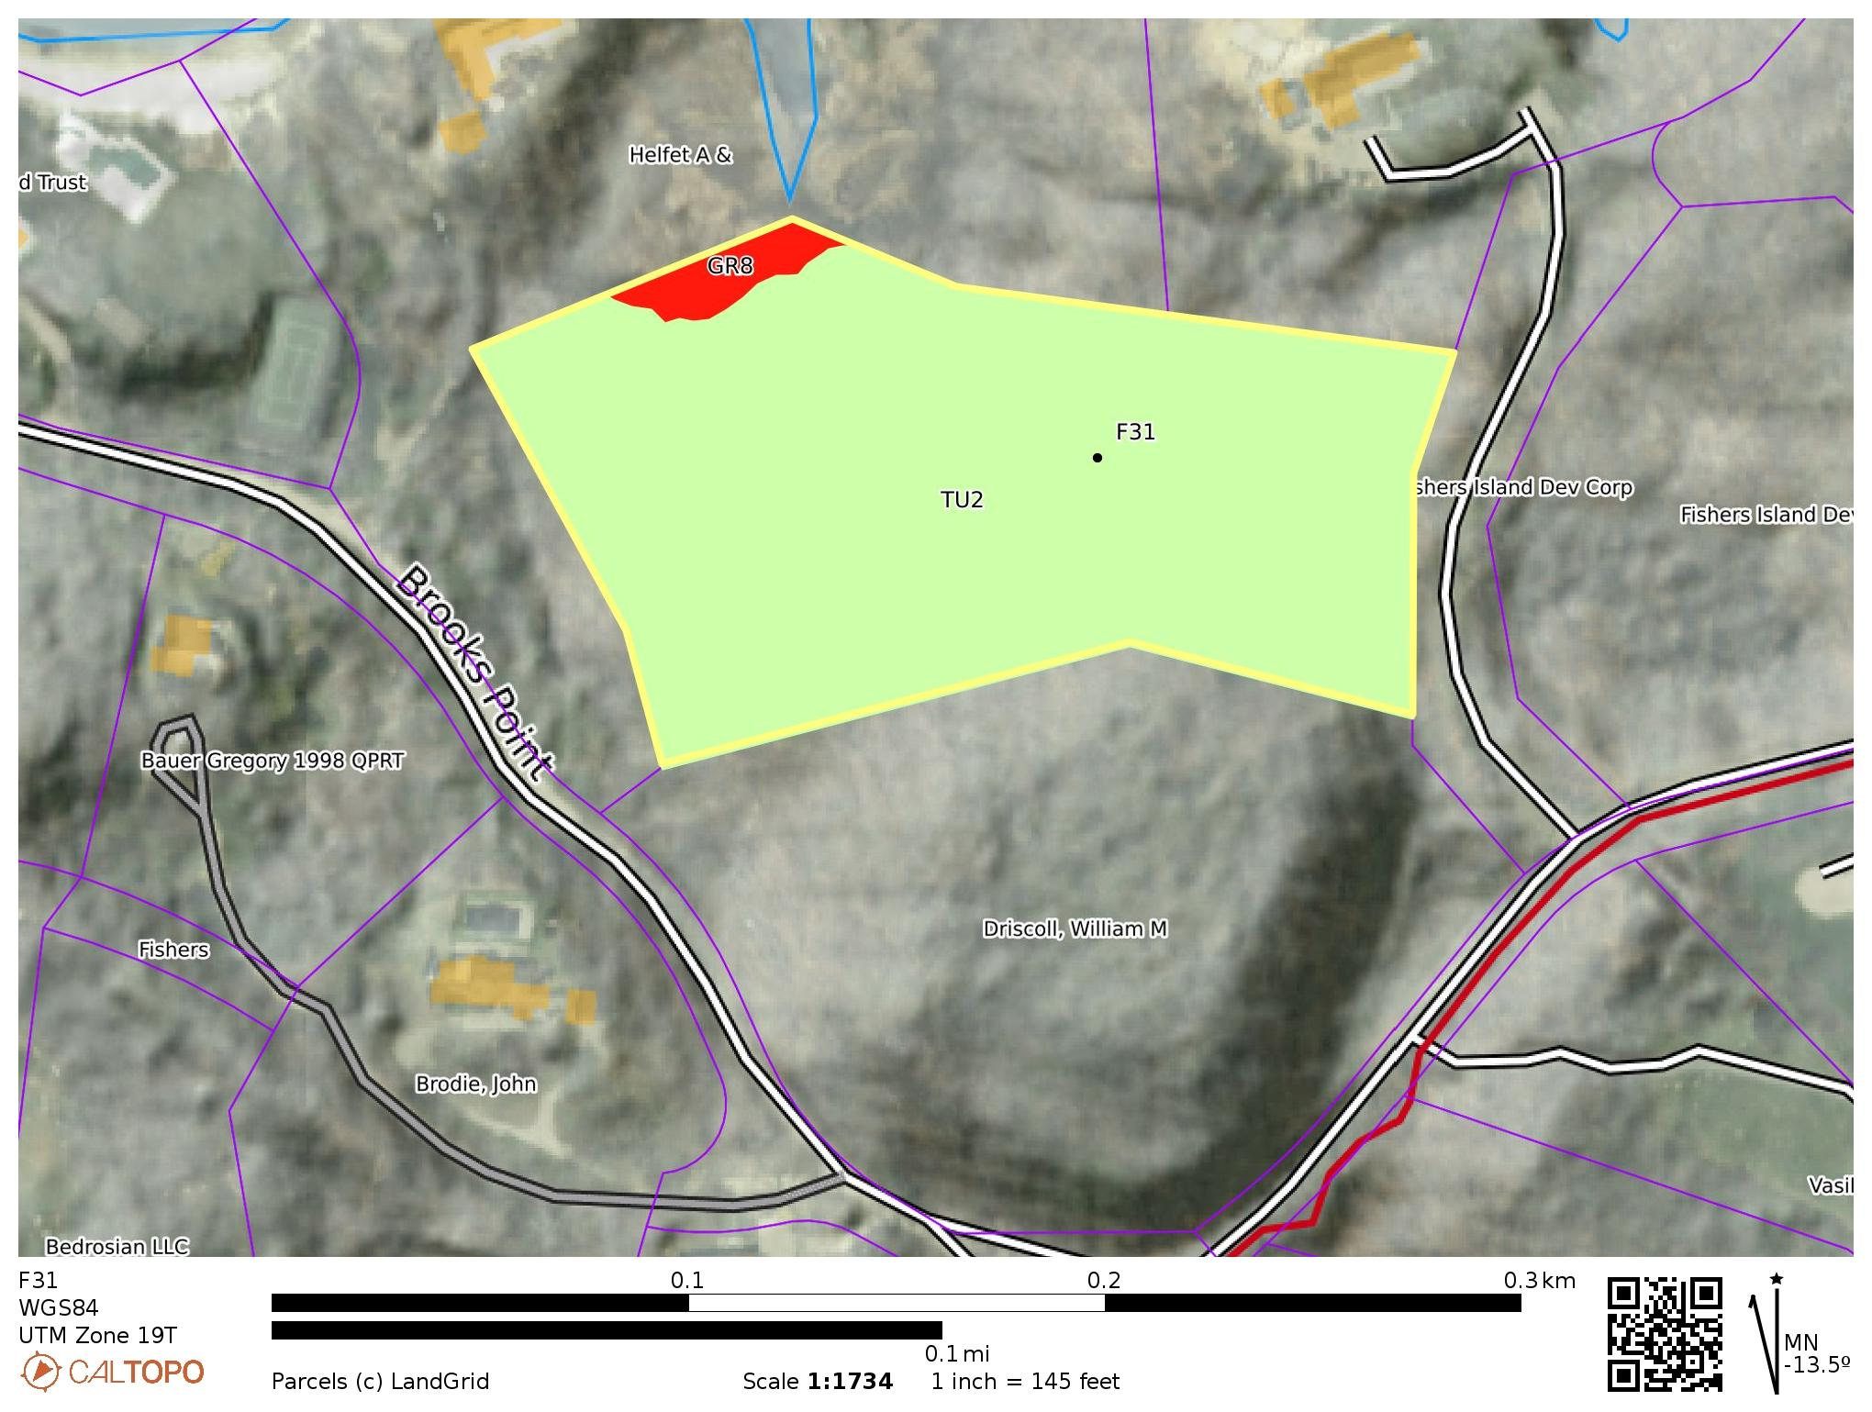

F31
FUEL MODEL | FUEL NAME | DESCRIPTION / CHARACTERISTICS
GR8 | High Load, Very Coarse, Humid Climate Grass (Dynamic) | The primary carrier of fire in GR8 is continuous, very coarse, humid- climate grass. Load and depth are greater than GR6. Spread rate and flame length can be extreme if grass is fully cured
TU2 | Moderate Load, Humid Climate Timber-Shrub | The primary carrier of fire in TU2 is moderate litter load with shrub component. High extinction moisture. Spread rate is moderate; flame length low.

Slide 46
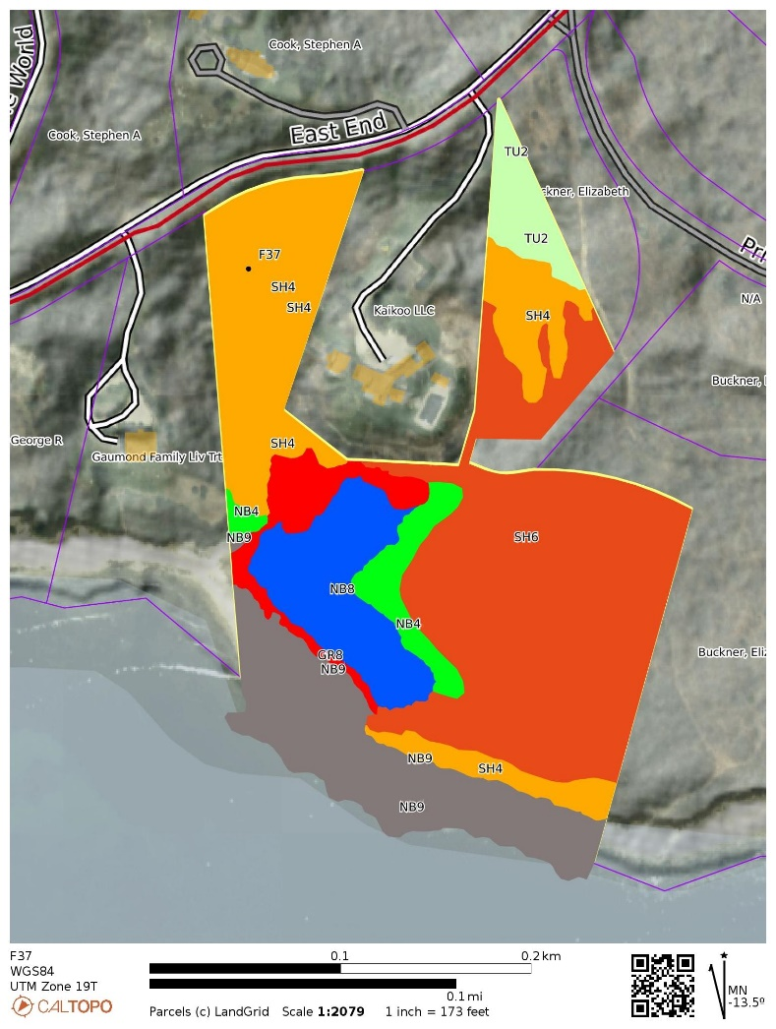

F37
FUEL MODEL | FUEL NAME | DESCRIPTION / CHARACTERISTICS
GR8 | High Load, Very Coarse, Humid Climate Grass (Dynamic) | The primary carrier of fire in GR8 is continuous, very coarse, humid- climate grass. Load and depth are greater than GR6. Spread rate and flame length can be extreme if grass is fully cured
TU2 | Moderate Load, Humid Climate Timber-Shrub | The primary carrier of fire in TU2 is moderate litter load with shrub component. High extinction moisture. Spread rate is moderate; flame length low.
SH4 | Low Load, Humid Climate Timber-Shrub | The primary carrier of fire in SH4 is woody shrubs and shrub litter. Low to moderate shrub and litter load, possibly with pine overstory, fuel bed depth about 3 feet. Spread rate is high; flame length moderate.
SH6 | Low Load, Humid Climate Shrub | The primary carrier of fire in SH6 is woody shrubs and shrub litter. Dense shrubs, little or no herbaceous fuel, fuelbed depth about 2 feet. Spread rate is high; flame length high
NB4 | Nonburnable Swamp / Marsh / Vineland | Will not burn except during extreme drought
NB8 | Nonburnable Lake / Open Water | Will not burn
NB9 | Nonburnable Beach / Rock | Will not burn, no fuel.

Slide 47

F37

Slide 48


F30
FUEL MODEL | FUEL NAME | DESCRIPTION / CHARACTERISTICS
TU2 | Moderate Load, Humid Climate Timber-Shrub | The primary carrier of fire in TU2 is moderate litter load with shrub component. High extinction moisture. Spread rate is moderate; flame length low.
SH3 | Moderate Load, Humid Climate Shrub | The primary carrier of fire in SH3 is woody shrubs and shrub litter. Moderate shrub load, possibly with pine overstory or herbaceous fuel, fuel bed depth 2 to 3 feet. Spread rate is low; flame length low

Slide 49


F13
FUEL MODEL | FUEL NAME | DESCRIPTION / CHARACTERISTICS
TU2 | Moderate Load, Humid Climate Timber-Shrub | The primary carrier of fire in TU2 is moderate litter load with shrub component. High extinction moisture. Spread rate is moderate; flame length low.
GR8 | High Load, Very Coarse, Humid Climate Grass (Dynamic) | The primary carrier of fire in GR8 is continuous, very coarse, humid- climate grass. Load and depth are greater than GR6. Spread rate and flame length can be extreme if grass is fully cured

Slide 50


F51
FUEL MODEL | FUEL NAME | DESCRIPTION / CHARACTERISTICS
TU2 | Moderate Load, Humid Climate Timber-Shrub | The primary carrier of fire in TU2 is moderate litter load with shrub component. High extinction moisture. Spread rate is moderate; flame length low.
SH3 | Moderate Load, Humid Climate Shrub | The primary carrier of fire in SH3 is woody shrubs and shrub litter. Moderate shrub load, possibly with pine overstory or herbaceous fuel, fuel bed depth 2 to 3 feet. Spread rate is low; flame length low

Slide 51


F50 / F48 / F47
FUEL MODEL | FUEL NAME | DESCRIPTION / CHARACTERISTICS
TU2 | Moderate Load, Humid Climate Timber-Shrub | The primary carrier of fire in TU2 is moderate litter load with shrub component. High extinction moisture. Spread rate is moderate; flame length low.
SH3 | Moderate Load, Humid Climate Shrub | The primary carrier of fire in SH3 is woody shrubs and shrub litter. Moderate shrub load, possibly with pine overstory or herbaceous fuel, fuel bed depth 2 to 3 feet. Spread rate is low; flame length low
SH6 | Low Load, Humid Climate Shrub | The primary carrier of fire in SH6 is woody shrubs and shrub litter. Dense shrubs, little or no herbaceous fuel, fuelbed depth about 2 feet. Spread rate is high; flame length high
NB4 | Non-burnable Swamp / Marsh / Vineland | Will not burn except during extreme drought
NB8 | Non-burnable Lake / Open Water | Will not burn

Slide 52


F56
FUEL MODEL | FUEL NAME | DESCRIPTION / CHARACTERISTICS
SH3 | Moderate Load, Humid Climate Shrub | The primary carrier of fire in SH3 is woody shrubs and shrub litter. Moderate shrub load, possibly with pine overstory or herbaceous fuel, fuel bed depth 2 to 3 feet. Spread rate is low; flame length low

Slide 53

EAST END PARCELS

Slide 54


E04 – STUDIO STRUCTURE AT RISK
This small structure is perched on the edge of the ravine at the top of this steep SE aspect and is surrounded by dense shrub fuels. The landowner should decide if some clearing to create a fire break on the SE side of the structure is merited, or, since this is not a very expensive structure just accept risk of loss due to an eventual wildfire. See Notes below for wildfire risk considerations.
NOTES: Most of E04 consists of a ravine with a southeast aspect on a slope of 36%. It rises nearly 80’ in elevation from Block Island Sound. There are continuous dense shrub fuels from the beach to the top of the ravine. The fuels consist of Maritime Shrub/Scrub and Successional shrubby hardwoods.

Slide 55


E04
FUEL MODEL | FUEL NAME | DESCRIPTION / CHARACTERISTICS
SH3 | Moderate Load, Humid Climate Shrub | The primary carrier of fire in SH3 is woody shrubs and shrub litter. Moderate shrub load, possibly with pine overstory or herbaceous fuel, fuel bed depth 2 to 3 feet. Spread rate is low; flame length low
SH4 | Low Load, Humid Climate Timber-Shrub | The primary carrier of fire in SH4 is woody shrubs and shrub litter. Low to moderate shrub and litter load, possibly with pine overstory, fuel bed depth about 3 feet. Spread rate is high; flame length moderate.
SH6 | Low Load, Humid Climate Shrub | The primary carrier of fire in SH6 is woody shrubs and shrub litter. Dense shrubs, little or no herbaceous fuel, fuelbed depth about 2 feet. Spread rate is high; flame length high
TU3 | Moderate Load, Humid Climate Timber-Grass-Shrub (Dynamic) | The primary carrier of fire in TU3 is moderate forest litter with grass and shrub components. Extinction moisture is high. Spread rate is high; flame length moderate
NB1 | Nonburnable Grass Lawn | Will not burn except during extreme drought
NB9 | Nonburnable Beach / Rock | Will not burn, no fuel.

