Slide 1

Unit 1: Course Overview Planning Section Chief November 15-18, 2021 Sandwich Police Department
RBIM

Slide 2


Slide 3
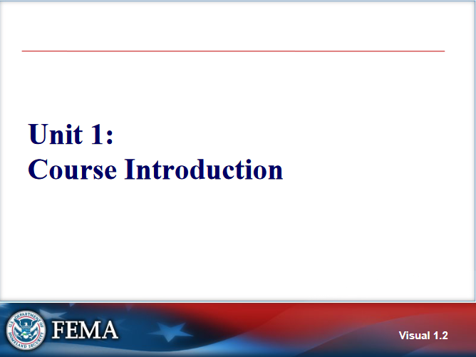

Slide 4
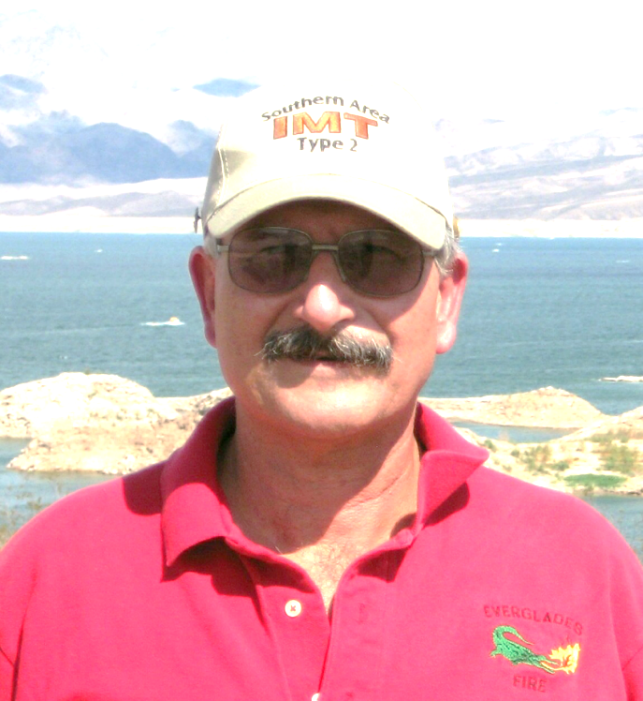
Instructor Introductions Bob Panko
Retired in Nov 2007 after 36 calendar years with NPS
USNPS Ranger / Supv Ranger / Asst Chief Ranger, Fire & Aviation Man Officer
Presently Fire Management Specialist, Central Pine Barrens Commission, Long Island NY
ICT2 – Southern Area IMT2 & NPS All Hazard 1993-2010
Southern Area Type 1 & 2 IMT’s 2004-2015 (IC / OSC / LOFR)
2016- Current Operations SC NY State IMT2
Risky Business Incident Management LLC “sole member”

Slide 5
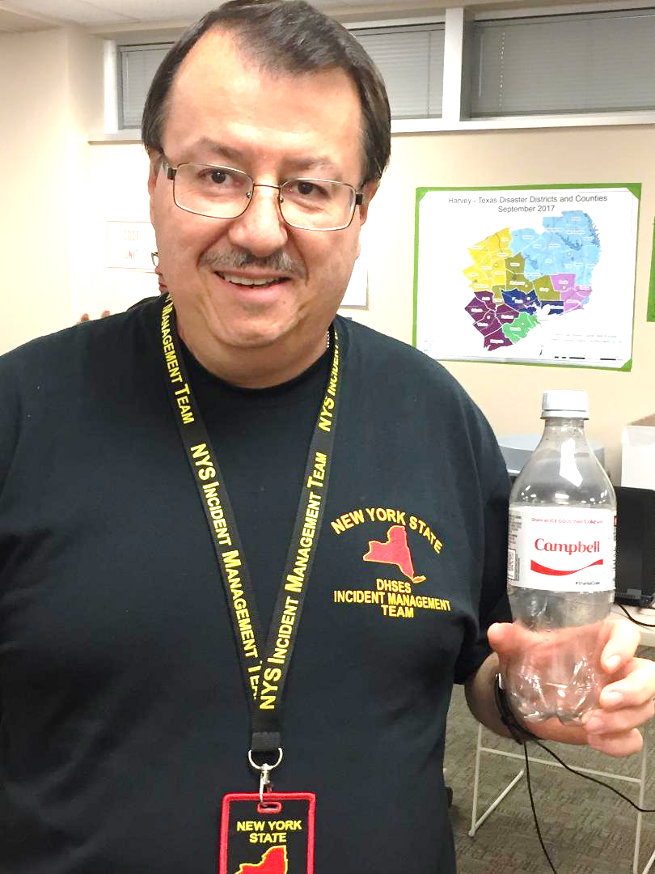
Instructor Introductions Bill Campbell
Retired in 2018 as Chief, IMT Section, NYS DHSES-OEM
Charter member NYS IMT2 & All Hazards IMT Assoc. (AHIMTA)
Director of Training & Exercises, SEMO 2001 - 2008
33 years NY State service (SEMO / DHSES)
Subject Matter Expert (SME) for NWCG’s ICS Curriculum Revision Team for ICS 300 & 400 2004 – 2006
Member of Rocky Mountain IMT2 (Blue Team) 2008 – 2018
Current National Qualifications (Red Card) PSC2; RESL & LOFR
EMT-Paramedic 1981 - 2005

Slide 6
Student Questions
I have had training as an All Hazard or NWCG Resource Unit Leader, Situation Unit Leader, Documentation Unit Leader or Demobilization Unit Leader.
I have experience on multiple incidents/events managed using ICS and worked on these assignments as a member of the Command & General Staff
I have been on multiple incidents/events managed using ICS but have usually worked as a single resource (part of a crew, as an EMT, etc.) or worked as a Unit Leader
I have had I300 & I400 training, but have had no real-life experience in using ICS

Slide 7
Student Introductions
Name
Day Job / Who you work or volunteer for
Your past experience in emergency & incident management – ICS positions you performed in the past
Expectations from attending this course

Slide 8
Operational Period Briefing
Current Situation
Objectives
Predictive Information
Assignments
Safety
Logistics
Finance
Planning
Information
Liaison
Agency Reps / Agency Administrator
Close Out

Slide 9
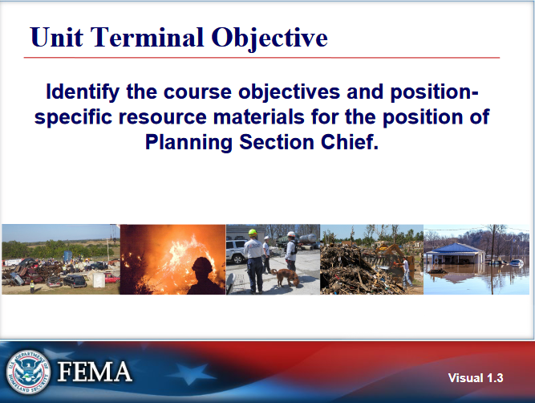

Slide 10
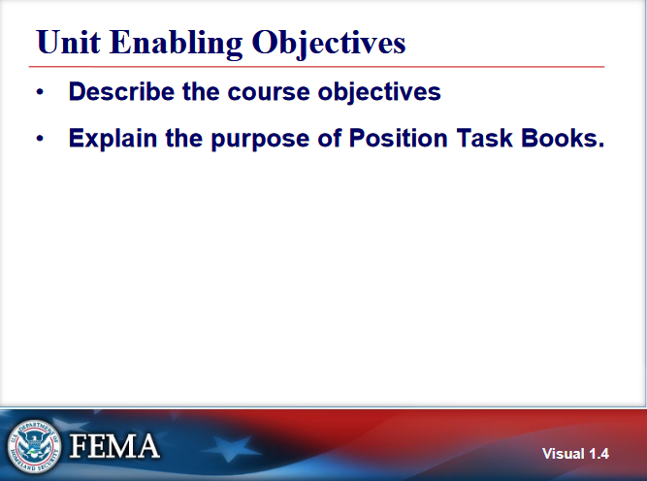

Slide 11
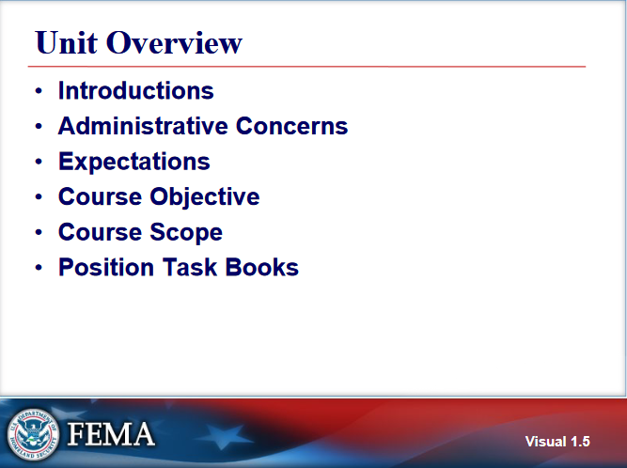

Slide 12
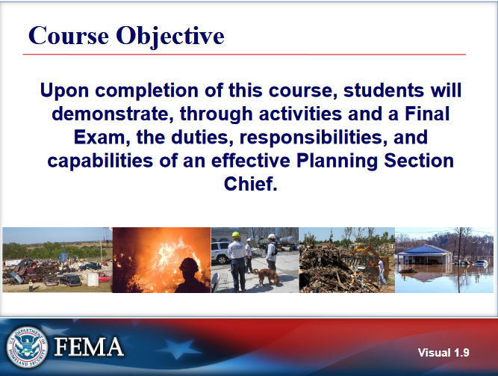

Slide 13
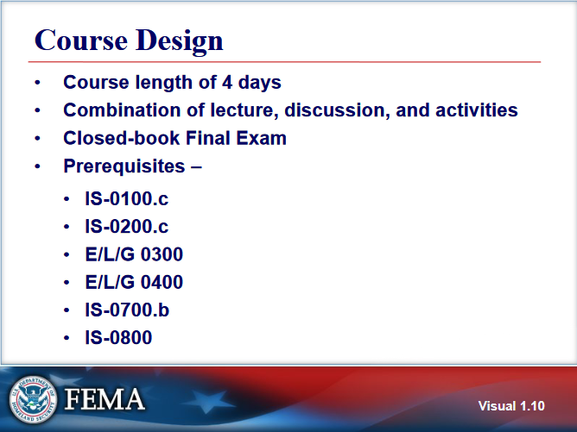

Slide 14
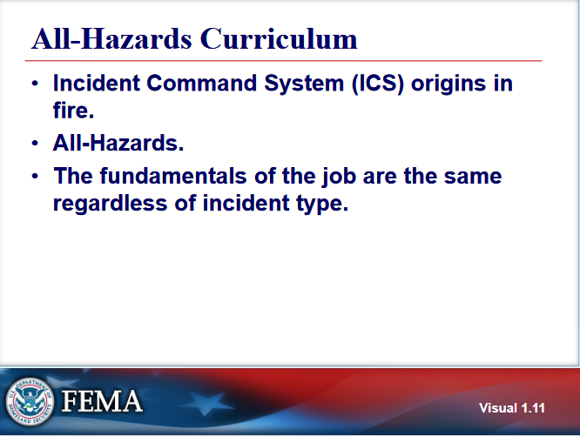

Slide 15
Pre-Test and Discussion
Complete the pre test – 30 minutes
Group will discuss pretest

Slide 16
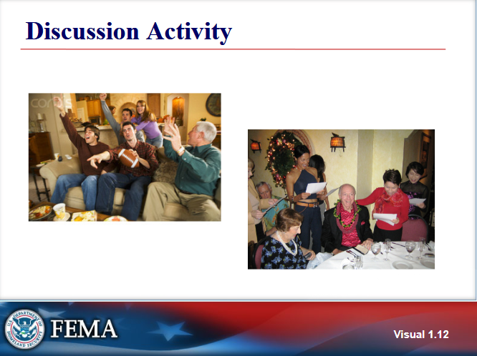

Slide 17
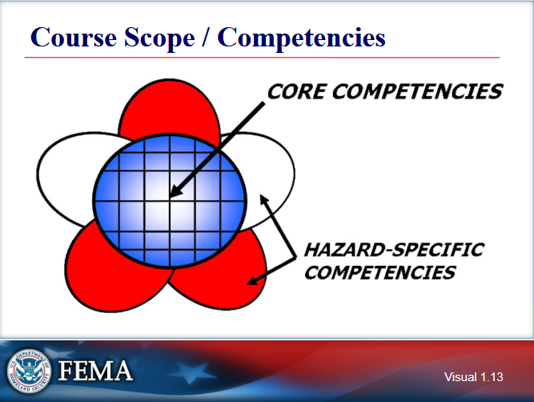

Slide 18
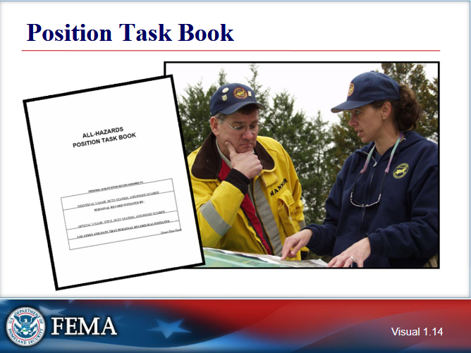

Slide 19
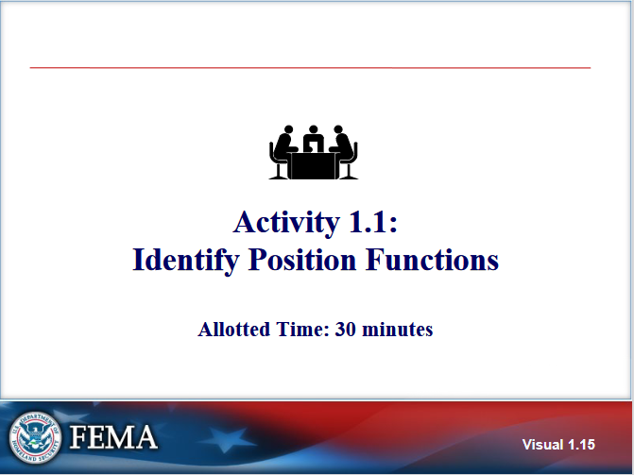

Slide 20
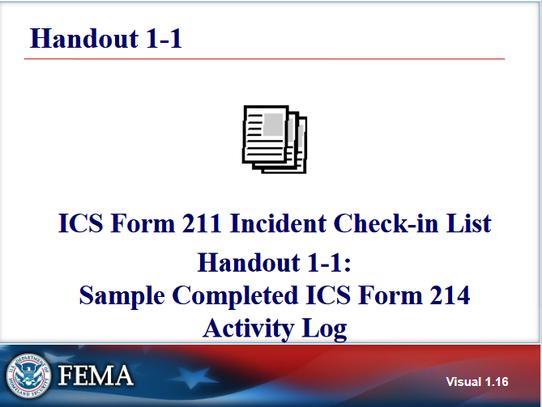

Slide 21
ICS 214 – Activity Log
Last page of every IAP
Good place to record cell numbers of each person working for you
Good place to record emergency contact info of those working for you
3 A’s
Actions – Agreements -- Accidents
3 I’s
Information – Issues -- Ideas
3 D’s
Disagreements – Disputes -- Disruptions

Slide 22
