Slide 1
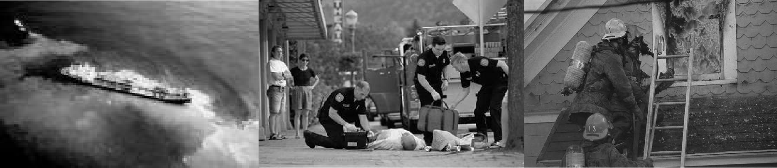
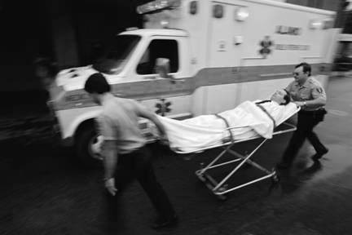
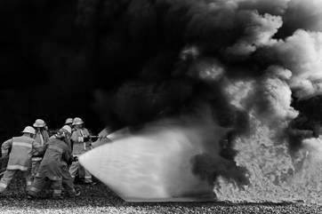
ALL-HAZARDS LIAISON OFFICER

Slide 2
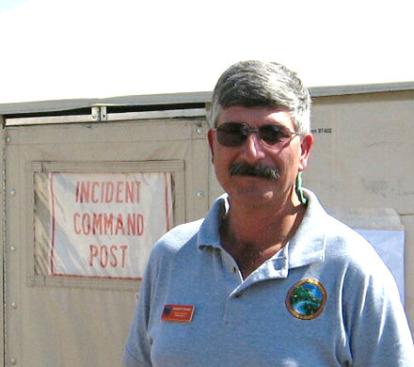

Instructor Introductions
Bob Panko
    Bob and ICS grew up together starting in 1982
    Retired in Nov 2007 after 36 calendar years with NPS.
    Ranger / Supv Ranger / Asst Chief Ranger (LE, Emer. Management)
    USNPS Fire & Aviation Man Officer Everglades NP (Wildland Fire)
    ICT2 – Southern Area IMT2 & NPS All Hazard 1994-2004)
    Southern Area Type 1 & 2 IMT’s 2004-2015 (IC / OSC / LOFR)
    2016- Operations SC NY State IMT
    Risky Business Incident Management LLC
    Central Pine Barrens Commission Fire Management Specialist Oct 2019
Photo courtesy TIME Magazine, June 1986

Slide 3
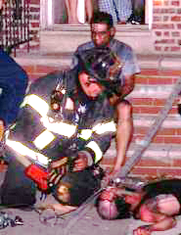
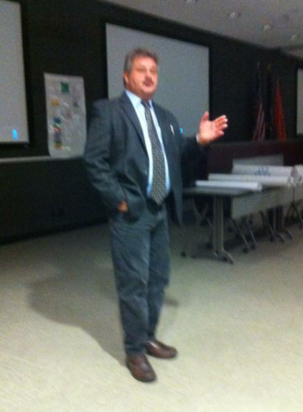
Instructor Introductions – Instructor Jim Hay
  Captain FDNY with 30 years in the department
  Retired from FDNY 2012
  Member of FDNY National Type 2 IMT as Information Officer, Liaison Officer and Haz-Mat Specialist since the Team was formed in 2004
  Multiple out of state assignments with FDNY IMT for wildland fires, floods and hurricanes
  Presently Director of Fire & Life Safety for USTA Billie Jean King National Tennis Center
  Instructor/Coach NY DHSES
  Member NY State IMT2
  NYWIMA instructor/ICS coach

Slide 4
Student Introduction Questions
I am a member of a local or State IMT and am working to develop my qualifications at the Command & General Staff level
I have been on multiple assignments as an Agency Rep or Liaison Officer working at Incident Command Posts or Emergency Operations Centers
I have worked on many incidents or planned events working as a Command & General Staff member
Most of my incident experience has been as a Single Resource or Strike Team / Task Force / Unit Leader.

Slide 5
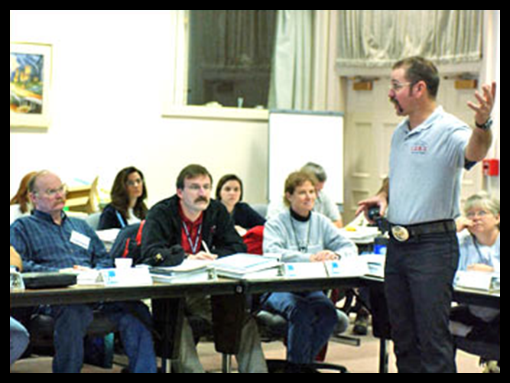
Student Introductions
Name & Day Job
Incident Response Experiences
Reasons for being a Liaison Officer
Expectations from this course
1-5
Notes:
INTRODUCTIONS
Instructor introduction
Brief background
Student introduction
Self introductions
Incident response experiences
Why be a Operations Section Chief?

Slide 6
Operational Period Briefing
Current Situation
Objectives
Predictive Information
Assignments
Safety
Logistics
Finance
Planning
Information
Liaison
Agency Reps / Agency Administrator
Close Out

Slide 7
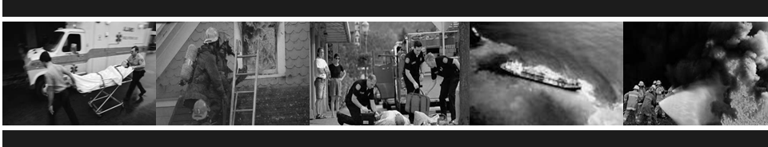
Course Objective
Upon completion of this course, students will demonstrate, through exercises and a final exam, an
understanding of the duties, responsibilities, and capabilities of an effective Liaison Officer.

Slide 8
Course Design
Course length of 2 days
Combination of lecture, discussion, and exercises
Closed-book Final Exam
Course was designed under the assumption that students have completed ICS 100, 200, 300, 700, and one of the following:
  All-Hazards Incident Management Team Training(O-0305)
  Command & General Staff Training for Local IMT(O-0337)
  ICS 420
ICS 400 is also recommended

Slide 9
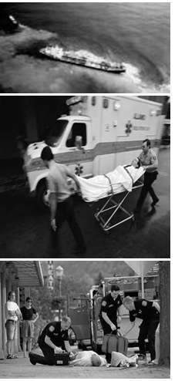
All-Hazards Curriculum
ICS origins in fire
All-Hazards
The fundamentals of the job are the same regardless of incident type

Slide 10

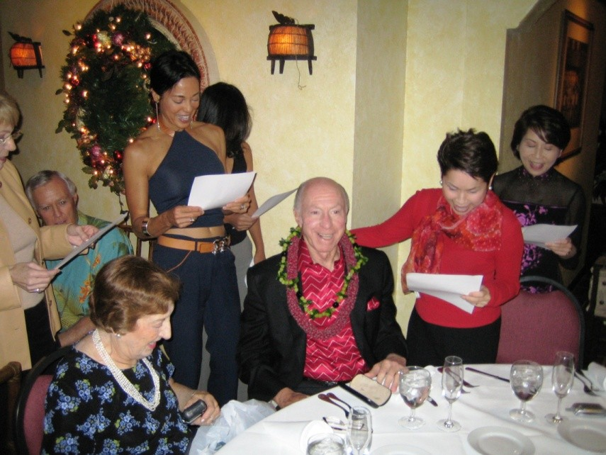
Discussion Activity

Slide 11

Course Scope / Competencies

Slide 12
Position Task Books

Slide 13
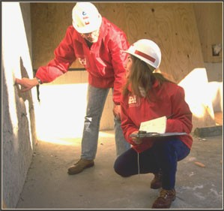
EXERCISE 1

Slide 14
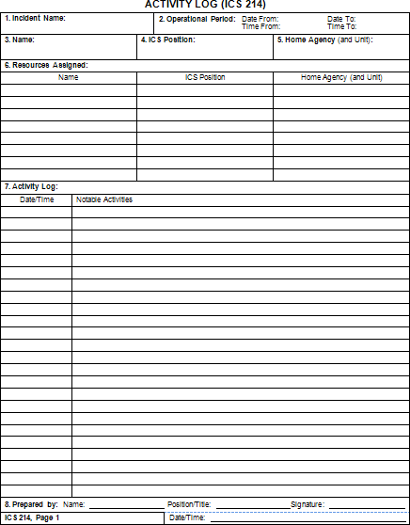
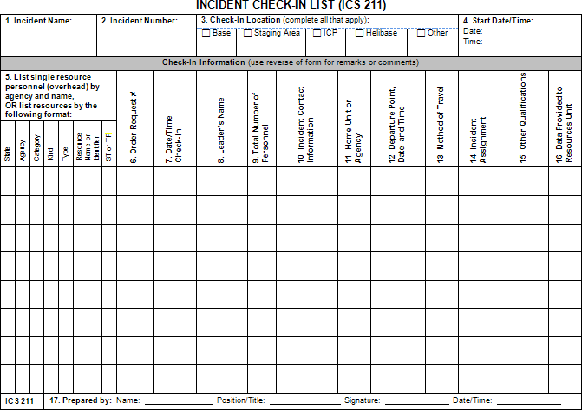
Handout 1-1
ICS Form 211: Check-In List
ICS Form 214:
Activity Log

Slide 15
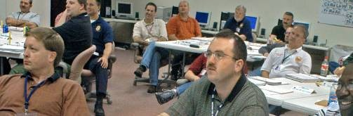
Objectives Review
What is the course objective?
What is the purpose of Position Task Books?

