Slide 1
Unit 2
Position Concept

Slide 2
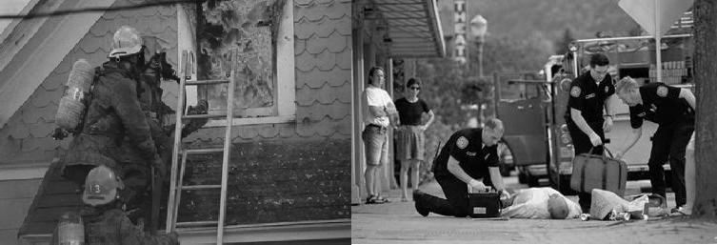
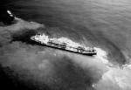
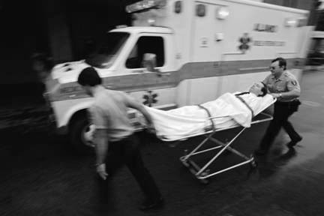
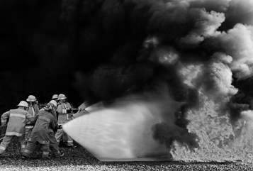
Unit Terminal Objective
Understand the role and responsibilities of the Liaison Officer as a member of the command staff.

Slide 3
Unit Enabling Objectives
Describe the roles and responsibilities of the Liaison Officer
Describe the relationship between the Liaison Officer and the Agency Representative
Describe the relationship between the Liaison Officer and the other IMT members
List qualities and behaviors that lead to the success of the Liaison Officer
Define, compare, and contrast: Assisting Agencies, Cooperating Agencies, Non-Governmental Organizations
List other common duties a Liaison Officer may encounter

Slide 4
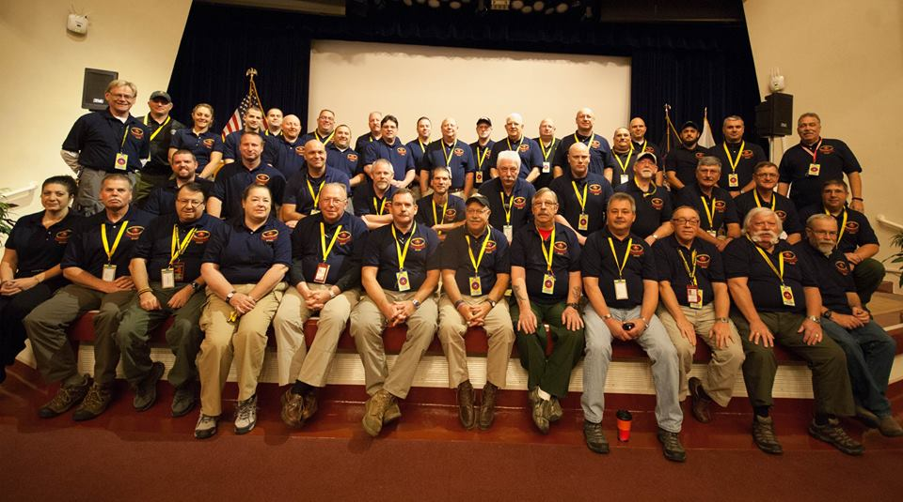
Definition of Incident Management Team (IMT)
The Incident Commander (IC) and appropriate Command and General Staff personnel assigned to an incident (NIMS definition).

Slide 5
Liaison Officer Position in the IMT
Incident Commander (IC)
Incident Commander
(IC)
Liaison Officer (LOFR)
Public Information Officer (PIO)
Safety Officer (SOFR)
Liaison Officer
(LOFR)
Public Information
Officer (PIO)
Safety Officer
(SOFR)
Liaison Officer Assistant
Public Information Officer Assistant
Safety Officer Assistant
Liaison Officer
Assistant
Public Information
Officer Assistant
Safety Officer
Assistant

Slide 6
Liaison Officer Position in the IMT
Incident Commander
Incident
Commander
Public
Liaison Officer
Public
Information Officer
Liaison Officer
Information Officer
Safety Officer
Safety Officer
Finance Admin
Operations
Planning
Logistics
Finance
Admin
Operations
Planning
Logistics

Slide 7

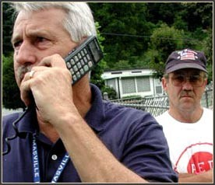
Liaison Officer Job Functions
The Liaison Officer is a member of the Command Staff
Liaison Officer is the conduit for communication between the Incident Management Team and the AREP

Slide 8
Interaction with the IMT
Participates in the planning process to collect and share resource and AREP info:
  The “Go To” team member for Assisting and Cooperating agency info
  Ensures the Incident Management Team (IMT) understands the appropriate use of resources from assisting agencies

Slide 9
Interaction with the IMT (cont.)
Coordinates flow of information between AREPS and Incident Management Team
Troubleshoots problems with other agencies
Monitors for developing situations that Incident Management Team needs to know
Handout 2-1: Expectations of IMT Members

Slide 10
A Successful Liaison Officer…
Works to be easily approachable
Adjusts to the unique “personality” of each incident
Is attentive to special concerns during transition

Slide 11
NRF/NIMS Definition of AREP
“A person assigned by a primary, assisting, or cooperating Federal, State, local, or tribal government agency or private entity that has been delegated authority to make decisions affecting that agency’s or organization’s participation in incident management activities following appropriate consultation with the leadership of that agency.”
Handout 2-2: Agency Fit on an Incident

Slide 12
Interaction with the Agency Representative (AREP)
AREPs interface with the Liaison Officer
AREPs work for their agency, not the incident
A complete discussion on AREP duties will be included in Unit 3

Slide 13
Other Agencies
Assisting Agencies
Cooperating Agencies
Non-Governmental Organizations (NGO) may serve as Assisting or Cooperating

Slide 14
Other Agencies
Support Functions of Assisting Agencies
Incident Commander
Support Functions of Cooperating Agencies
Incident
Commander
Public Information Officer
Liaison Officer
Public
Information Officer
Liaison Officer
Safety Officer
Safety Officer
Operations
Planning
Logistics
Finance Admin
Operations
Operations
Operations
Planning
Logistics
Finance
Admin

Slide 15
Other Types of Liaison Officers
Only 1 Incident Management Team Liaison Officer per incident
Other types of Liaison Officers may be encountered
Other Agencies may have Liaison Officers as permanent positions:
  TSA
  Military
  EPA
  Others

Slide 16
Other Liaison Officer Duties
Meeting and briefing local Multi-Agency Coordination (MAC) or other organizations
Coordinating VIP visits
Coordinating with Stakeholders

Slide 17
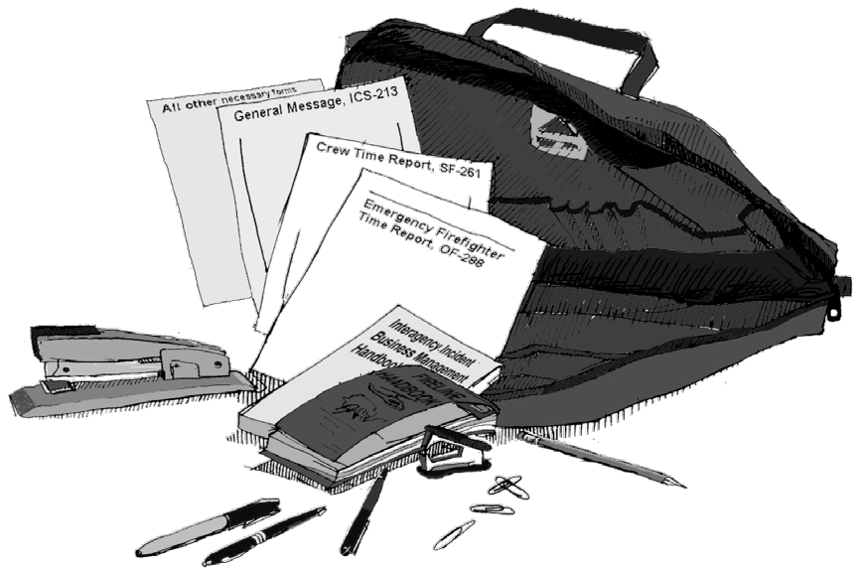
Discussion 1
Liaison Officer Kit
Handout 2-3: Liaison Officer Kit

Slide 18
Objectives Review
What are the roles and responsibilities of the Liaison Officer?
What is the relationship between the Liaison Officer and Agency Representatives?
What is the relationship between the Liaison Officer and the other Incident Management Team members?

Slide 19
Objectives Review (cont.)
What are the qualities and behaviors that lead to Liaison Officer success?
What are:
  Assisting Agencies
  Cooperating Agencies
  Non-Governmental Organizations?
What are other common duties an Liaison Officer may encounter?

