Slide 1
Unit 4
Stakeholders
Visual 4-1

Slide 2
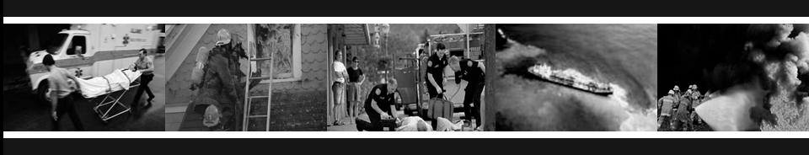
Unit Terminal Objective
Understand the roles and responsibilities of the Liaison Officer regarding stakeholders, and evaluate Liaison Officer success.
Unit Enabling Objectives
Define Stakeholders
Describe the differences between the job functions of Liaison Officer and the Public Information Officer
Identify, profile, and prioritize Stakeholders
Discuss the importance of measuring Liaison Officer success with Stakeholders

Slide 3
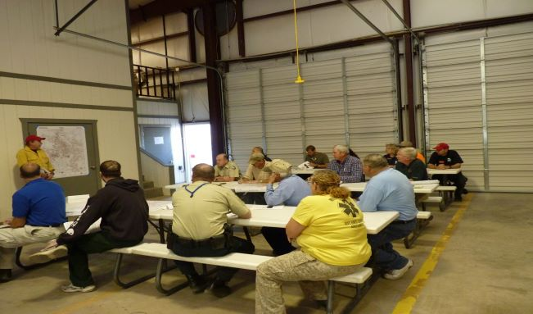
Discussion
Defining Stakeholders.

Slide 4



Stakeholders
Defined: “A person, group, or organization affected by or having a vested interest in the incident (i.e., marina owners, landowners, investigators, environmental trustees, etc.)”

Slide 5


The Team
The Liaison Officer and Public Information Officer both work for and represent the IC, so they must coordinate with each other to represent the incident accurately.
INCIDENT COMMANDER
PIO
LOFR

Slide 6
Discussion
Liaison Officer and Public Information Officer Job Functions.
Handout 4-1: LOFR vs PIO

Slide 7
Major Tasks of the LOFR Regarding Stakeholders
Identify
Profile
Prioritize

Slide 8
Identify and Profile Stakeholders
Sources to help identify stakeholders:
The IC/UC
Other IMT personnel
PIO or Joint Information Center (JIC)
Agency Executives
Local Sources (i.e. Public Officials)
Others

Slide 9
How to Profile
Profiles should describe:
Nature of the members in the Stakeholder group
Whom they trust and go to for information
What they believe
  Prevailing attitudes
  Knowledge
  Perception
What concerns and worries motivate their actions

Slide 10

Prioritizing Stakeholders
Stakeholder Examples:
Inner Circle - Elected Officials
Middle Circle - Homeowners, Local Merchants
Outer Circle - General Public

Slide 11

Forums
Inner Circle
  Example: Elected Officials

Slide 12

Forums
Middle Circle
  Example: Homeowners, local merchants

Slide 13

Forums
Outer Circle
  Example: General public

Slide 14
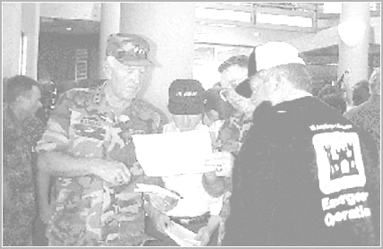
Exercise 2
Prioritizing Stakeholders.

Slide 15
IMT Planning Process
Communicating Stakeholder Issues
The Liaison Officer must keep the IMT informed on the importance of the stakeholders’ critical issues during the planning process. This is a must-do task.

Slide 16
Strategies for Handling Stakeholder Concerns
Some stakeholders want specific information
Other stakeholders will be satisfied with periodic updates

Slide 17
Mutual Gains
How can we obtain mutual gains between response organizations and stakeholders?

Slide 18
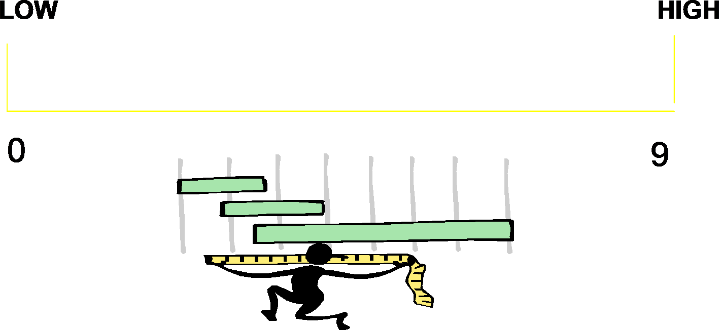
Measuring Success
The Liaison Officer must identify stakeholder satisfaction.
10

Slide 19
Methods of Measuring Success (Cont.)
Informal Evaluation
Suggestion Box
Surveys
Interviews

Slide 20
Objectives Review
What is a Stakeholder?
What are the differences between the job functions of Liaison Officer and Public Information Officer (PIO)?
How does the Liaison Officer identify, profile, and prioritize Stakeholders?
Why is it important to measure success with stakeholders?

