Slide 1
Unit 5
Incident Communications and Work Location
Visual 5-1

Slide 2
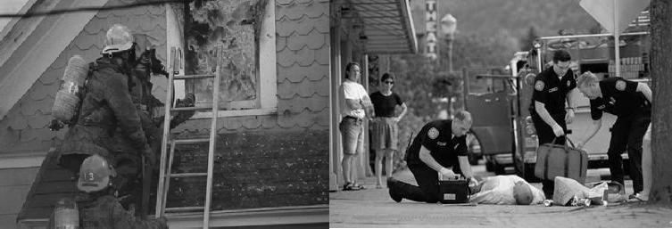
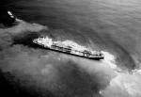
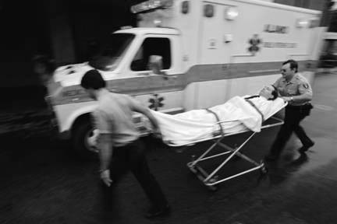
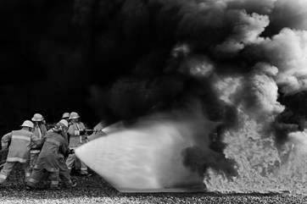
Unit Terminal Objective
Identify types of communication and work location needs for a given incident
Given an incident assignment, identify and list the means and types of communications that are used to keep agency and incident personnel informed
Identify and list the requirements for a Liaison Officer work location

Slide 3
Communication Challenges
On a large incident the AREPs are constantly moving:
  Around the ICP
  Visiting agency resources
  To and From Lodging
  To and From Home office
Liaison Officer may have similar changes in location

Slide 4
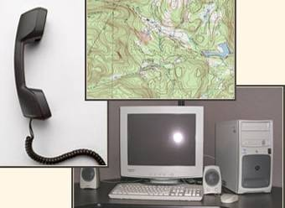
Discussion
“On-Incident” and
“Off-Incident” Communications
Coms On-Incident | Coms Off-Incident
IAP | IAP
Easel Chart w/cards
“AREP HERDING” IDEAS

Slide 5
Communication Priorities
Liaison Officers need to establish communication priorities
  Assisting agencies
    Agencies with the largest number of resources
    Agencies with more critical resources
  Cooperating agencies
    Law enforcement for temporary assistance
    Red Cross
Bastrop Complex Priorities

Slide 6
Work Location
Where to be located:
  At or near the Incident Command Post (ICP)
  Not in same location as the Incident Command
  Near the Planning Section, if possible

Slide 7
Work Location (cont.)
ICICIC
--- ---
--- ---
LOLOLOFRFRFR PIPIPIOOO
ICICIC
IC
-
-
ICP Set Up
-
-
LOFR
PIO
Unit 5:
Visitors Go Through Bottleneck
Incident Communications and Work Location

Slide 8
Work Location (cont.)
Things to do:
  Advise the Communications Unit where you are located
  Use bulletin boards, if possible
  Put up signs
Visual 5-8

Slide 9
Work Location (cont.)
Things to have:
  Adequate number of potential assistants
  Space for AREP workspace and briefing area
  Adequate communications capability
  Weather and creature comforts
Visual 5-9

Slide 10
Check-in Locations
Incident Command Post
Staging Areas
Base
Camps
Helibases
At a Division/Group
Visual 5-10

Slide 11
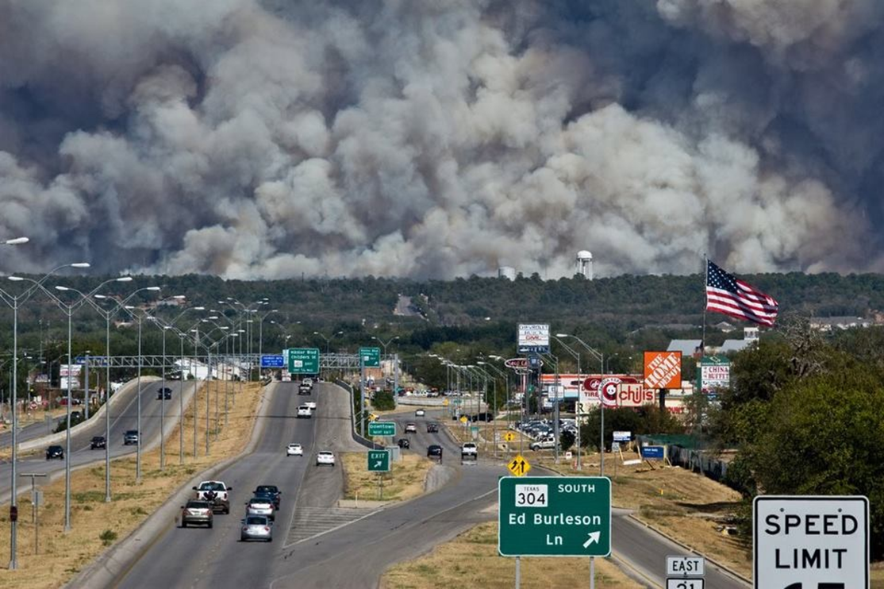
The Bastrop Complex Liaison Officer Tale
Things We Did in Liaison
Assistant & Trainee because of multiple OPB locations & times
Work station location
  Near Safety & Operations
  Chow Line
Easel pad display / business cards
AREP meetings post OPB & pre/post Planning Mtg
Use of General Message forms
Facilitation with Sheriff
Utility companies
Bastrop county branching problem
Best Practice's
Always evaluate complexity & staff accordingly
Establish work station and static display of information
Arrange AREP meeting times that work around the Planning cycle schedule
Use of Gen. Msg forms enable quick distribution of intel & documentation
Brief AREPS about Mtgs & Briefings beforehand
Distribute IAP’s & Situation Reports s to AREP’s / Stakeholders. Explain them to them.

Slide 12
Objectives Review
Given an incident assignment, what are the types and means of communication that are used to keep agency and incident personnel informed?
What are the requirements for a Liaison Officer work location?
Visual 5-12

