Slide 1
Unit 6
Information Flow and Use of Assistants

Slide 2
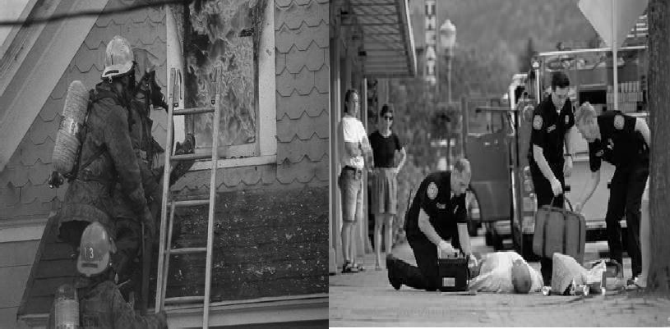
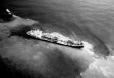
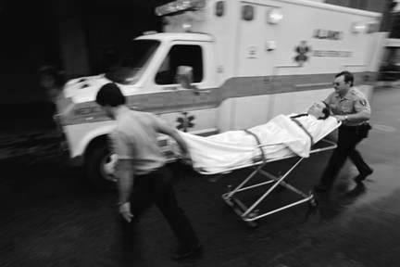
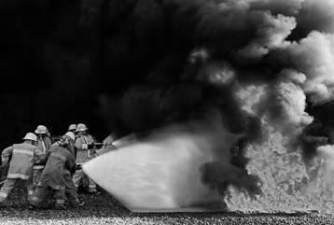
Unit Terminal Objective
Describe the process and relevant parties involved in incident information flow, including the role of Assistant Liaison Officers.

Slide 3
Unit Enabling Objectives
Describe how to obtain status and information about Assisting and Cooperating Agencies
Describe what information the Liaison Officer is required to obtain from participating agencies
Describe what information the Liaison Officer should provide to the AREP
Describe how to identify and list the information needed from AREPs for the Incident Planning Meeting
Describe what information the Liaison Officer needs to provide for the Incident Status Report

Slide 4
Identify and Gather Involved Agency Information
Obtain a briefing from the IC or Agency:
Informal Briefing
Formal Briefing
Handout 6-1: Essential Elements from an Agency Official Briefing
Visual 6-3

Slide 5
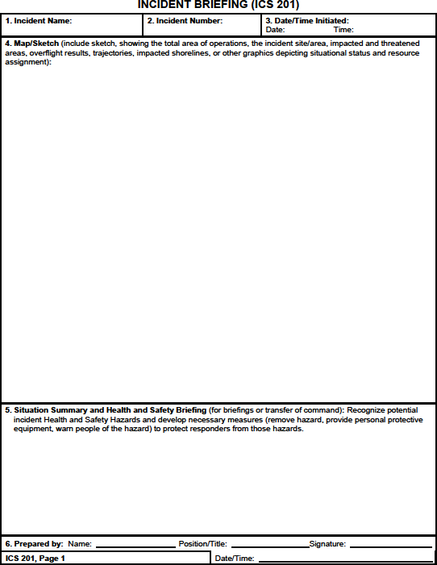
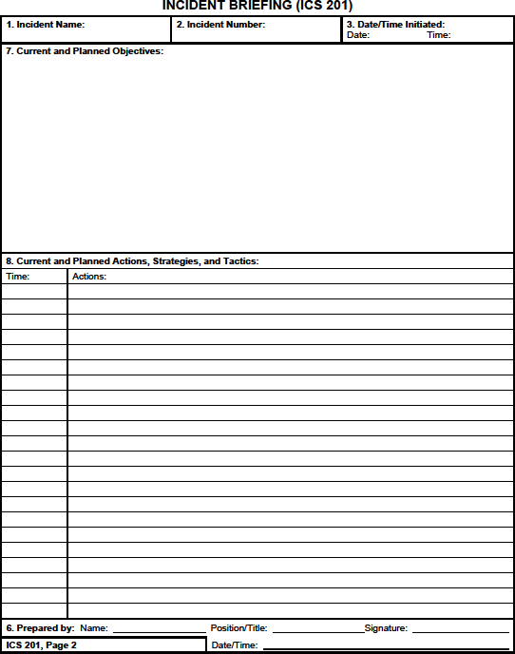



ICS Form 201 – Incident Briefing
Handout 6-2: Completed ICS Form 201

Slide 6
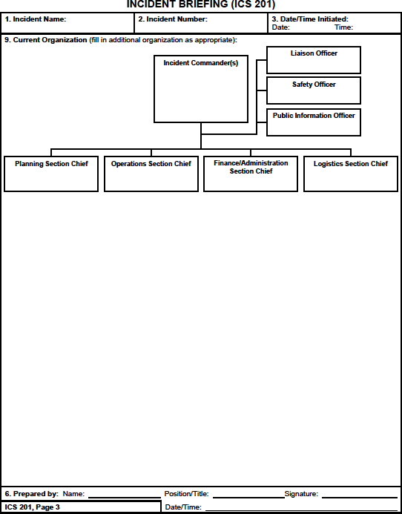
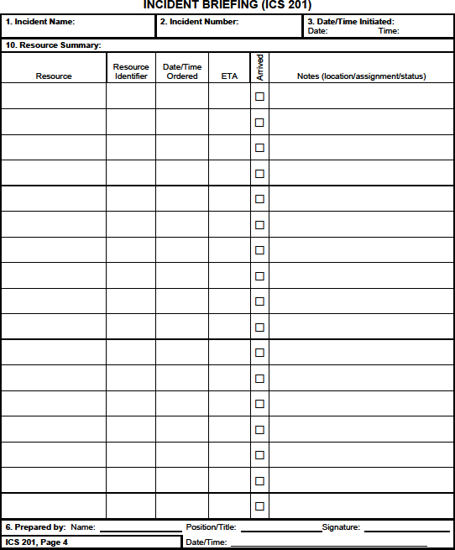



ICS Form 201 (cont.)

Slide 7
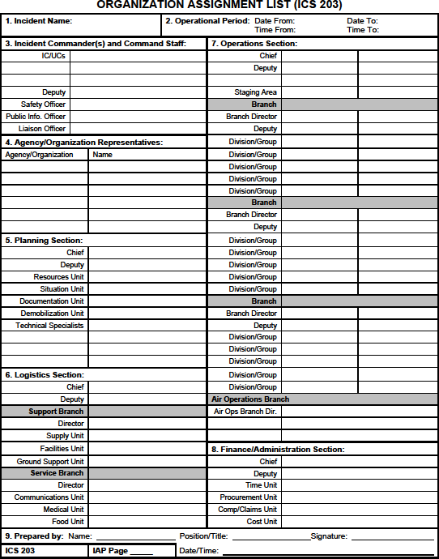
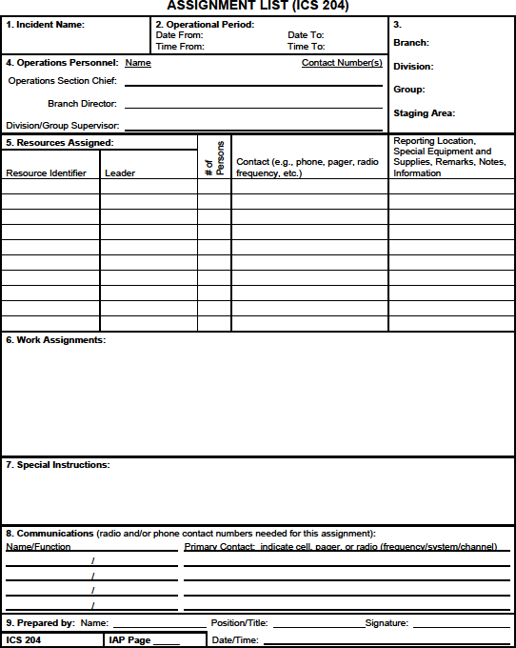

Incident Action Plan (IAP)
Handout 6-3: Sample IAP

Slide 8
Other Sources of Information
Contact Agency Personnel On-Scene
EOC
Nearest Agency Office
What if there is no AREP assigned?

Slide 9
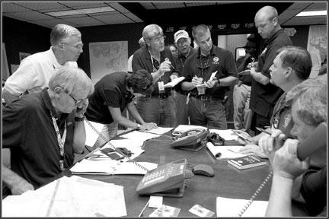
Discussion
Collecting Information From AREPs
Handout 6-4: Collecting Information From AREPs

Slide 10
Agency Information AREP Provides
Required to safely, effectively and efficiently use agency resources
Liaison Officer coordinates the information flow
AREP may work closely with either the IMT or Liaison Officer depending on style of IMT

Slide 11
Information the LOFR Must Provide to the AREP
Special instructions from the IC
Information obtained at initial briefings
Copy of the Incident Action Plan (IAP)
Assignment of agency resources

Slide 12
Information the LOFR Provides the AREP
Your contact information
IMT roster and contact information
Future needs of agency resources

Slide 13
Sensitive Law Enforcement Information
Screen information
Identify Law Enforcement (LE) contact for AREPs
May be a Joint Operation Center (JOC)

Slide 14
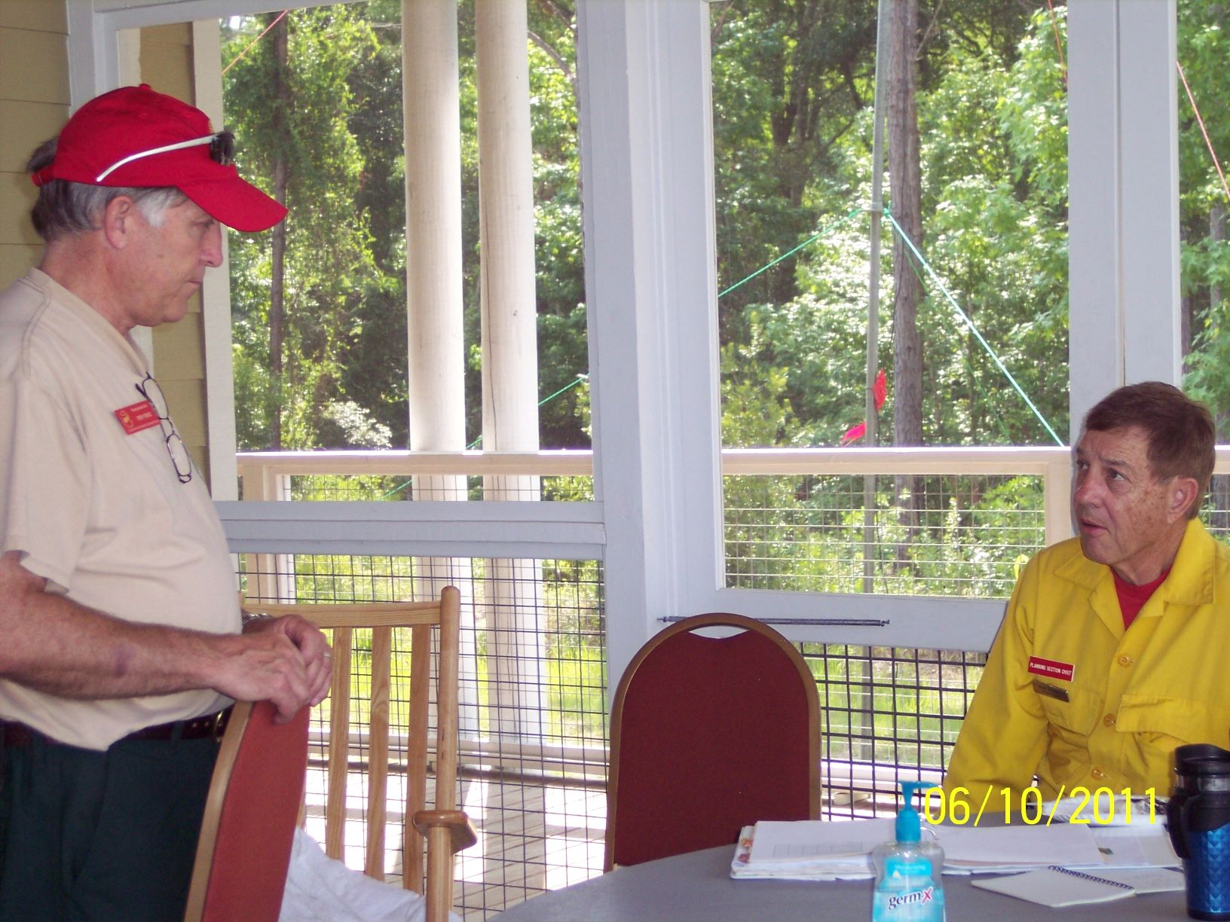
Exercise 3
Information Flow From the Liaison Officer to the AREP.
Agency Representative
Liaison Officer

Slide 15
Information Sharing Among the IMT
Personnel capability and restrictions of the agency
Equipment type and kind – Limitations
Crew replacement – “Timed out”
Agency restrictions – Local government
Psychological impact on personnel
Other

Slide 16
Incident Situation Reporting
Agency Specific Situation Report
ICS Form 209 – Incident Status Summary
Other

Slide 17
Internal and External Documents
Used for:
Headquarters Briefings
Agency Briefings
Media
Public

Slide 18
Assistant Liaison Officer
Assign work duties as needed:
Consider the use of other involved agencies
Span-of-Control
Organize Information Flow
Split Workload
Manage Work Area

Slide 19
Sample Liaison Officer Organization Chart
Liaison Officer
Assistant
Liaison Officer for Cooperating Agencies
Assistant
Liaison Officer for Assisting Agencies
Assistant Liaison Officer for Internal Activities

Slide 20
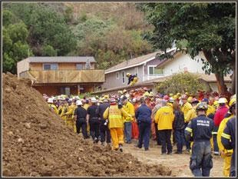
Exercise 4
Work Load Indicators and Use of Assistants.

Slide 21
Objectives Review
How can the Liaison Officer obtain status and information about Assisting and Cooperating Agencies?
What information must the Liaison Officer obtain from participating agencies?
What information should the Liaison Officer provide to the AREP?

Slide 22
Objectives Review (cont.)
What information should the Liaison Officer provide to other IMT members?
What information does the Liaison Officer need to provide for the Incident Status Report?

