Slide 1
Unit 7
The Planning Process
Visual 7-1

Slide 2
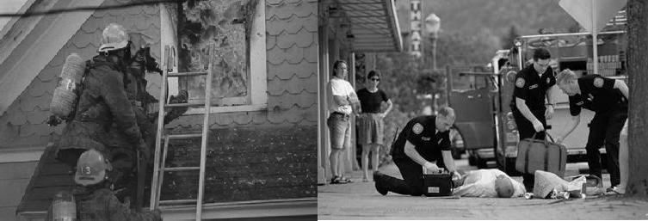
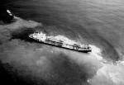

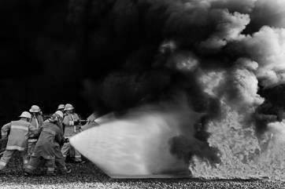
Unit Terminal Objective
Know how the Liaison Officer fits into the planning process

Slide 3
Unit Enabling Objectives
Describe the components of the planning cycle
Describe the responsibilities of the Liaison Officer in the ICS planning process

Slide 4
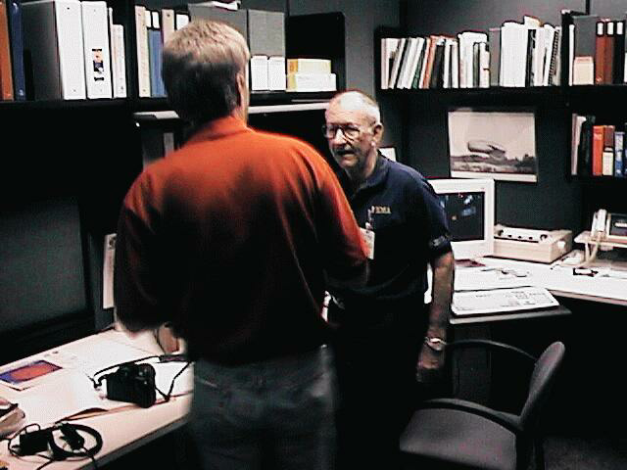
Liaison Officer Role in Incident Planning
Plays a critical role in coordinating the use of resources from Assisting Agencies
Ensures Agency Representatives are available and provide required information in a timely manner
Ensures problems are resolved and opportunities are identified prior to the Planning Meeting

Slide 5
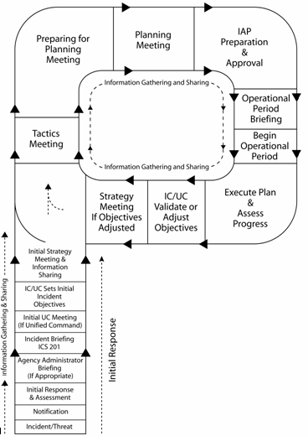
The Planning Cycle
Handout 7-1: The Planning P
Handout: LIAISON OFFICER DAILY ACTIONS / NEEDS

Slide 6
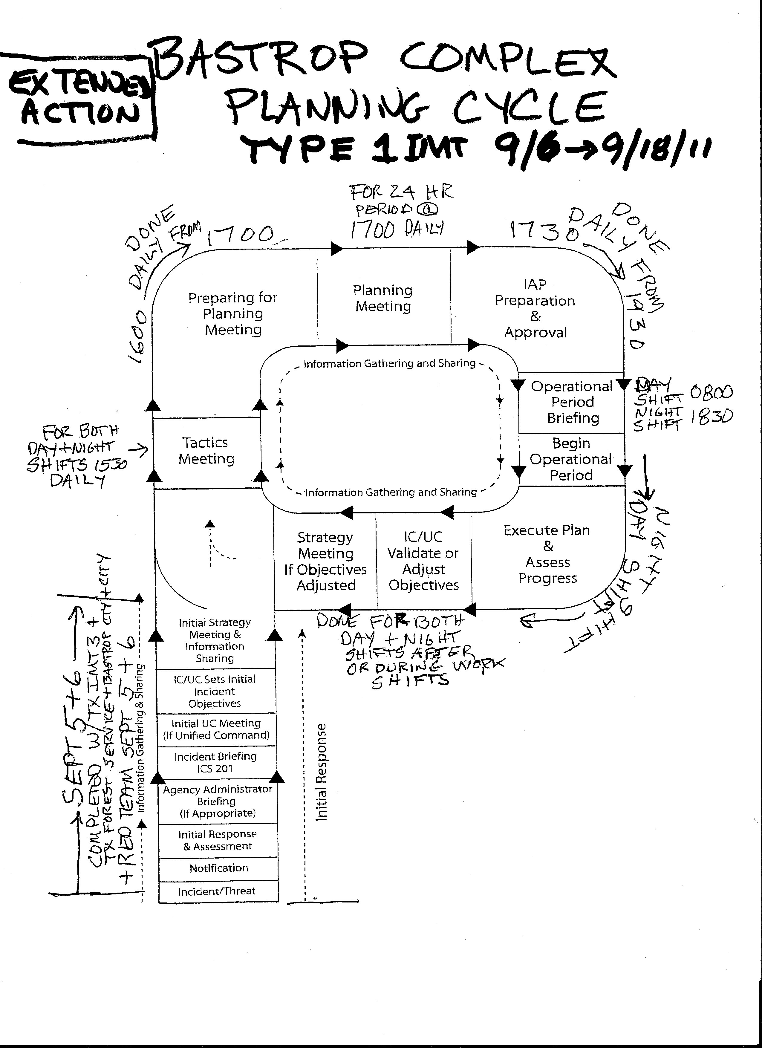
Planning Steps and Meetings
Initial Incident Briefing
Command and General Staff
Initial Briefing for AREPs
Tactics Meeting
Preparing for Planning Meeting with AREPs
Planning Meeting
Assemble the Incident Action Plan parts
Incident Action Plan distribution
Operations Briefing

Slide 7
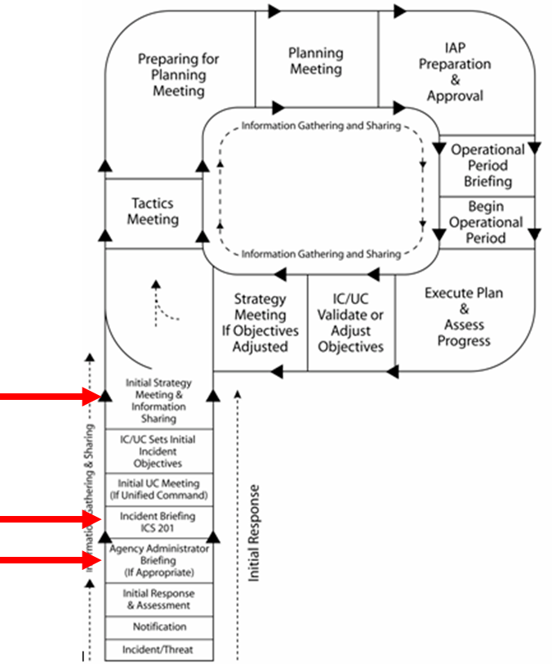
Role of the Liaison Officer
Initial Incident Briefing
  Gathers information on Assisting and Cooperating Agencies that are or will be on the incident
Command and General Staff Meetings
  Provides information to the IMT concerning important issues with other agencies
Initial Briefing for AREPs
  Provides information regarding required information for the planning process

Slide 8
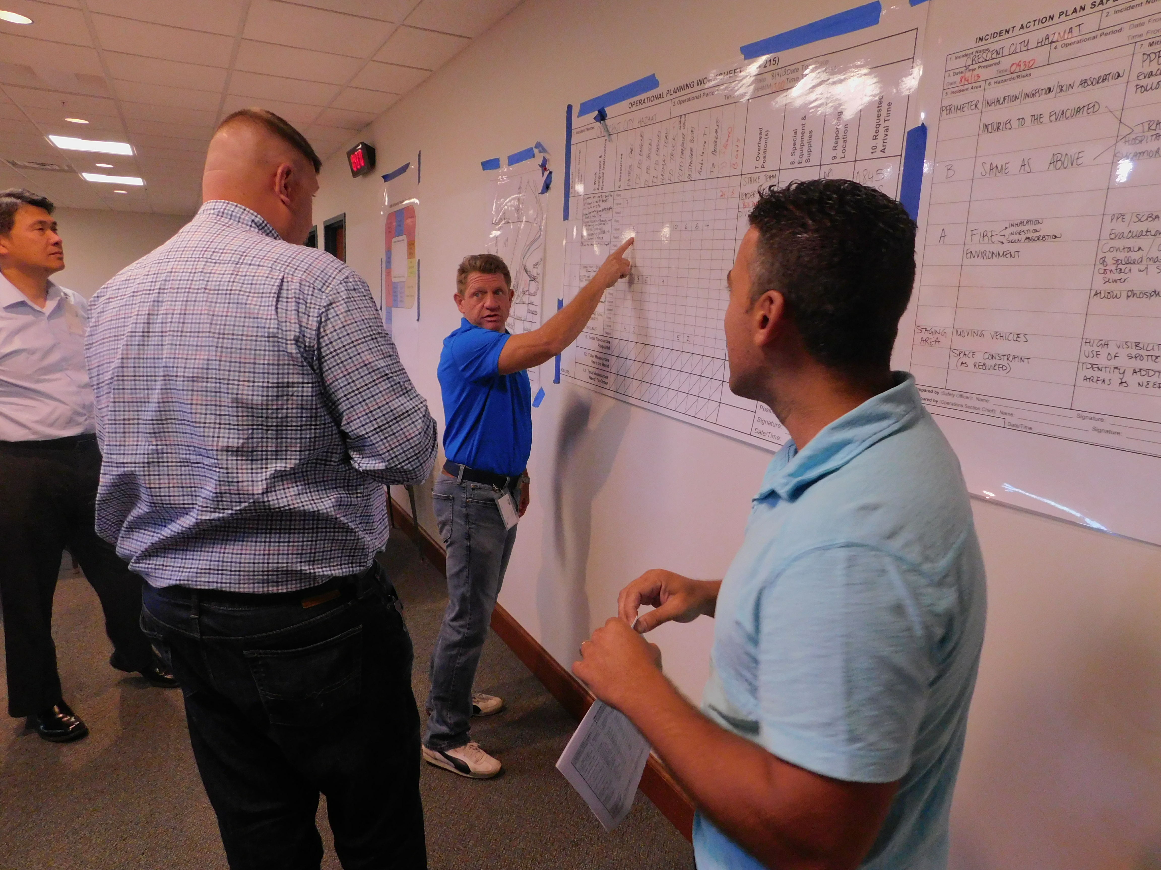
Role of the Liaison Officer (cont.)
Tactics Meeting
  If requested to attend by the OSC, provides information on the capabilities and limitations of resources to accomplish proposed tactics
Preparing for the Planning Meeting
  Ensures Agency Representatives can support the proposed assignments of their resources
Planning Meeting
  Attends the meeting and coordinates interaction with the AREPS

Slide 9
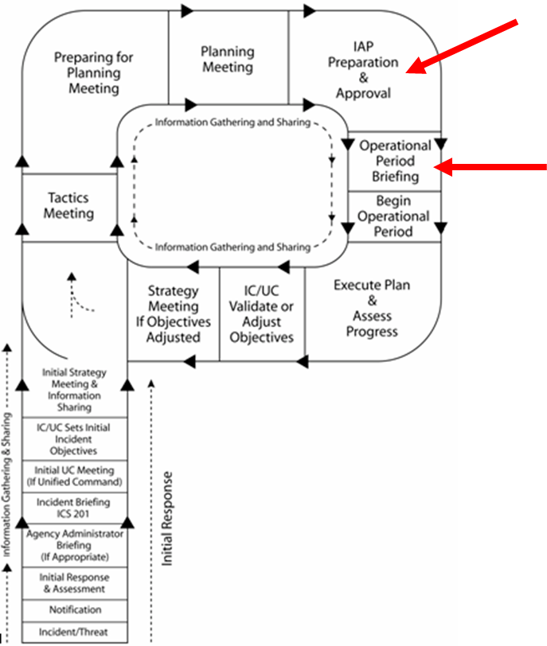
Role of the Liaison Officer (cont.)
Assemble Incident Action Plan Parts
  Ensures coordination between AREPs and the RESL on specific assignments of resources
Incident Action Plan Distribution
  Ensures Agency Representatives and their Resource Leaders receive copies of the plans
Operations Briefing
  Ensures critical information is getting to Assisting Agencies

Slide 10
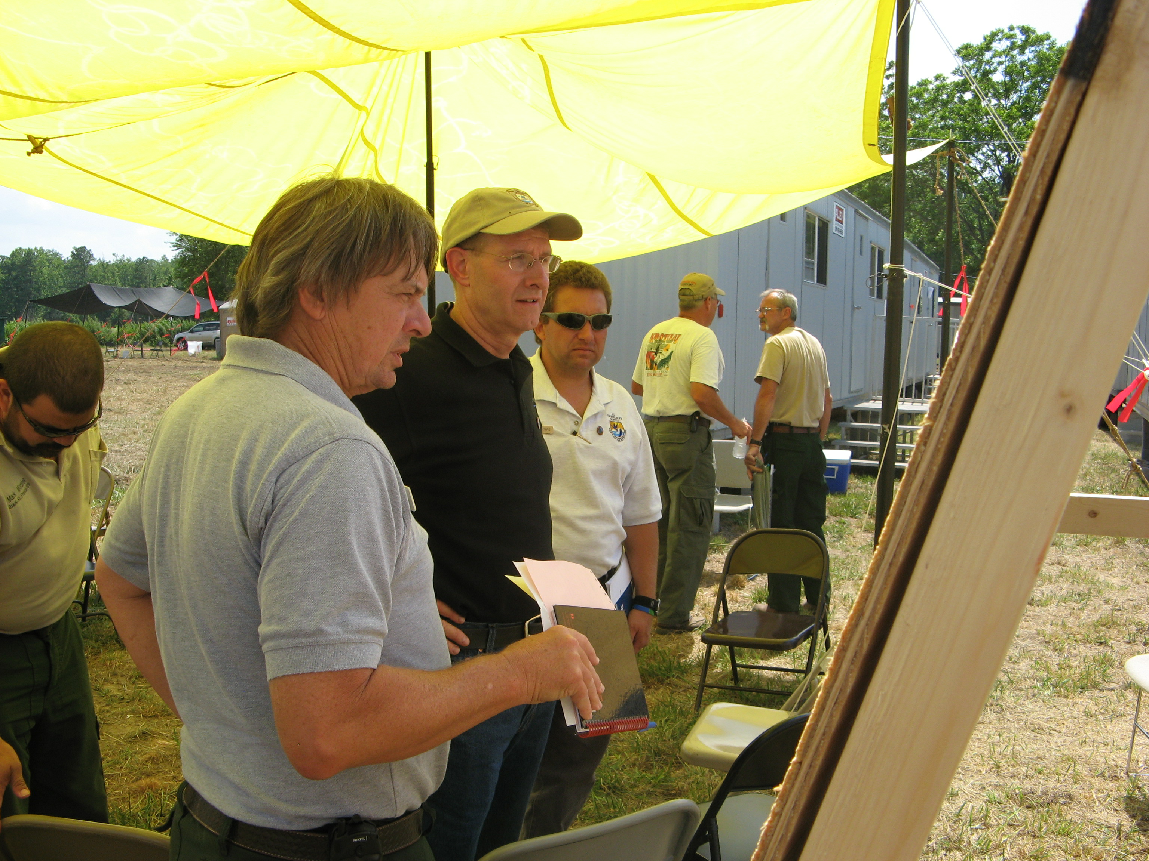
Special Meetings
Demobilization meeting
Meetings when conditions change
Contingency planning
VIP visiting from Assisting or Cooperating Agencies
Other

Slide 11
Objective Review
1. What are the responsibilities of the Liaison Officer in the ICS Planning Process?

