Slide 1
Unit 8
Special Situations
Visual 8-1

Slide 2
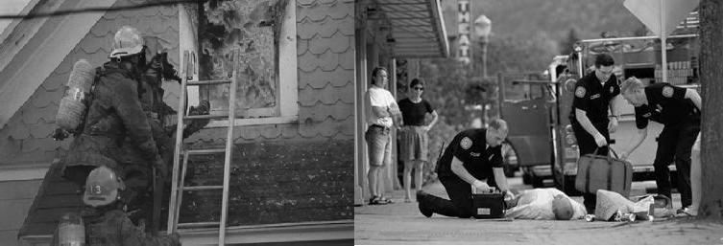
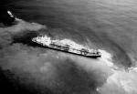
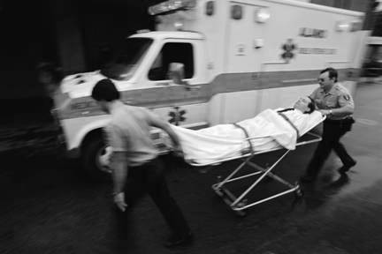
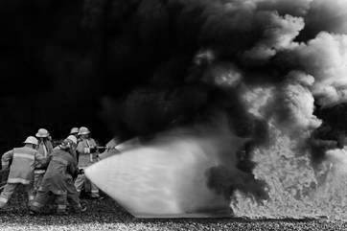
Unit Terminal Objective
Describe how to determine the proper steps to follow in the event of a special situation.

Slide 3
Unit Enabling Objectives
Provide three examples of special situations
Describe appropriate actions for the Liaison Officer to take in response to a special situation in a given scenario

Slide 4
What Are Special Situations?
Accidents or injuries
Unexpected problems involving other agency personnel
Problems back home
VIP visits
Issues or problems with stakeholders
Other

Slide 5
Scenario 1
An Agency Representative from the local fire department reports that members of her USAR crew have been on this incident for five days and need to go home. Their employee union contract does not allow them to be away from their normal work site for more than 5 days.

Slide 6
Scenario 1 - Possible Textbook Answers
Contact Plans-determine status of crew.
Contact Finance to confirm number of days/hours they have been on the assignment and the exact time they need to be demobilized.
Find out if the fire dept has a replacement USAR crew.
Find out if it’s possible to extend this crew past 5 days.
Inform OPS, Plans, Logistics, Finance of the outcome.

Slide 7
Scenario 2
A strike team leader from an assisting agency stops you and wants to know where he can find his Agency Representative. He has not seen him in two days and wants to know when they are going to be released from the incident.

Slide 8
Scenario 2 - Possible Textbook Answers
Obtain this strike team leader’s contact info.
Track down the AREP or give this supervisor the AREPs contact info.
See if Plans or Operations knows the expected release date and give the supervisor this information.
Consider advising the AREP to be more available to his or her Agency resources.

Slide 9
Scenario 3
There has been an oil spill. A farmer arrives at the Incident Command Post looking for someone in charge. He tells you that a bulldozer has taken down 300 feet of his new fence, and his cattle are scattered near the oil spill. He wants to know who is going to fix the fence, round up his cattle, and when you are going to get off of his land.

Slide 10
Scenario 3 - Possible Textbook Answers
Obtain as much information as you can from the farmer, including contact info
Inform the following IMT members:
  IC
  OSC
  Plans (situation unit)
  Finance/Administration (comp/claims unit)
  PIO (FYI)
Determine what actions the IMT plans to take and notify the farmer
Continue follow-up with the farmer until the issue is resolved

Slide 11
Scenario 4
A State Trooper contacts the Law Enforcement Agency Representative and informs her that an incident vehicle has been involved in an accident with a civilian vehicle. There are injuries but the details are incomplete.

Slide 12
Scenario 4-Possible Textbook Answers
Immediately notify the following IMT members:
  Safety Officer
  Finance/Administration (compensation and claims)
  Logistics
    Medical Unit (FYI)
    Ground Support Unit
  IC
  PIO (FYI)
Provide liaison as needed, with the following:
  Investigation Team
  State Police
  Possibly the involved civilians

Slide 13
Objective Review
1. How do you determine the proper steps to follow in the event of a special situation?

