Slide 1

Unit 9
Demobilization
Visual 9-1

Slide 2
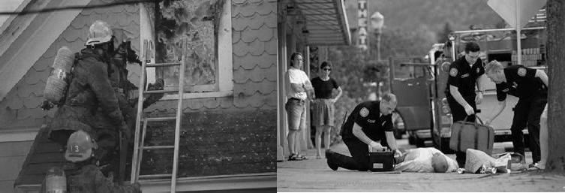
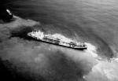
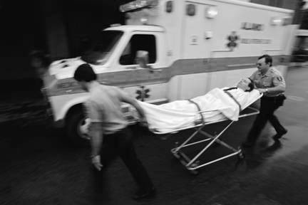
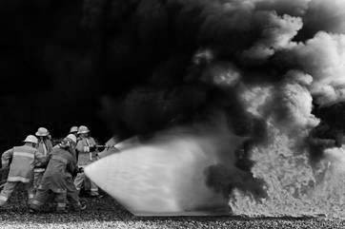
Unit Terminal Objective
Understand the Demobilization process as it relates to the duties of the Liaison Officer

Slide 3
Unit Enabling Objectives
Describe the Liaison Officer’s responsibilities throughout the demobilization process
Identify and list the information needed from Assisting and Cooperating agencies before and during incident demobilization

Slide 4
Responsibilities During Demobilization
Maintain constant interaction with other IMT members
Give input for release priorities for Assisting Agencies
Ensure documentation for Assisting and Cooperating Agencies is complete and submitted before leaving the incident
Sign-off tasks completed in the Position Task Book (PTB) for Liaison Officer Trainees
Complete Performance Evaluations ICS Form 226 - Performance Evaluations on all Liaison Officer Assistants

Slide 5
Personnel Performance Evaluations
As required by IMT or agency policy
Two special target groups:
  Trainees
  Exceptional performers (exceptionally good or exceptionally poor)

Slide 6
Personnel Performance Evaluations (cont.)
As required by IMT or agency policy
Two special target groups:
  Trainees
  Exceptional performers (exceptionally good or exceptionally poor)

Slide 7
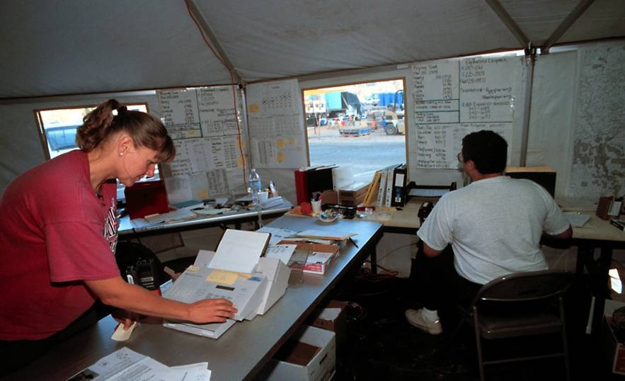
Evaluate Performance of Assigned Personnel
Evaluate individuals as required by agency policy
Complete ICS Form 226 (Individual Performance Rating) or equivalent agency form
Discuss with the individual

Slide 8
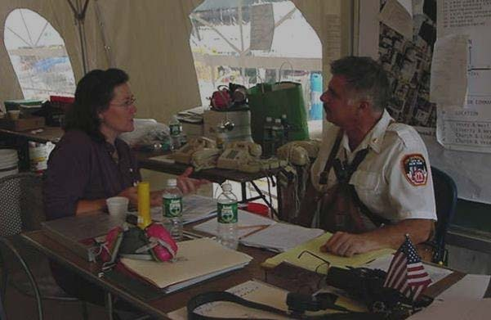
Exercise 5
Demobilization Information
Handout 9-1: Train Derailment Scenario Demobilization Plan

Slide 9
Objectives Review
What information does the Liaison Officer need from assisting and cooperating agencies before and during incident demobilization?
What are the Liaison Officer’s responsibilities throughout the demobilization process?

Slide 10
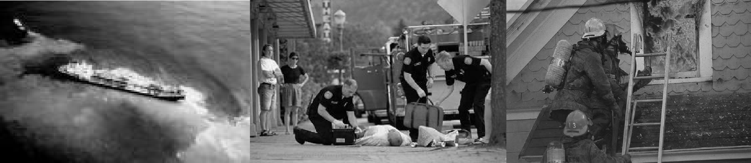
FINAL
Review of Course Expectations

Slide 11
After Action Review

Slide 12
FINAL
Course Final
Visual 9-11

