Slide 1
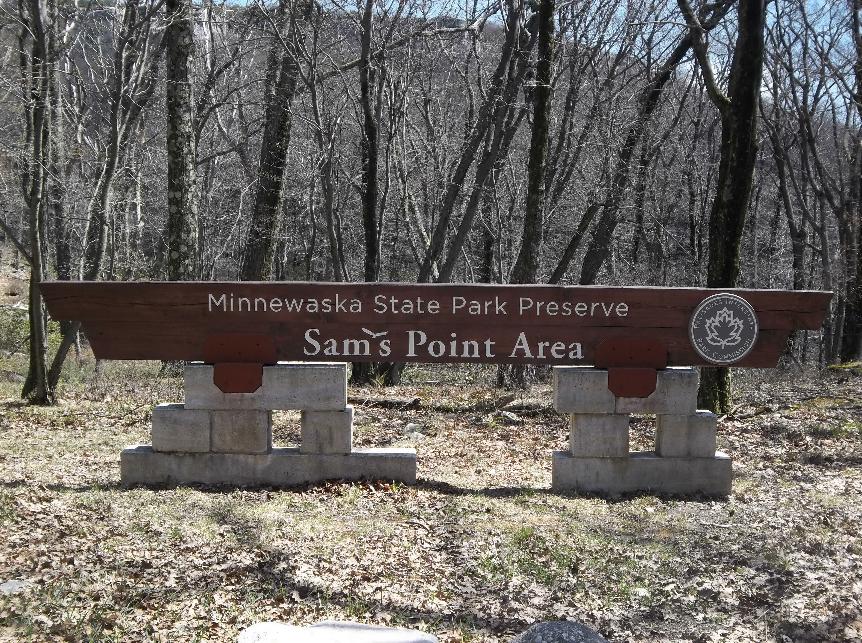
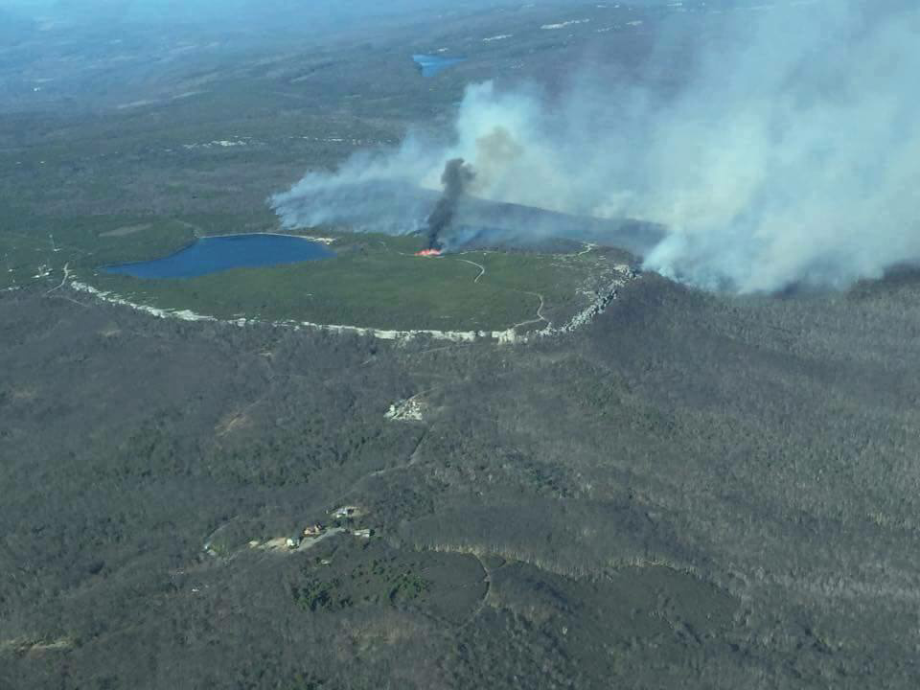
Sam’s Point Fire
April 22-May 01, 2016
Minnewaska State Park Preserve

Slide 2
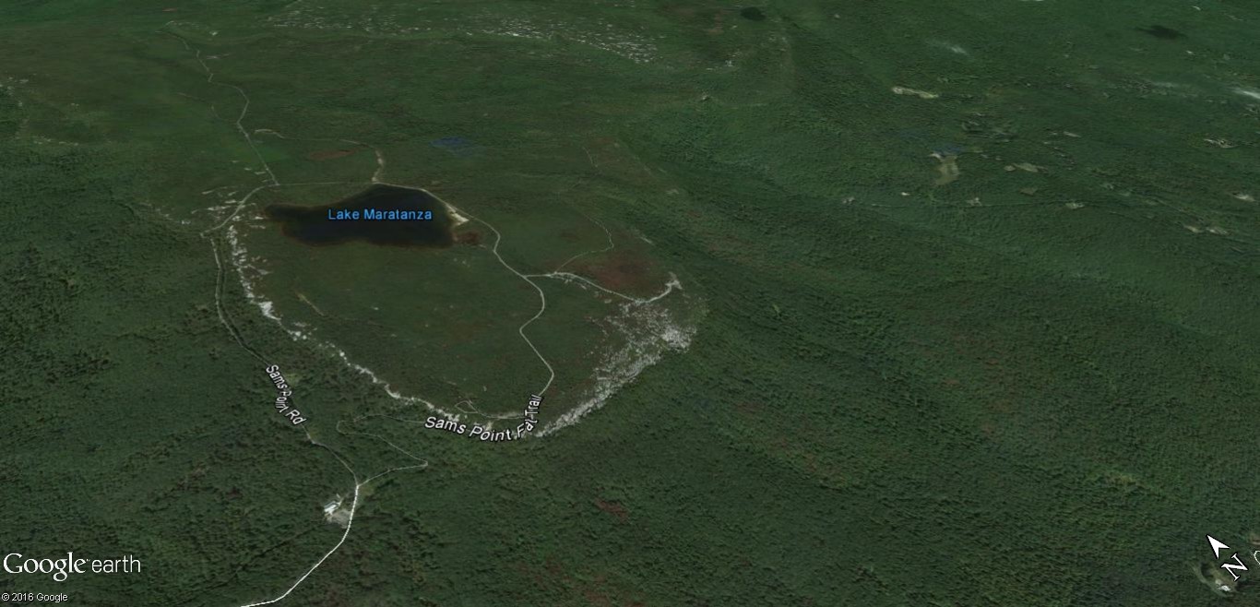
Fire Began Saturday 4/23/16 Near the Icecaves Road – By Sunday it was nearly 200 acres

Slide 3
Fuels and Features
Very old Dozer line that was marshy
Dense Pitch Pine on mountaintop
Rocky cliffs/boulder jumbles
Hardwood forest on lower slopes – open hardwood leaf litter & some thick Laurel stands

Slide 4
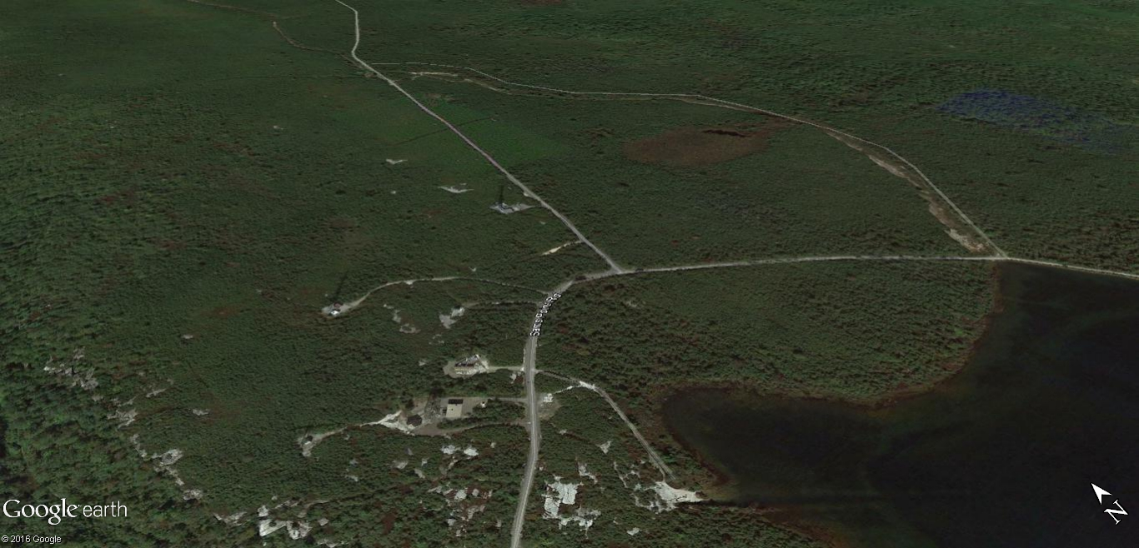
Communications Tower Farm – High $ value at risk (with huge propane tanks for backup generators)

Slide 5
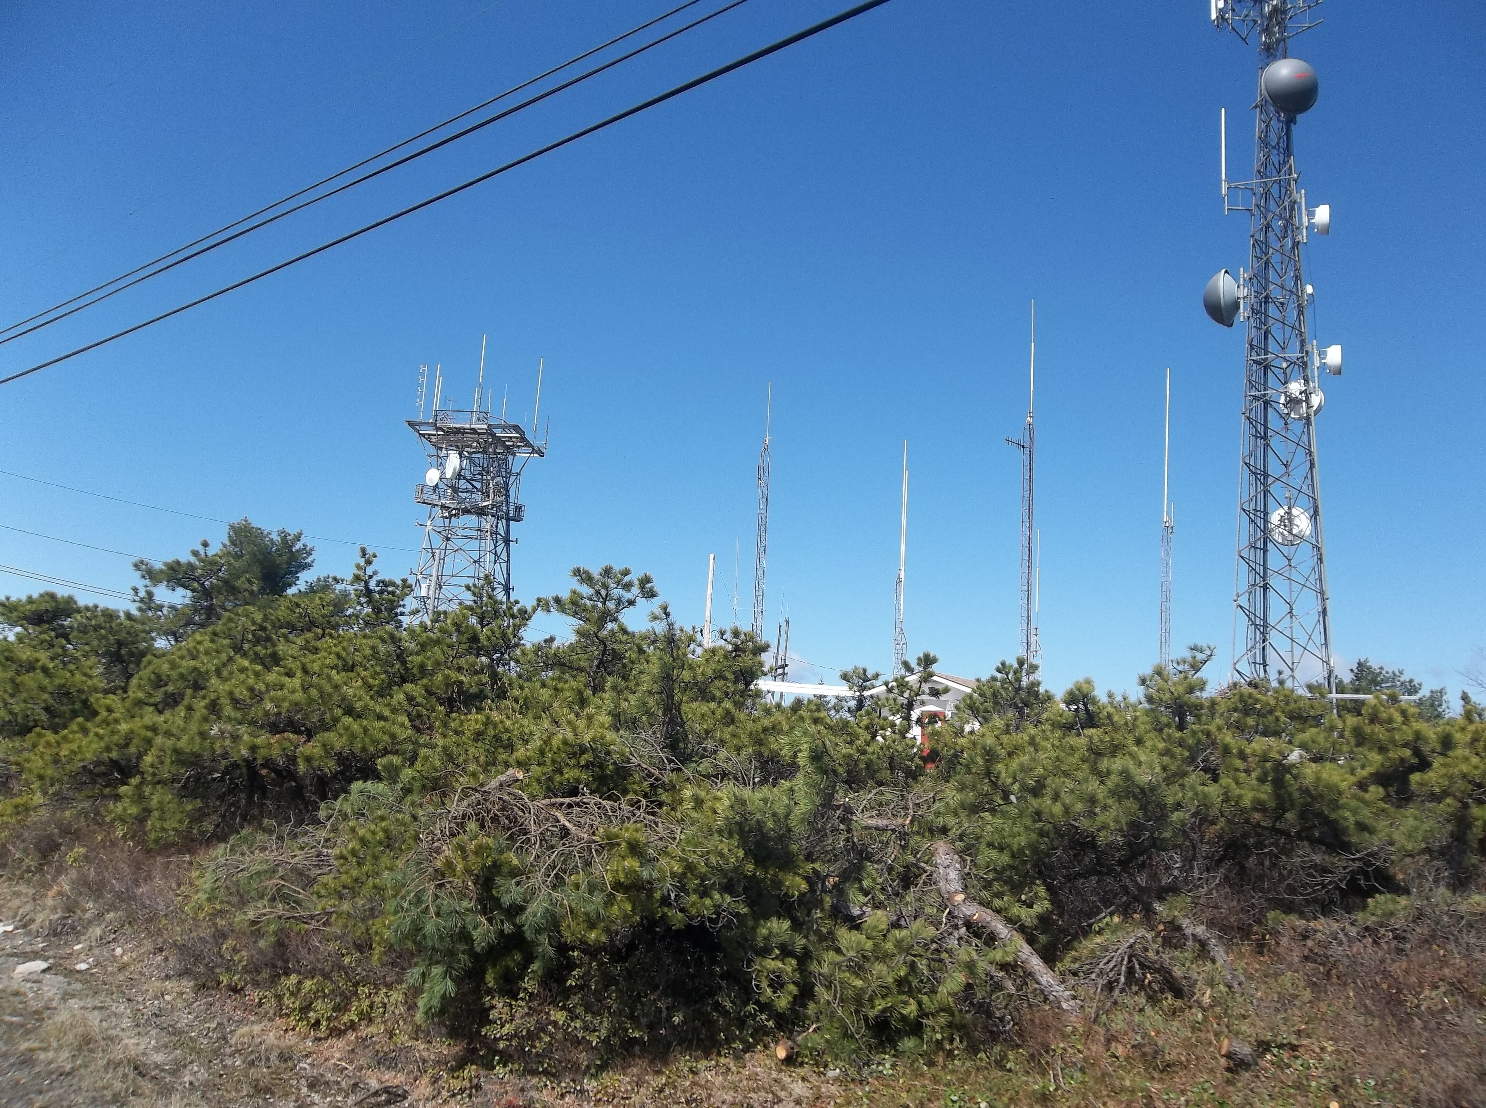
Tower Farm

Slide 6
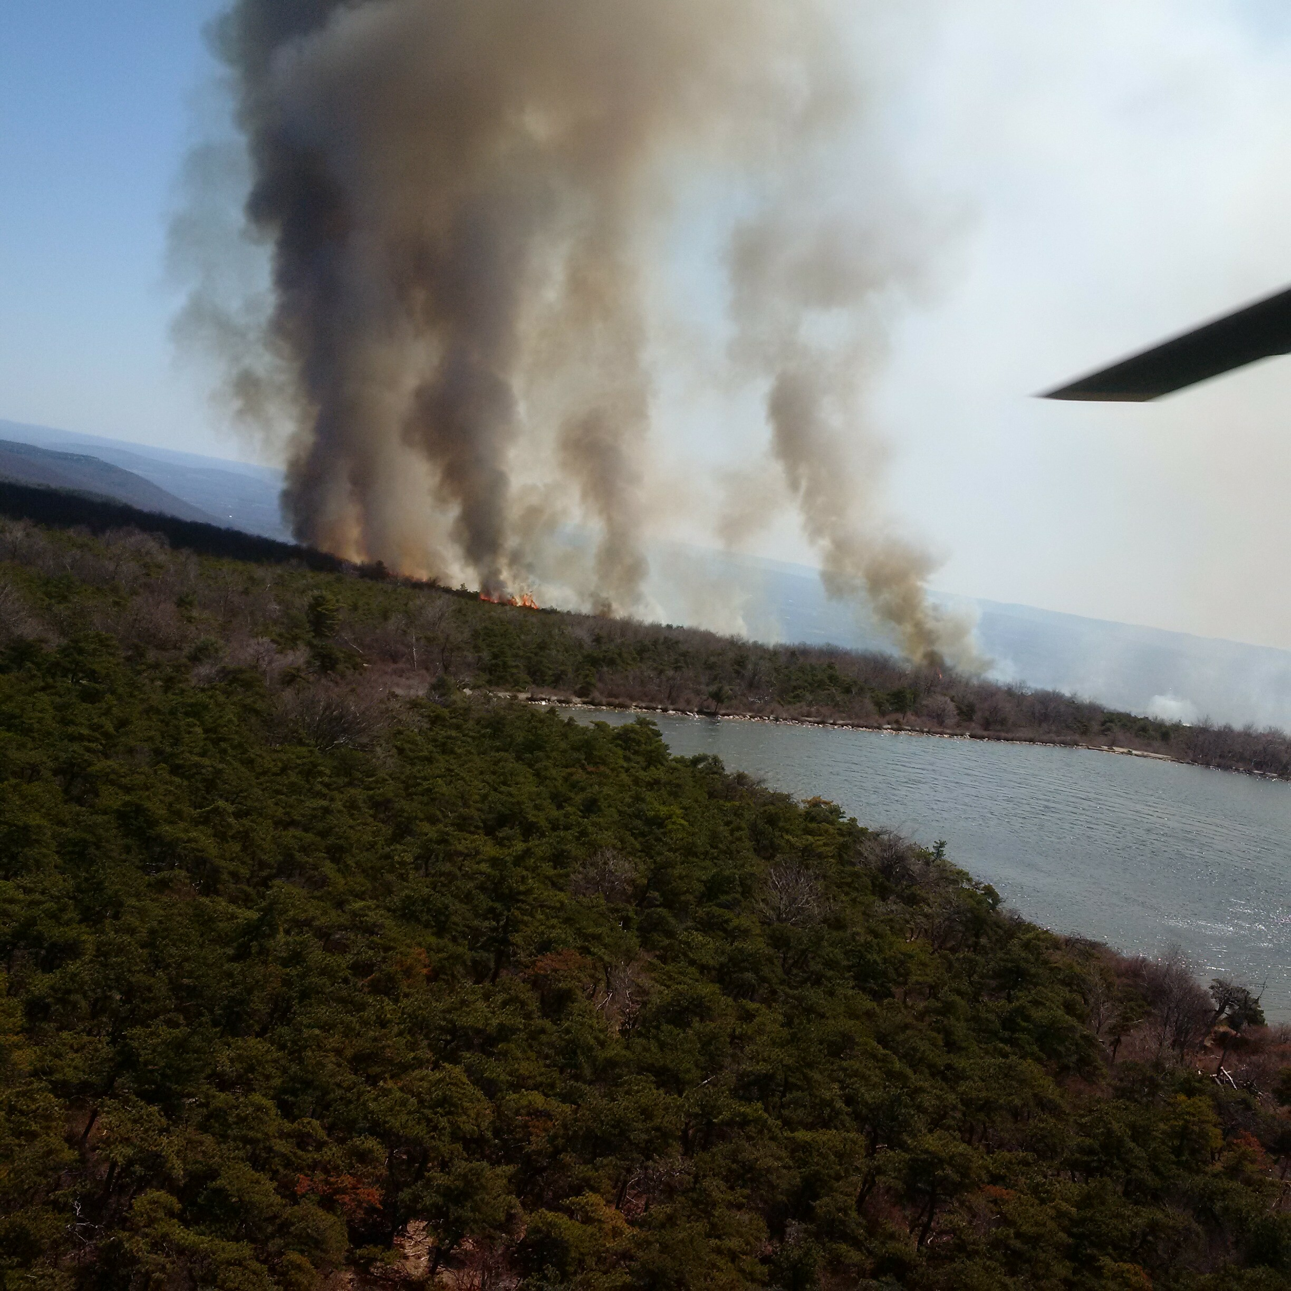
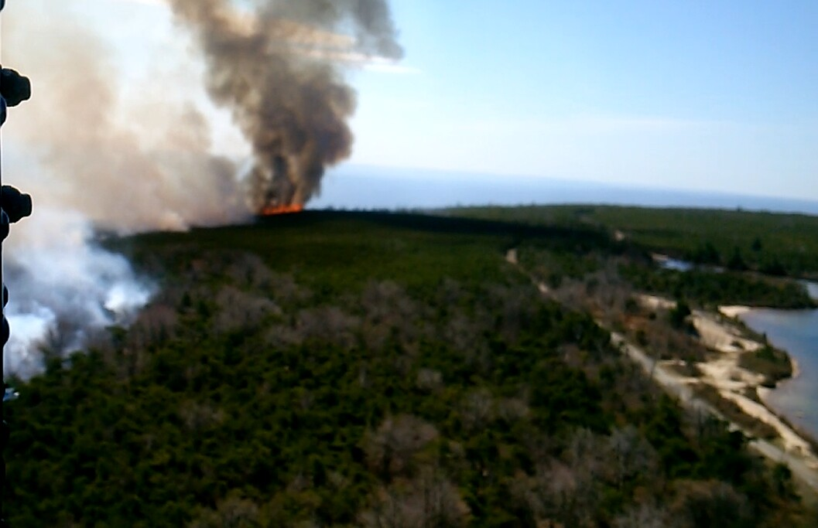
Sunday, April 24 – Fire moves up into Pitch Pine Fuels east of Lake Maratanza & shows aggressive fire behavior

Slide 7
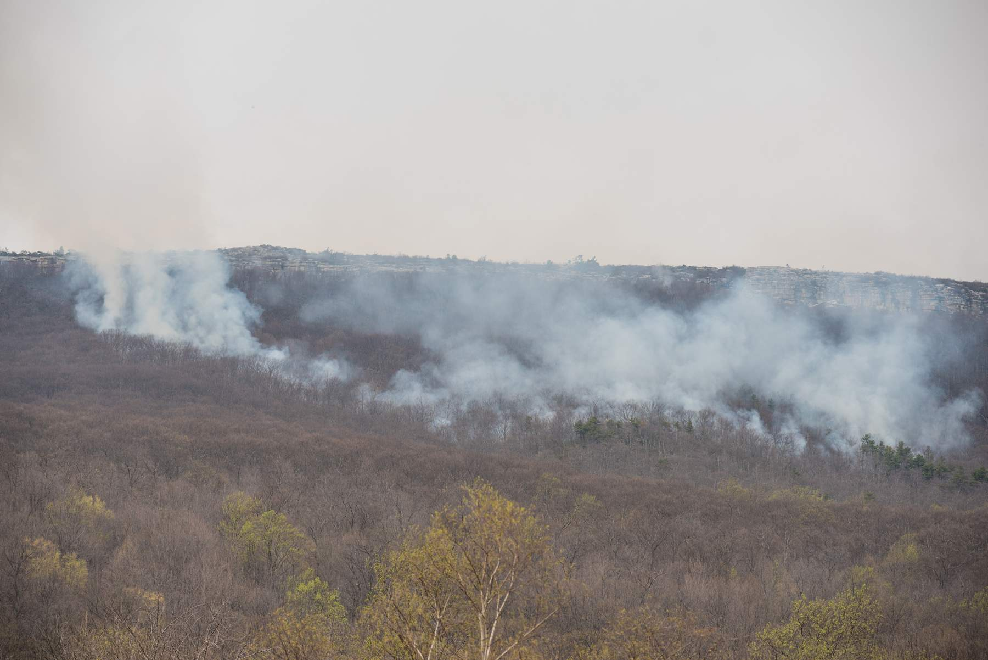
On Monday Morning the S & E Flanks looked like this

Slide 8
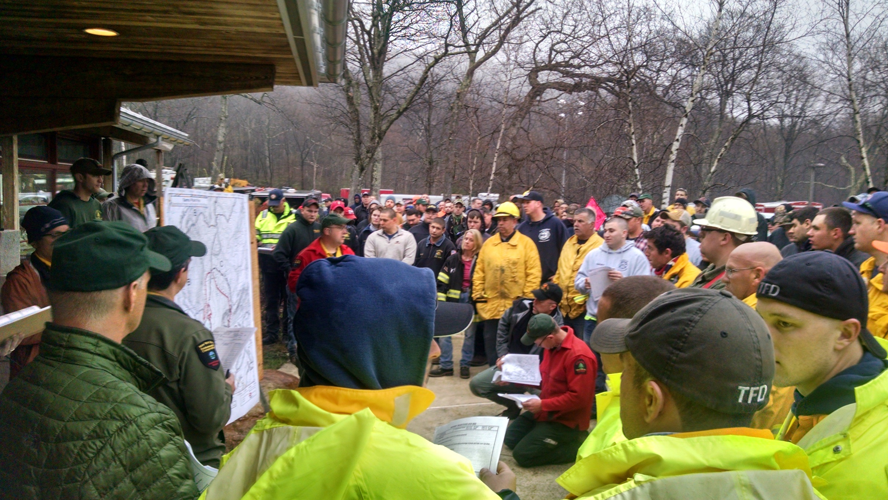

Slide 9
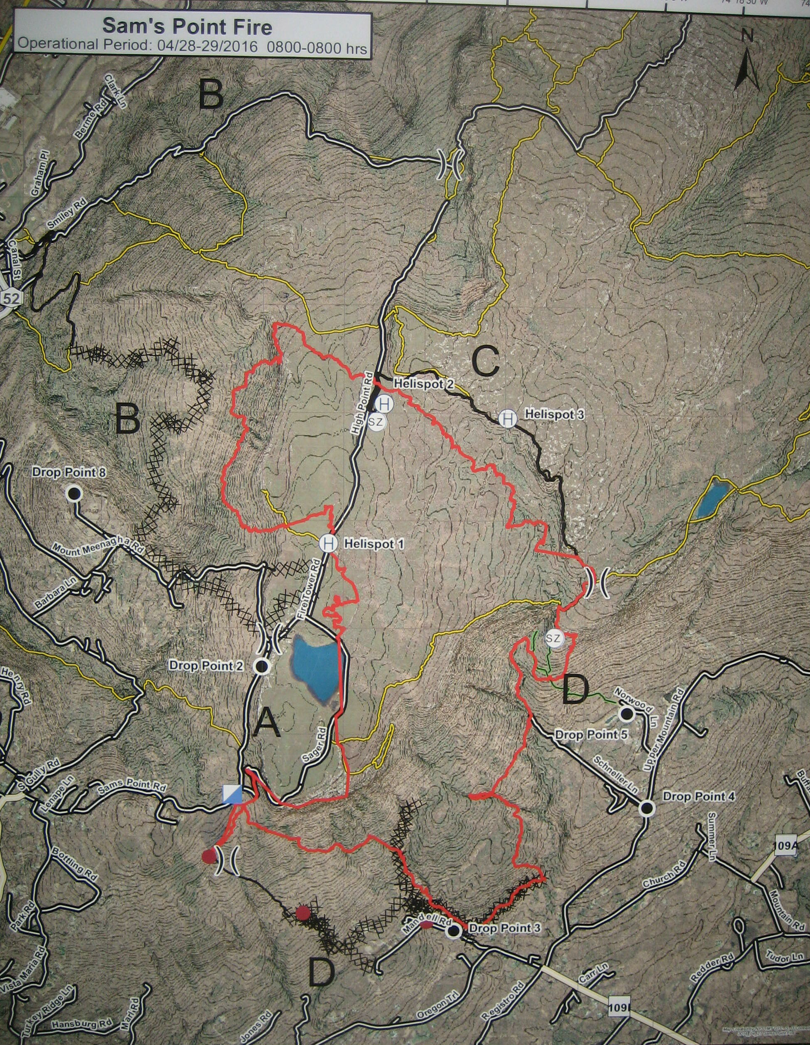
Operations Organization
DIV A-SW Flank
DIV B-NW Flank
DIV C-NE Flank
DIV D-East & South Flank
Structural Protection Group – Performed work East of Div D and West of Div B
Rehabilitation Group – Worked in Div A, B & C (Started Thurs 4/28)
Air Operations Branch

Slide 10
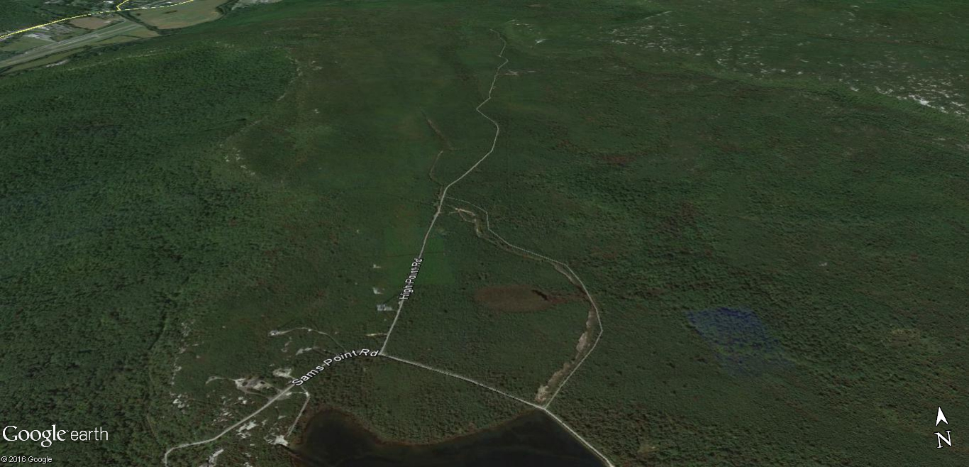
On a Helicopter Recon Flight Monday 4/25 at 0900 NYSIMT OSC Panko saw the fire was already torching and everything was in alignment for a big run that day.
A Safety Zone had been established at N. end of Div A on Sunday
High Point Rd was Div A, and crews were brushing out road edge to widen firebreak
Single Trees Torching in this area at 0900
Wind was out of SE

Slide 11
By 1000 hours Fire activity was increasing and began to threaten Crews in Div A along the High Point Road
Safety Zone
Div A crews were directed by OPS to evacuate South & NOT to the Safety Zone
Fire Activity increased by 1000 hrs and Air resources advised firefighters in Div A to evacuate.
Wind was out of SE

Slide 12
Monday 1030 hours Strategy of NYSIMT OSC Panko
Panko’s Strategy was to hold the old Dozer line to protect the Tower Sites
To that end NYS Ranger Field Ops Stratton & Panko conducted a recon on foot.
Div A resources were evacuated and back at Inc Base
Towers
Fire Activity continued to increase with multiple tree torching but fire created safe black east of old dozer line
Wind was out of SE

Slide 13
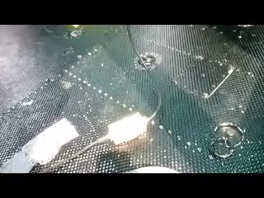
About 1100 hours Monday the fire was pushing against the old dozer line. OPS Panko & Ranger Eric were reconing the Dozer line to Anchor the flank and protect the Tower Farm

Slide 14
At 1300 Field Ops had a meeting with Div A Supv & other Div A overhead and planned to re-engage resources to old dozer line…
But fire jumped High Point Rd at 1330 before we could engage, so we assigned resources to try to suppress spots on High Point Road N. of old Dozer line.
Div A resources assigned to attempt suppressing spot fires west of High Point Rd to no avail.
Towers
Fire Activity continued to increa
Wind was out of SE

Slide 15
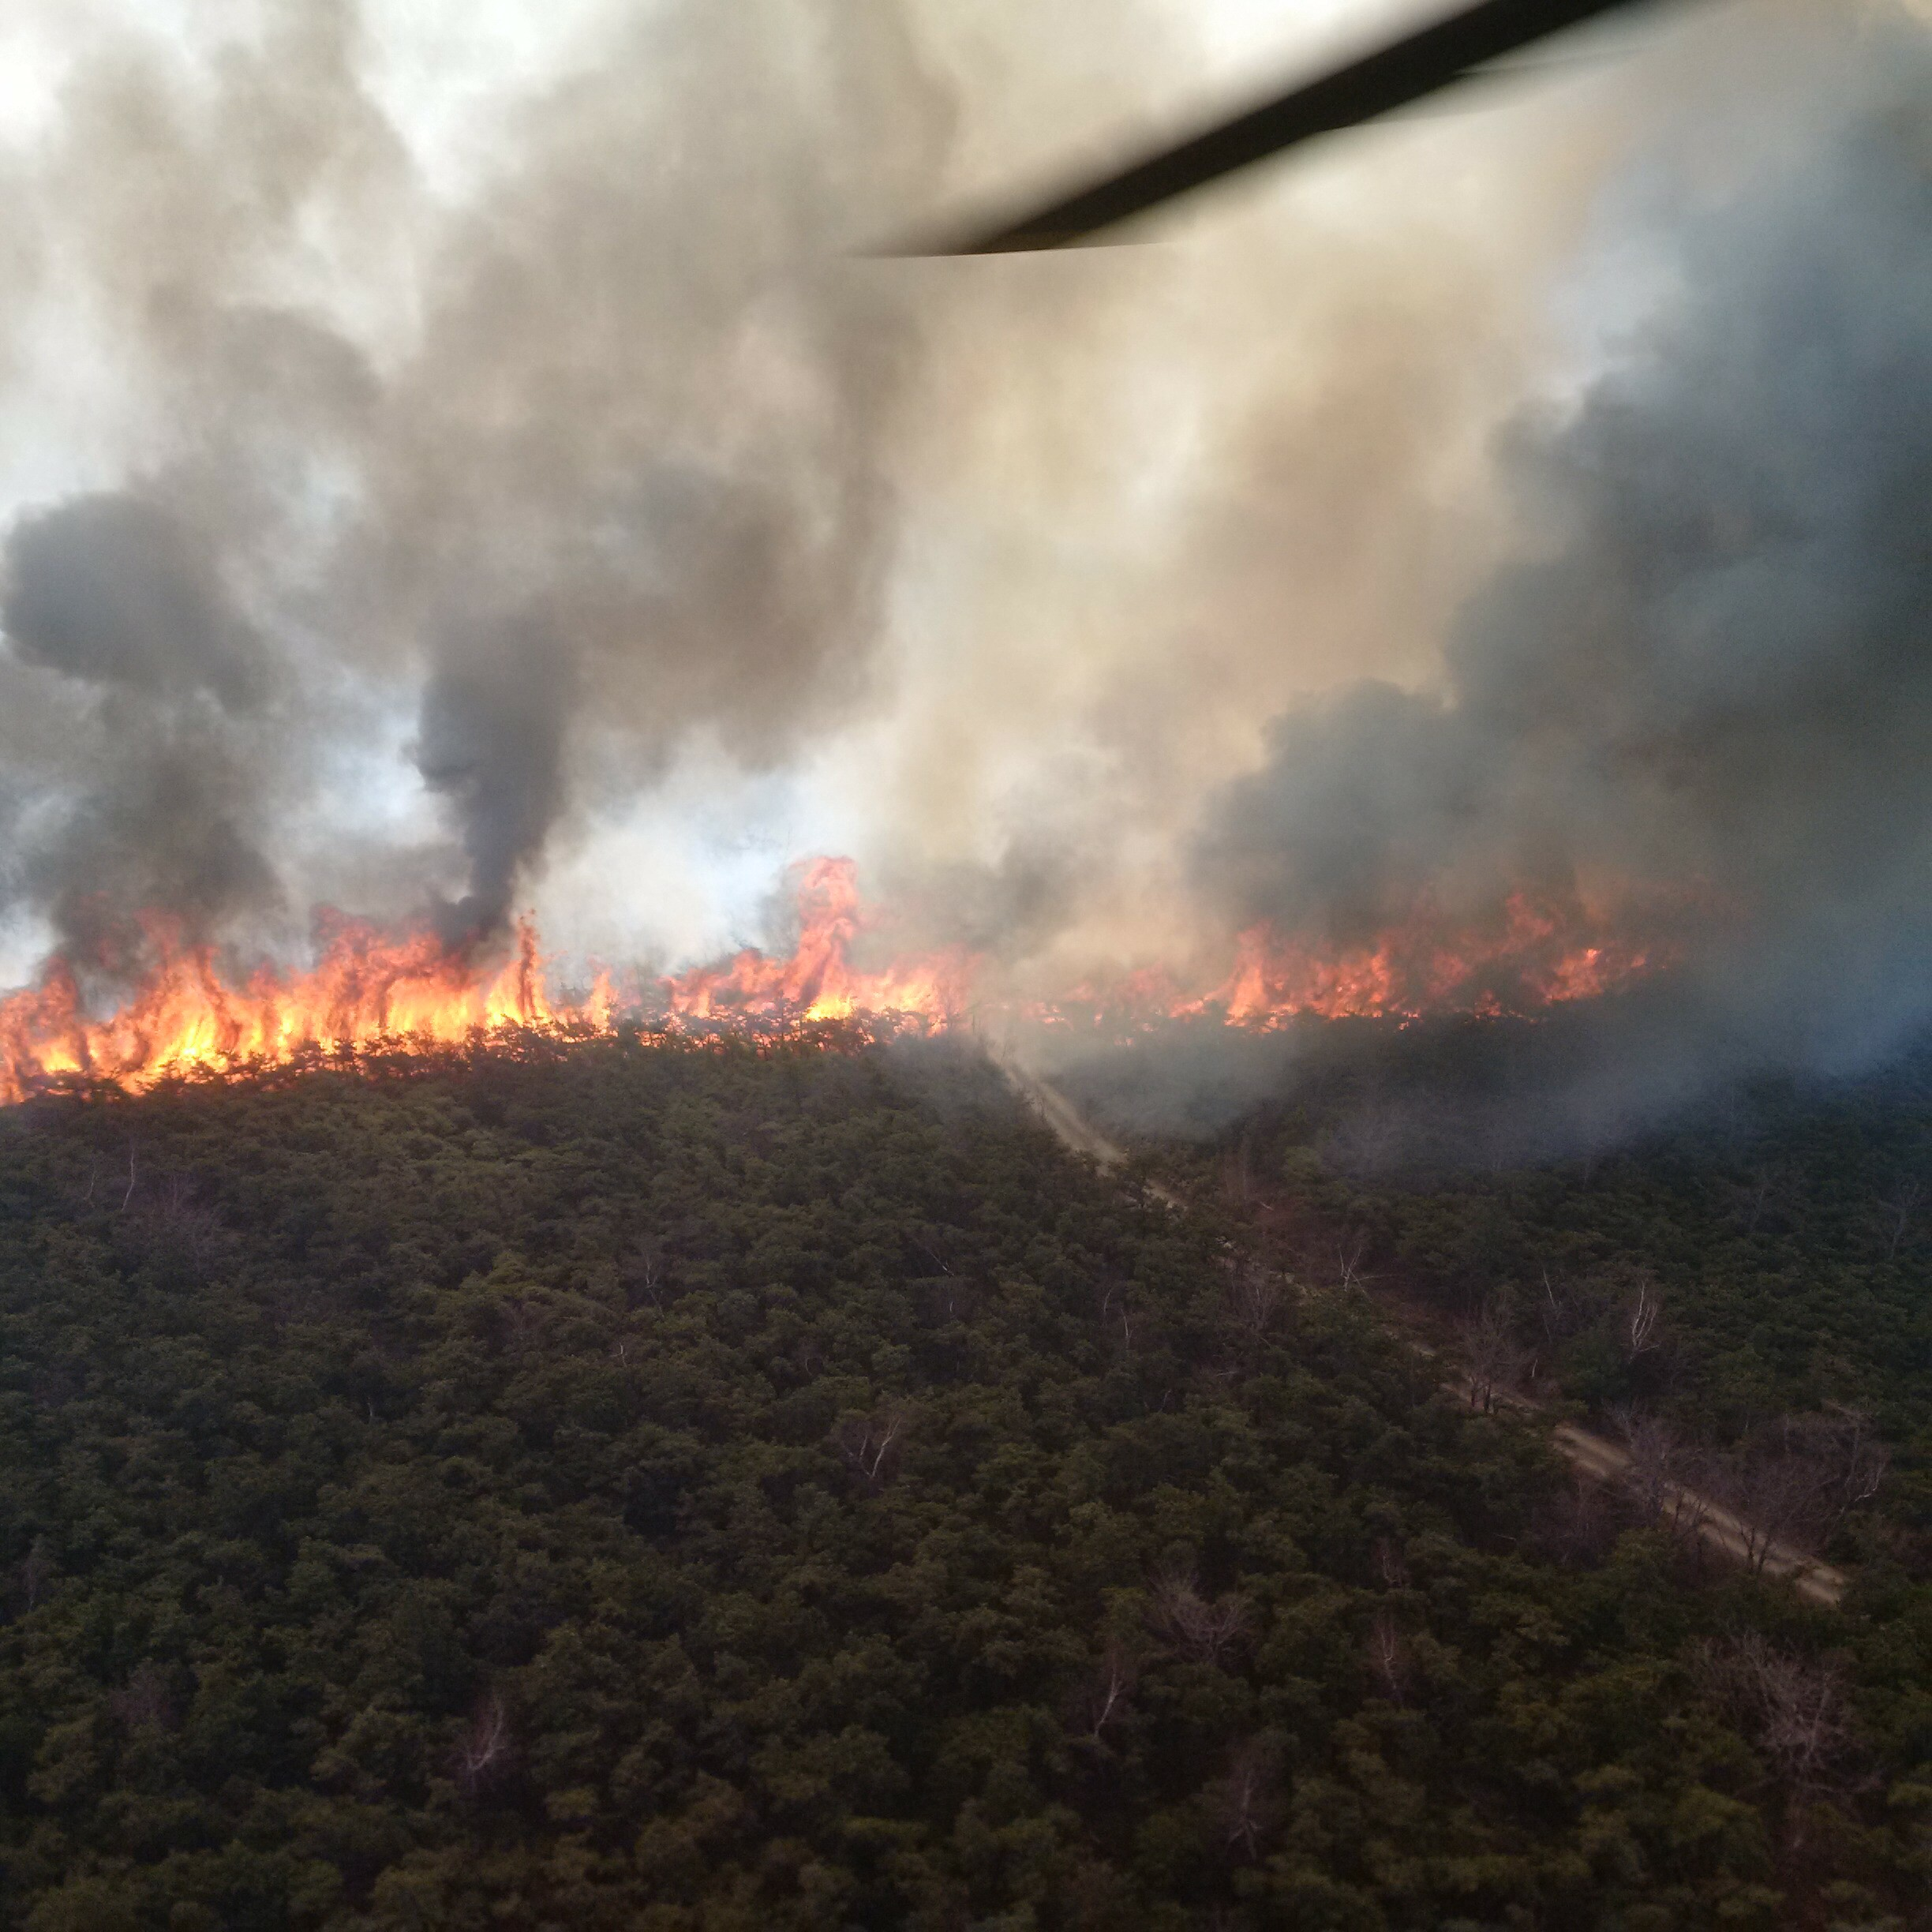
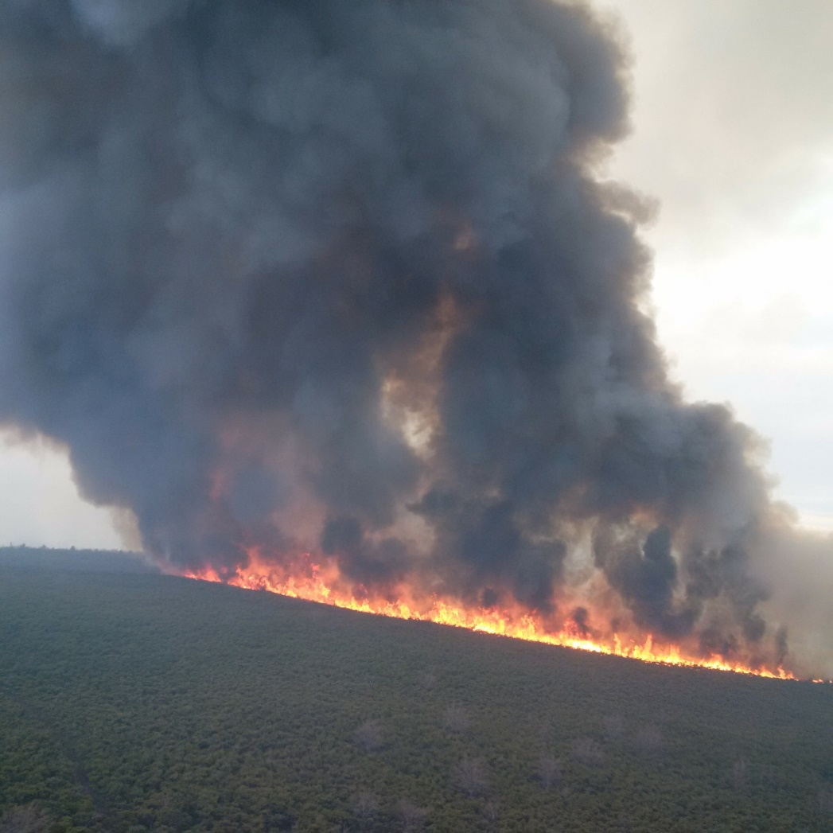
Fire Crossing High Point Rd in Div A & heavy flank West of High Point Road

Slide 16
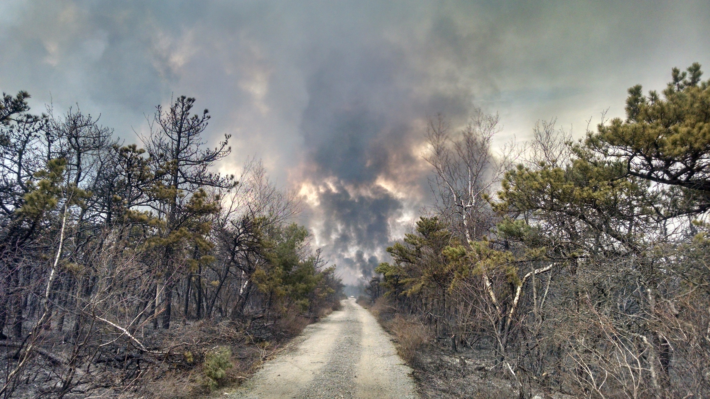

Slide 17

Before Actions Could be taken to engage the fire there with ground resources by 1300 the fire erupted. The following private video captures the run very well

Slide 18
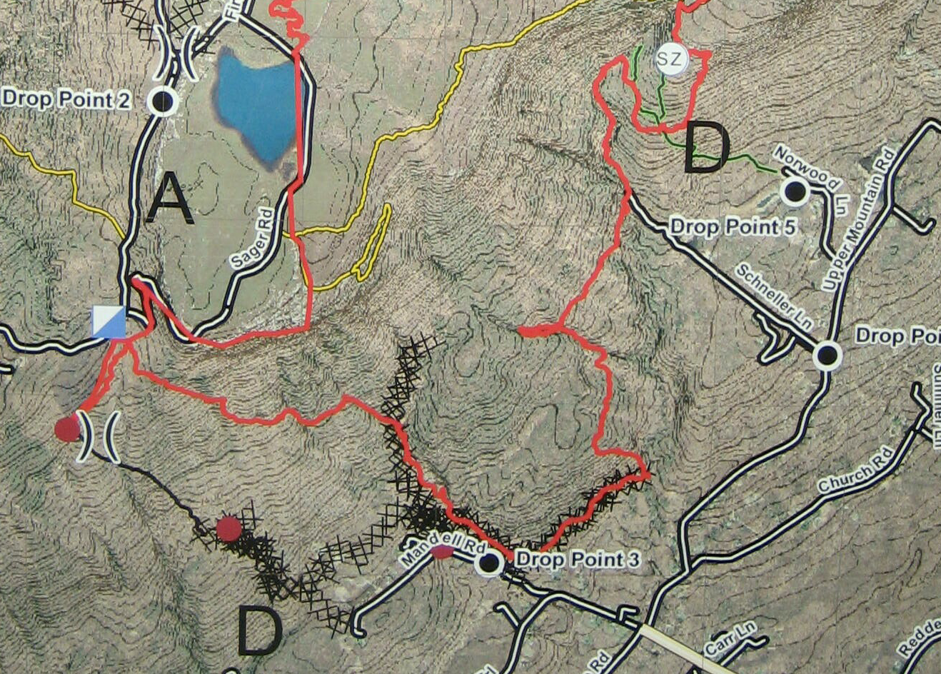
On the S & E flanks (while the fire was blowing up to the N & W) great progress was made constructing handline, brushed line and dozer line.
Brushed Trail
Handline
Dozer Line

Slide 19
With favorable SE upslope winds, resources in place and constructed lines completed a large burnout was conducted starting 1900 hours in these hardwoods litter fuels
The burnout was conducted simultaneously from the West and East moving to the center. 4 miles worth
Burnout didn’t carry well here
Burnout Secured Handline
Burned out well from Dozer Line

Slide 20
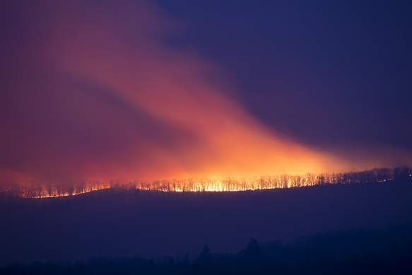
Burnout was conducted based on forecast of rain overnight. The burnout secured hundreds of homes and made for quite the traffic jam of “look-e-loos” & jammed 911

Slide 21
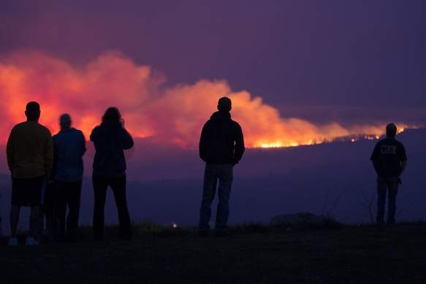
In hindsight Ops could have done a better job notifying PIO of the Burnout, but Ops was called from the SE flank of the fire to go to the Towers which appeared threatened by a “wind shift from the North”

Slide 22
In the long run OSC Panko suspects the folks in the helicopter were actually talking about the fingers of fire that crept &/or spotted across the old dozer line and were threatening the Towers (there was in reality no prolonged wind shift)

Slide 23
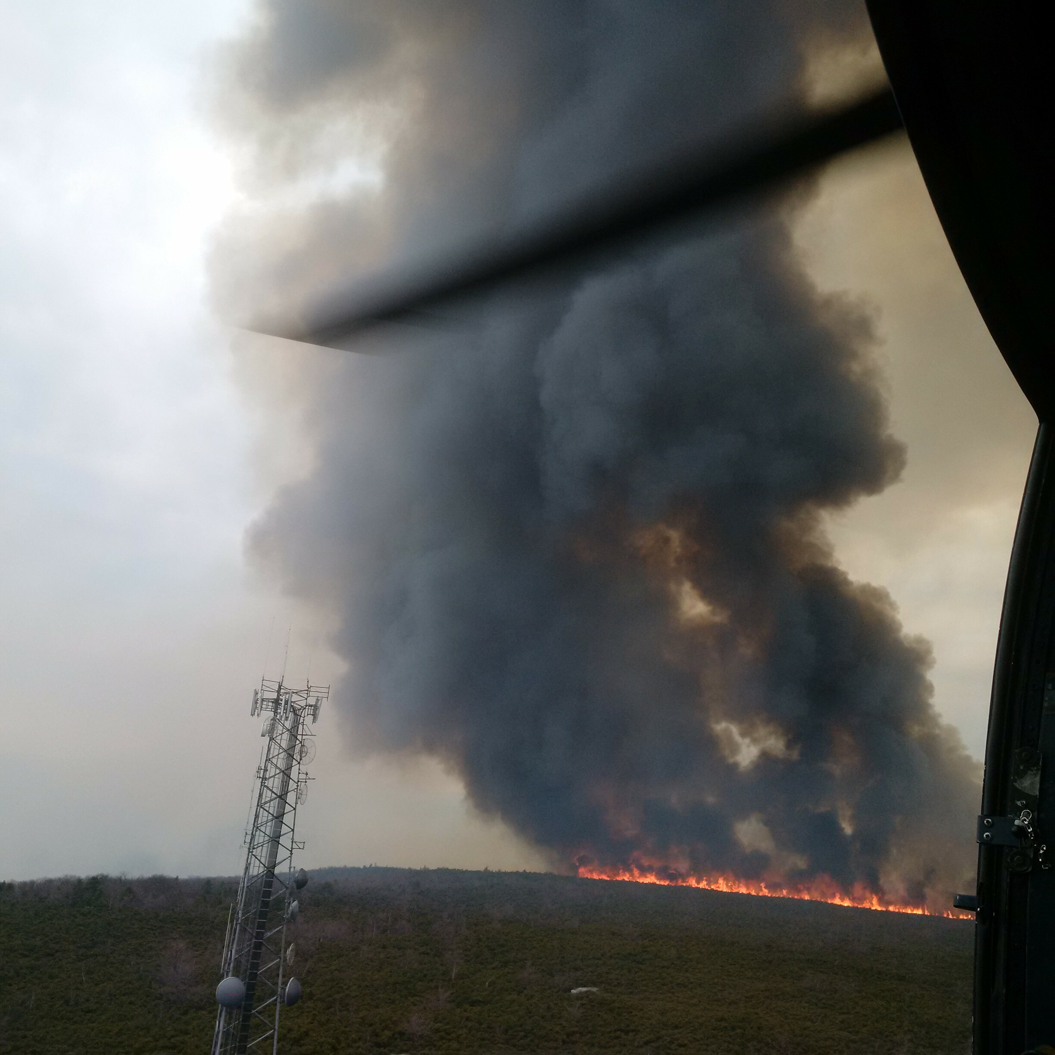
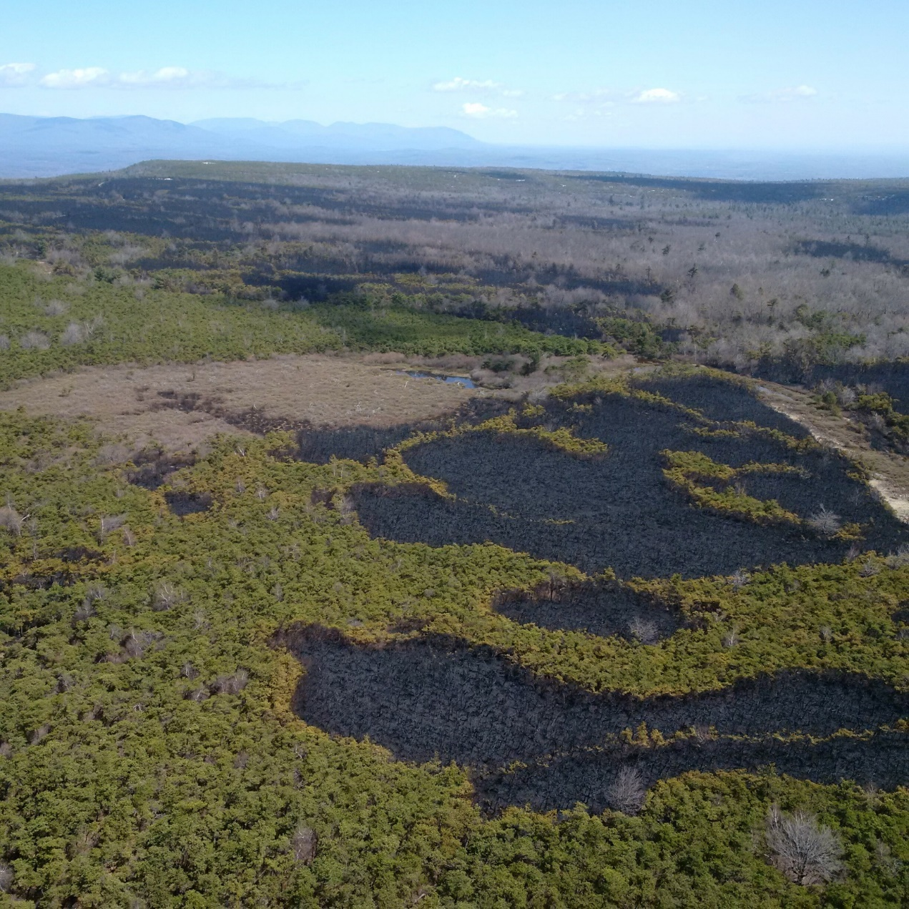
Old Dozer Line
Spots across old Dozer line

Slide 24
Starting around 1930 the following actions were taken to help protect the Towers: dozer breaks inside fences of Tower Pads; 3 blade wide dozer scrape outside fences; 1 ½ mile hose lay; Type 1 CAFS Engine on site
Dozers were re-assigned to clear defensible space around Towers
A hose lay was installed from the Lake to the driveways to the Towers

Slide 25
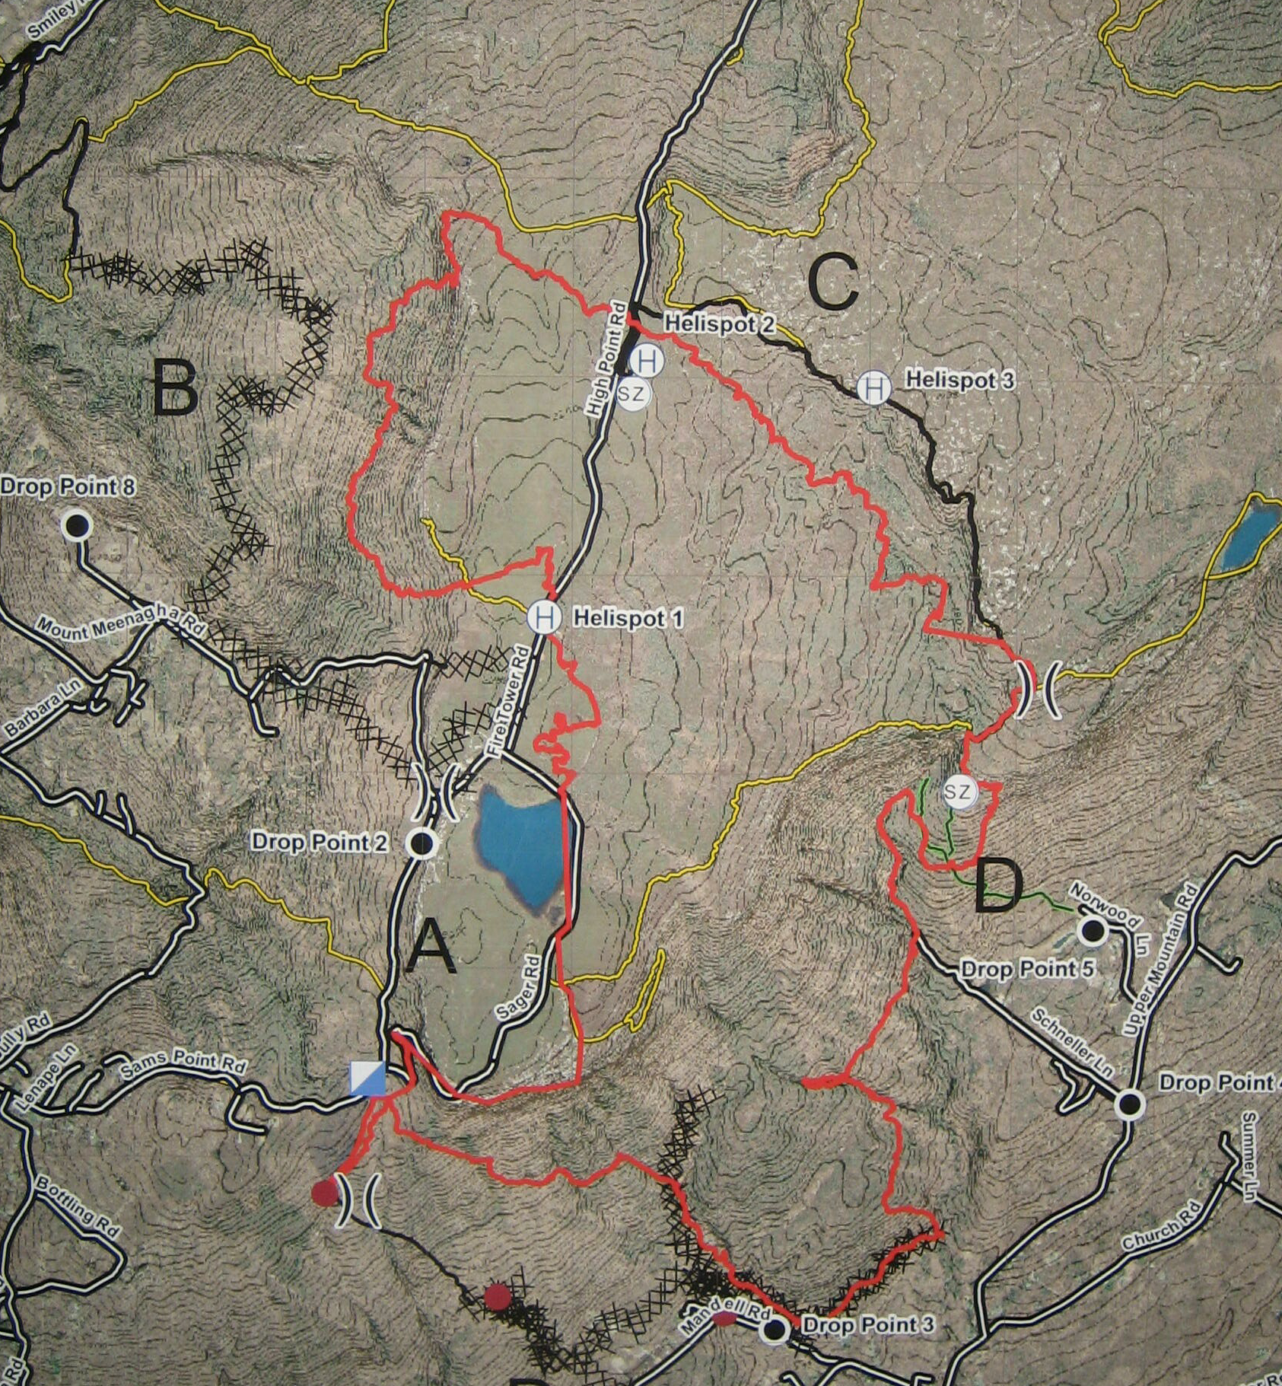
About 0200 Tues 4/26 it started to rain
The rain stopped the fire in its tracks.

Slide 26
Tues 4/26 & Wed 4/27 suppression activities focused on:
Div A inner and outer dozer lines were completed around the Towers.
Div B building indirect dozer line
Div C building indirect brush line and hoselay
Div D cold-trailing
Structural Prot Group worked E. of Div D
FOBS gathering accurate fire perimeter information

Slide 27
On Thurs 4/28, based on the intelligence gathered previous two days a direct suppression strategy was selected and resources in all Div’s cold-trailed known fire edge with no threats found.
Hose lays were backhauled from Div C by helicopter and returned to Helispot 2.
Structural Protection Group was released after 1300
A Rehabilitation Group was assembled of “Park Resources” and began smoothing dozer work at Tower sites.

Slide 28
On Fri 4/29 backhaul of Div A hoselay was completed.
The Rehab Group continued work at Tower sites and inner & outer contingency dozer lines around Towers and removing brushing stumps along High Point Road.

Slide 29
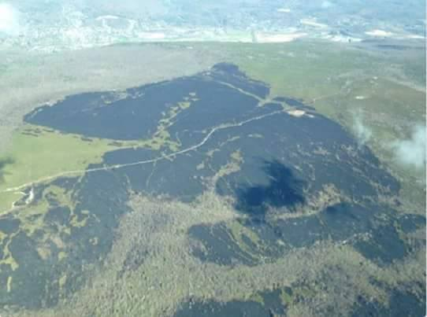
As Lewis Carroll said in Alice in Wonderland
“ ‘Begin at the beginning’ the King said very gravely, ‘and go on till you come to the end then stop’.“

Slide 30
