Slide 1
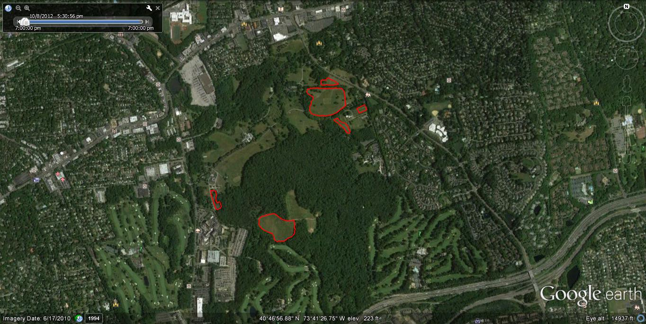
Prescribed Burning at Greentree Foundation
Achieving Natural Resource Management Objectives Using Prescribed Fire in a Densely Populated Urban Setting

Slide 2
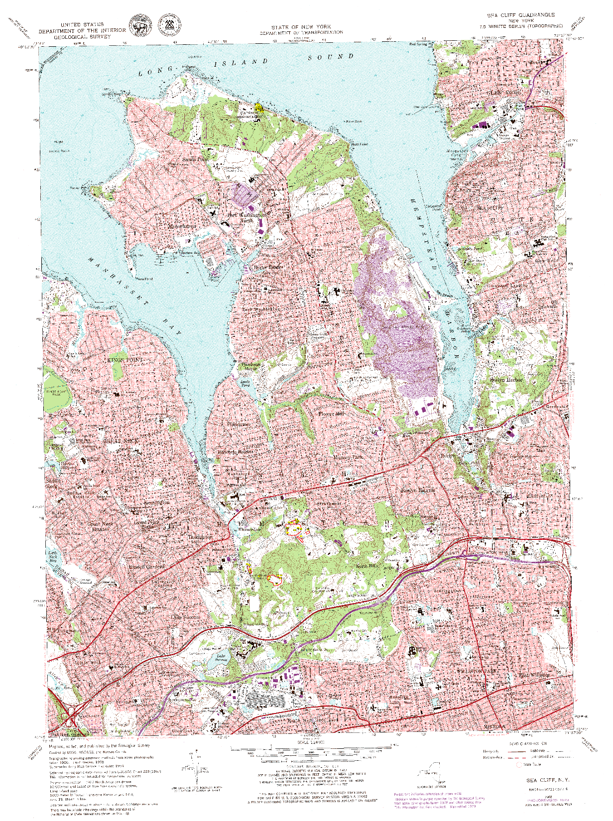
Challenges
Dense urban intermix very near NYC limits / major transport routes / major hospital
Stakeholder concerns
Nassau County history of Rx burns
Cultural bias's

Slide 3
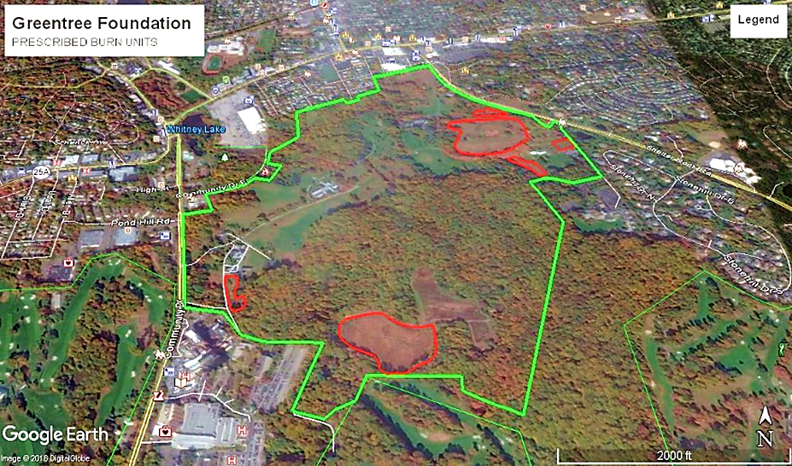

Slide 4
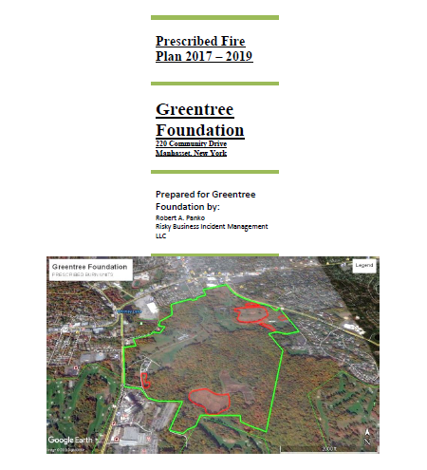
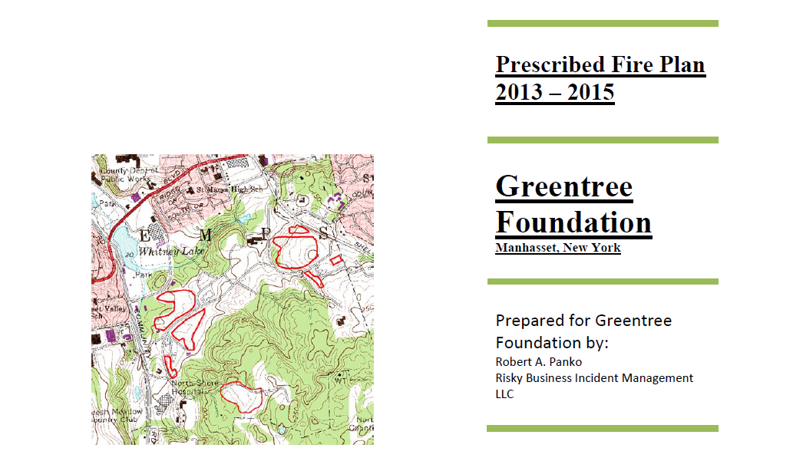
History
January 11, 2013- RBIM LLC first on site visit
Original Plan 2013-2015
Wildfire in Tower Unit – April 2015
Second Plan 2017-2019
Stakeholder meeting Mar 2017 Achieved Approval Concensus

Slide 5
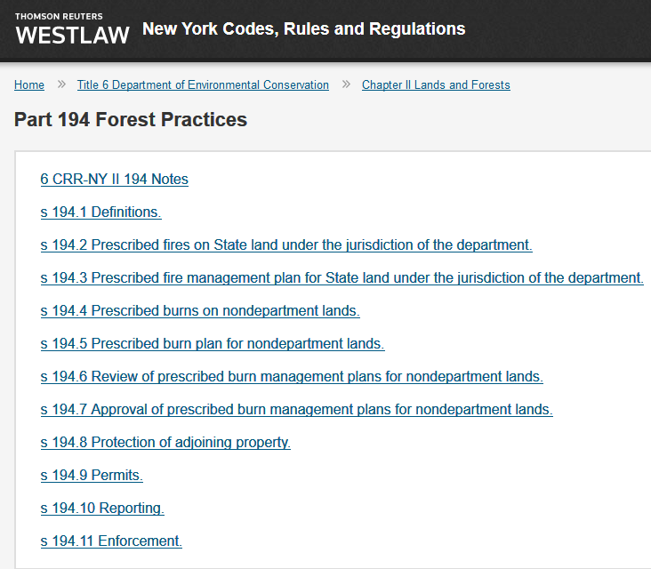
Processes & Applications
Authority to Rx Burn on private lands in NY = Part 194 Regulations
Part 194.4 = 12 Plan Elements vs published plan that incorporated NWCG & NYDEC elements
Multi Year / Landscape Plan
Year round plan allowing for normally “out of season” treatments (eg. Summer burns in herbicided areas)
Staffing / Training constraints
Insurance

Slide 6
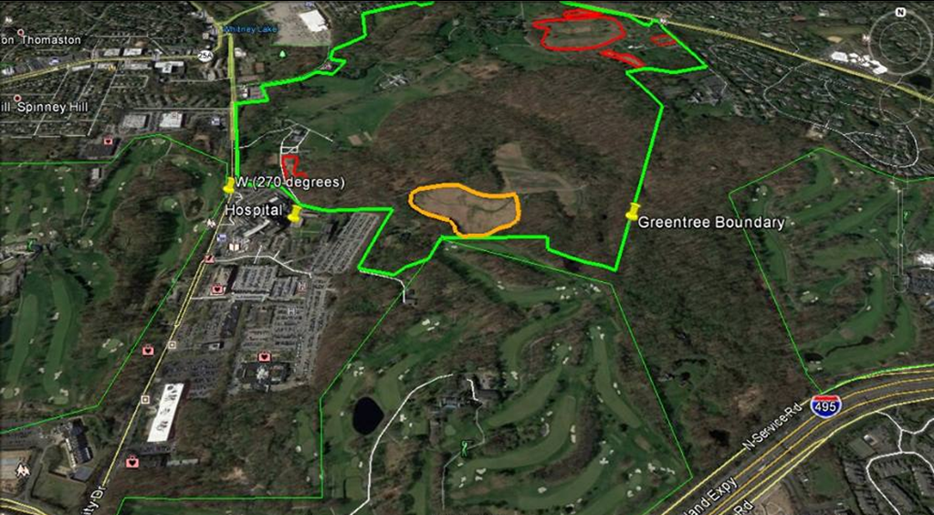
Implementation – Prescribed Wind Vector
Permitted Wind Directions

Slide 7
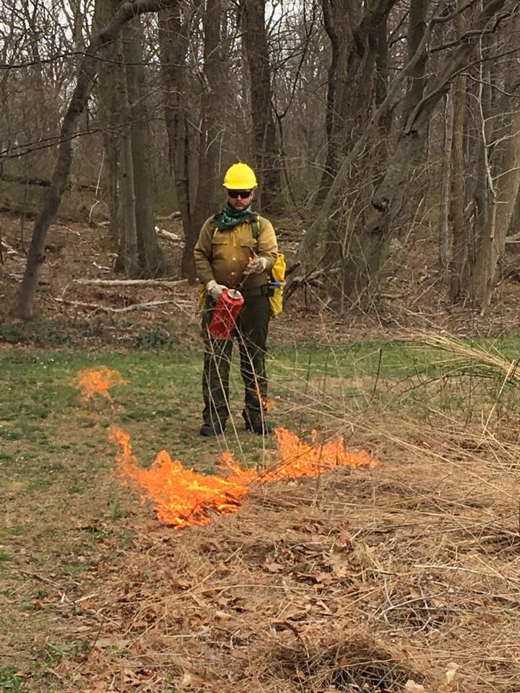
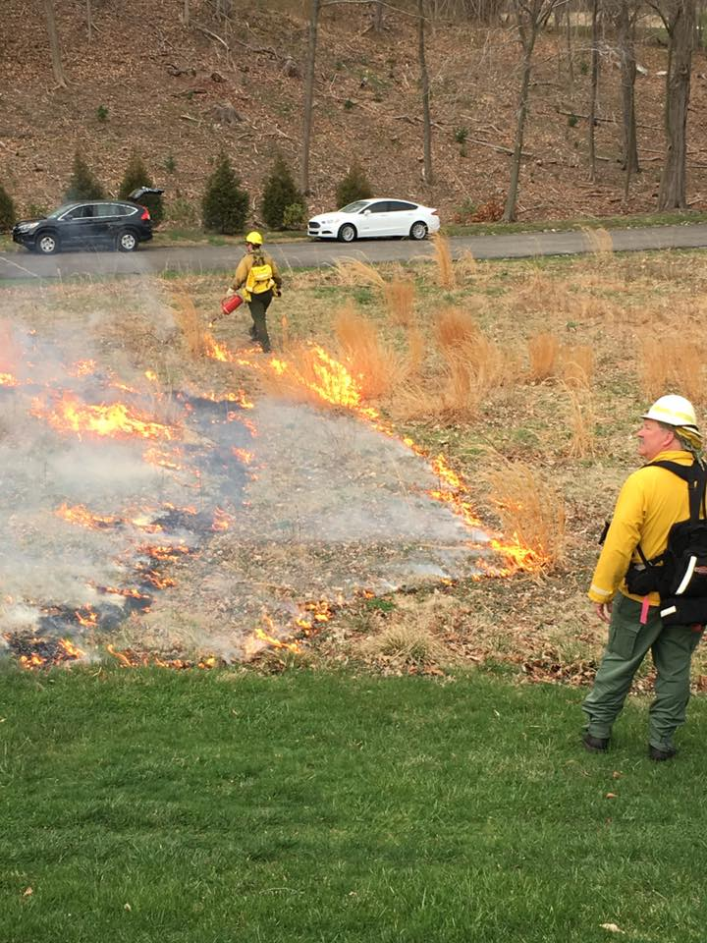
Implementation - Process
Backing Fire Establishes Anchor Point - Initial firing is conducted at the downwind edge against control edge. This creates burned out “Blackline”
Strip Head Firing – Once the blackline is sufficiently wide parallel “Strip Head” fires are lit to burn into the burned out Blackline
Strip Head Firing – As the width of the Blackline increases, the width of the strip heads can increase
We call this the Strip Head Ignition Method
Permitted Wind Directions

Slide 8
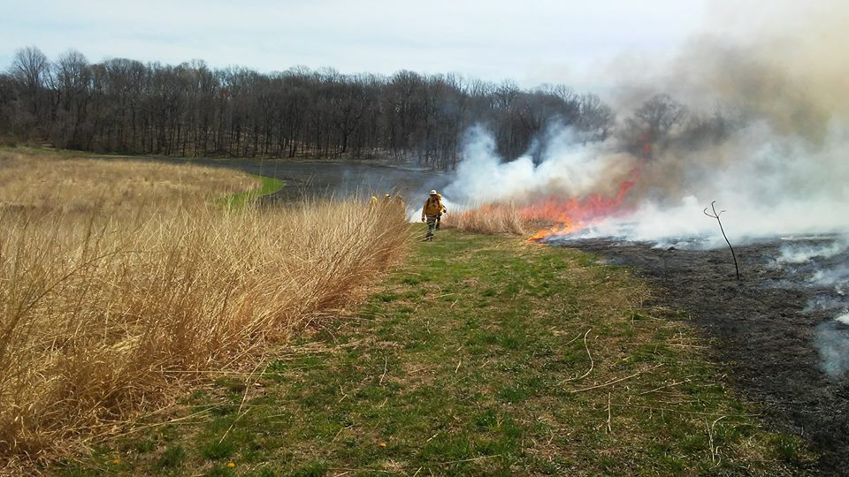
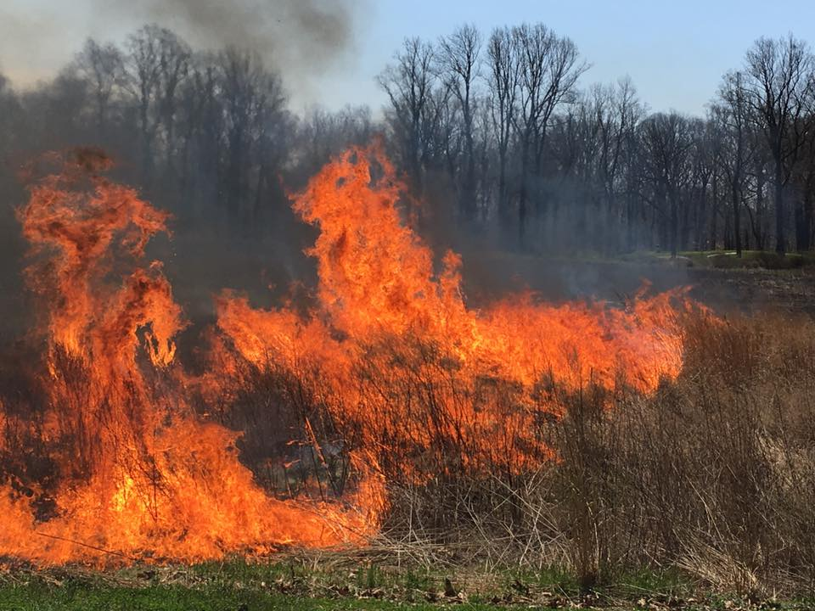
Implementation - Process
THE STRIP HEAD METHOD ADVANTAGES:
Fire Control
  limited amount of active fire at any time
  can be quickly extinguished if wind shifts
  once secure black line is established fire escape is very unlikely except by “spotting” of aerial embers
Smoke Control
  width of strips manage active smoke emissions
  Creates pulses of smoke rather than generating smoke column
  Reduces long distance transport of smoke
  Easy to stop if undesirable smoke impacts are observed
Resource advantages
  Allow a wide range of firing actions to meet the desired objectives
THE STRIP HEAD METHOD DISADVANTAGES:
Requires more people
Takes longer

Slide 9
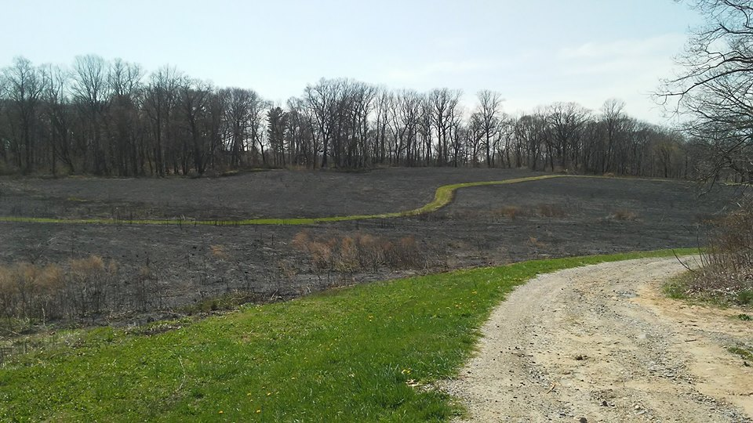
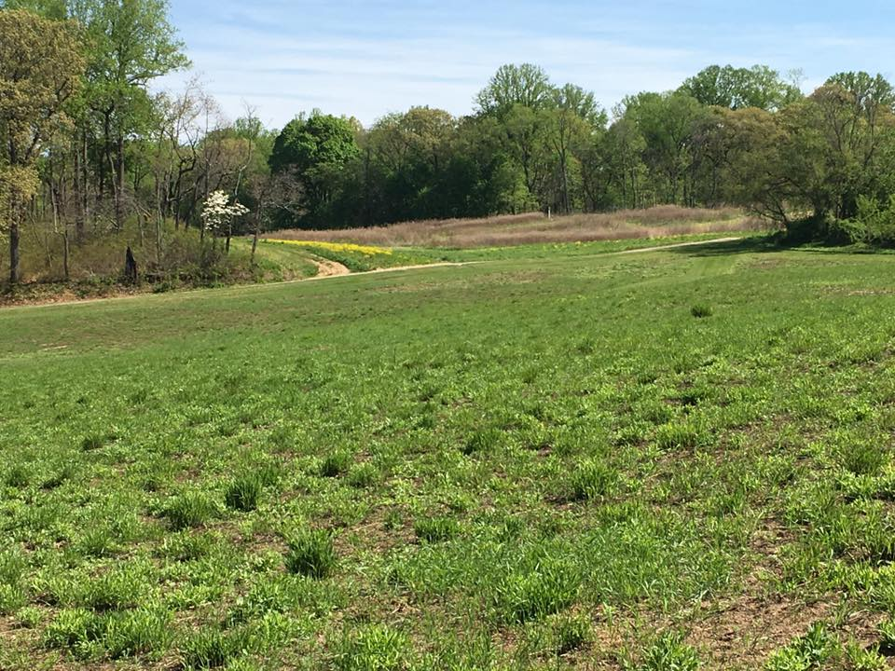
Monitoring
If you are not Monitoring to measure if you are meeting treatment objectives, you are merely a “permitted arsonist”
Things to Monitor May Include:
  Flora / Fauna / Non-Native Plants
  Simple to detailed methodologies
Burn Day April 13, 2017
May 05, 2017

Slide 10
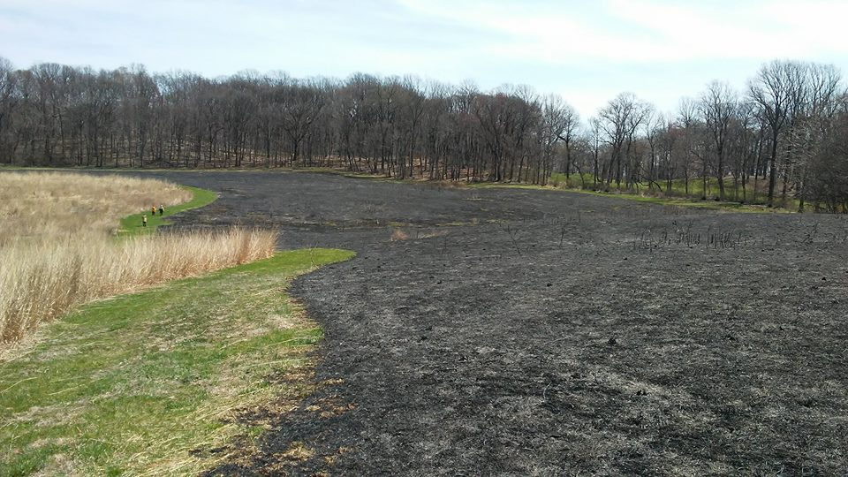
Questions?

