Slide 1
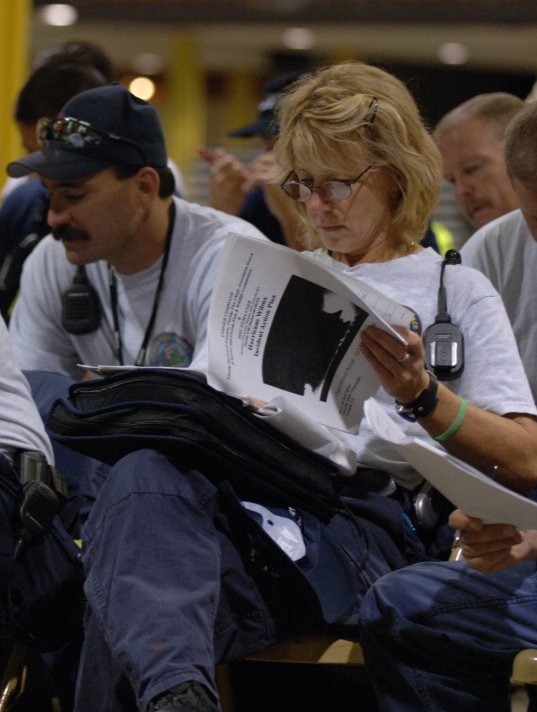
Unit 7:
Demobilization, Transfer of Command,
and Closeout

Slide 2
Unit Objectives (1 of 2)
  Describe the importance of demobilization planning.
  Identify the impact of agency-specific policies, procedures, and agreements upon demobilization planning.
  Identify the ICS titles of personnel who have responsibilities in developing and implementing the Demobilization Plan and list their duties.

Slide 3
Unit Objectives (2 of 2)
  List the major sections in a Demobilization Plan.
  Identify the need for transfer of command or closeout.
  Identify the process involved in a closeout meeting.

Slide 4
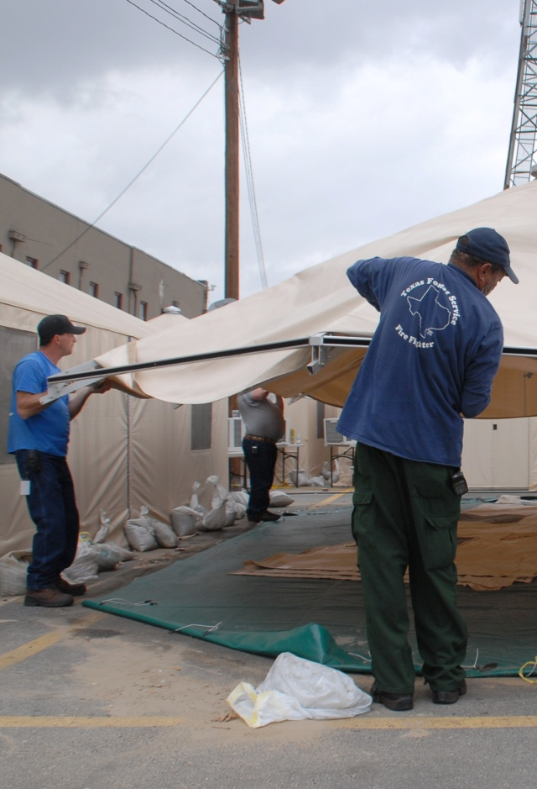
Demobilization
  Demobilization:
  Is the release and return of resources that are no longer required.
  May occur at any time during or after the incident/event.

Slide 5
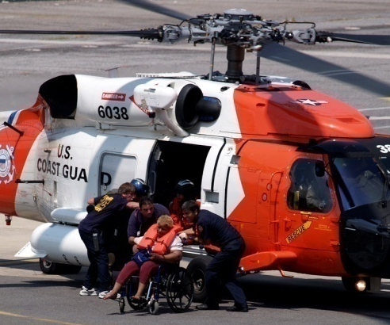
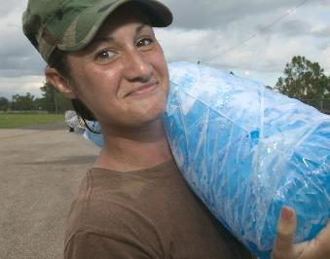
Demobilizing Nonexpendable and Expendable Resources
Nonexpendable Resources
  Account for resources returned.
  Restore resources to functional capability.
  Replace broken and/or lost items.
Expendable Resources
  Account for resources used.
  Reimburse for expendable items used.
  Return and restock items.

Slide 6
Demobilization Challenges
What challenges are related to demobilization?

Slide 7

Demobilization Planning Benefits
Demobilization planning helps to:
  Ensure a safe, controlled, efficient, and cost-effective release process.
  Eliminate waste.
  Eliminate potential fiscal and legal impacts.

Slide 8
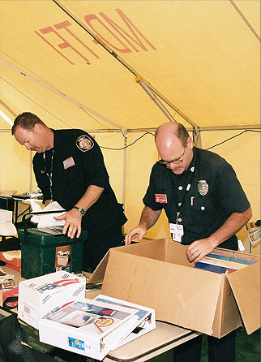
Agency Policies and Procedures
Demobilization policies and procedures depend on the size of the incident and may involve:
  Fiscal/legal policies and procedures.
  Work rules.
  Special license requirements.
  Other requirements.

Slide 9
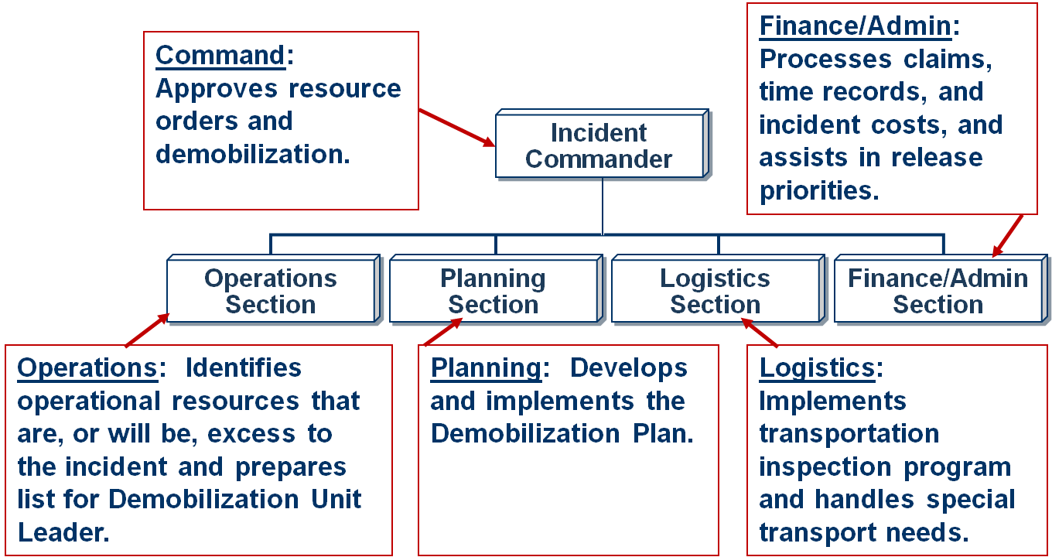
Who Does What?

Slide 10
Demobilization Plan: Information Needs
What Information Is Needed? | Who Provides?
Excess resources; release priorities | All Supervisors and Managers
Plan development; resource information; demobilization process | Planning Section
Continuing needs for tactical resources | Operations Section
Transportation availability; communications; maintenance | Logistics Section
Claims, time records, and costs of individual resources that are a factor in release | Finance/Admin Section
Agreements regarding other agency resources | Liaison Officer
Physical condition of personnel; physical needs; adequacy of transportation | Safety Officer
Return and reassignment of resources | Agency Dispatch/Ordering Centers

Slide 11
Demobilization Plan Sections
General Information
Responsibilities
z
Release Procedures
zz
Demobilization Plan
Release Priorities
Travel Information

Slide 12
Activity: Reviewing the Demobilization Plan
Instructions: Working as a team:
  Review the sample Demobilization Plan for the cruise ship hazmat incident found in your Student Manuals.
  Next, determine whether the five elements required for a Demobilization Plan are adequately addressed in the sample.
Record your work on chart paper as follows:
  Select a spokesperson and be prepared to present your work in 10 minutes.
Strengths
Areas for Improvement

Slide 13
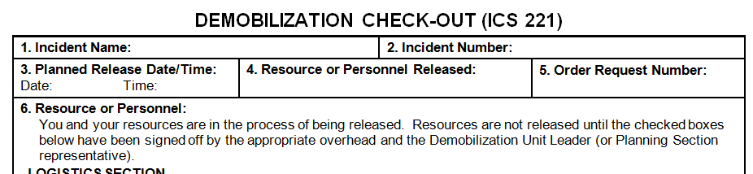
ICS Form 221, Demobilization Check-Out
ICS Form 221 ensures that resources checking out of the incident have completed all appropriate incident business, and provides the Planning Section information on resources released from the incident.

Slide 14
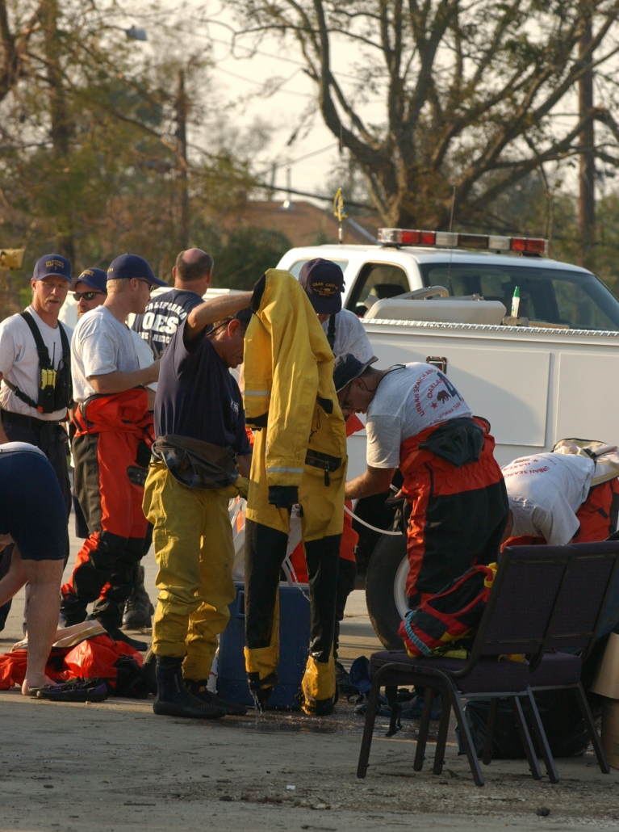
Stabilizing or De-Escalating Incidents
When an incident stabilizes or de-escalates:
  The need for incident management may also be reduced.
  A transfer of command
  should be considered.

Slide 15
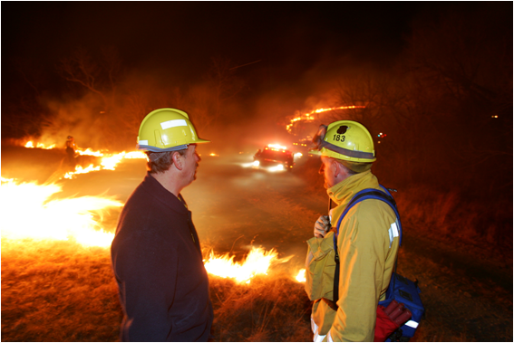
Review: Transfer of Command
What steps must the incoming Incident Commander take before assuming command?

Slide 16
Steps in Assuming Command
Incoming IC (Assuming) | Outgoing IC (Transferring)
Assess situation with current IC. | Assess situation with incoming IC.
Receive briefing. | Deliver briefing.
Determine appropriate time for transfer of command. | Determine appropriate time for transfer of command.
Notify others of change in command. | Notify others of change in command
Reassign or demobilize current IC. | Accept new assignment or demobilize.

Slide 17

Transfer of Command Briefing Checklist
Situation and Prognosis
Resources Remaining and Status
Areas of Concern (political, community interest, etc.)
Logistical Support Needed or Retained
Turnover of Appropriate Incident Documentation

Slide 18

Incident Command and Closeout
The Incident Commander position will remain staffed until the absolute conclusion of the incident and the “closing out.”

Slide 19
Closeout Briefing
A closeout briefing includes the following information:
  Incident summary
  Major events that may have lasting ramifications
  Documentation, including components that are not finalized
  Opportunity for the agency officials to bring up concerns
  Final evaluation of incident management by the agency executive/officials

Slide 20
Closeout
Think about the ongoing
scenario from the past units. Given this scenario, what agenda items would you include in a closeout briefing?

Slide 21
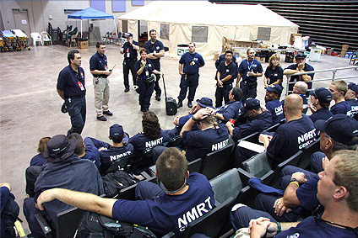
Team Closeout Meeting
  Incident Management Teams or other teams may hold a closeout meeting to discuss team performance.
  These meetings may result in a “lessons learned” summary report.

Slide 22
Conducting an After-Action Review
An after-action review answers the following questions:
  What did we set out to do?
  What actually happened?
  Why did it happen?
  What are we going to do differently next time?
  Are there lessons learned that should be shared?
  What followup is needed?

Slide 23

Applied Activity
Follow instructions . . .
  Presented by instructors.
  Outlined on handouts.

Slide 24
Summary (1 of 2)
Are you now able to:
  Describe the importance of demobilization planning?
  Identify the impact of agency-specific policies, procedures, and agreements upon demobilization planning?
  Identify the ICS titles of personnel who have responsibilities in developing and implementing the Demobilization Plan and list their duties?

Slide 25
Summary (2 of 2)
Are you now able to:
  List the major sections in a Demobilization Plan?
  Identify the need for transfer of command or closeout?
  Identify the process involved in a closeout meeting?

