Slide 1

Unit 3
Overview of the Strike Team
and Task Force Leader Positions

Slide 2

Unit Terminal Objective
Describe the role and responsibilities of the Strike Team
Leader and Task Force Leader.
Unit 3:
Unit 3:
Visual 3-3
Overview of the Strike Team and Task Force Leader Positions
Visual 3-2

Slide 3

Strike Teams
Specified combinations of the same kind and type of
resources, with common communications and a
leader.
Unit 3:
Overview of the Strike Team and Task Force Leader Positions
Visual 3-3

Slide 4

Task Force
A group of mixed resources with common
communications and a leader that may be pre-
established and sent to an incident or formed at an
incident.
Overview of the Strike Team and Task Force Leader Positions
Visual 3-4
Unit 3:
Overview of the Strike Team and Task Force Leader Positions
Visual 3-3
Unit 3:

Slide 5

Task Force
A Task Force can include:
■ Any combination of resources that does not meet the
criteria for a Strike Team
■ Any combination of one kind of resource with other
kinds of resources (and to be exact combination of multiple types of a single kind of resource)
Unit 3:
Overview of the Strike Team and Task Force Leader Positions
Visual 3-5

Slide 6
Utilization Principles
■ The Strike Teams and Task Forces concept is
designed to maximize the efficiency of multiple
resources on an incident
■ Same or similar for both
■ The use of Strike Teams and Task Forces is
encouraged whenever possible
Task Force
Visual 3-6
Unit 3:
Overview of the Strike Team and Task Force Leader Positions
Unit 3:
Overview of the Strike Team and Task Force Leader Positions
Visual 3-5

Slide 7

Utilization Principles (cont.)
The Strike Team and Task Force concept works by:
■ Maximizing the use of resources
■ Reducing the manager’s span of control
■ Simplifying communications
Unit 3:
Unit 3:
Visual 3-9
Overview of the Strike Team and Task Force Leader Positions
Visual 3-9
Overview of the Strike Team and Task Force Leader Positions

Slide 8
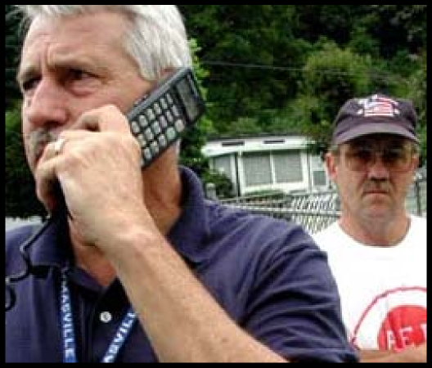
Strike Team and Task Force Leader
■ Responsible for performing tactical assignments
assigned to the Strike Team or Task Force
■ The Strike Team or Task Force Leader is the Strike
Team or Task Force point-of-contact for the
Division/Group Supervisor
Unit 3:
Unit 3:
Visual 3-9
Overview of the Strike Team and Task Force Leader Positions
Visual 3-8
Overview of the Strike Team and Task Force Leader Positions

Slide 9
Strike Team and Task Force Leader (cont.)
■ Typically reports to a Division/Group Supervisor on
extended response and major incidents
■ Reports work progress, resources status, and other
important information
■ Maintains work records on assigned personnel
■ Can be a great source of feedback
Unit 3:
Overview of the Strike Team and Task Force Leader Positions
Visual 3-9

Slide 10
Objectives Review
What is the difference between a Strike Team and a
Task Force?
What is the purpose of using a Strike Team or Task
Force?
What information does the Strike Team or Task Force
Leader provide the Division/Group Supervisor?
Unit 3:
Overview of the Strike Team and Task Force Leader Positions
Visual 3-10

