Slide 1

Unit 3:
Delegation of Authority & Management by Objectives

Slide 2
Unit Objectives
Describe the delegation of authority process.
Describe scope of authority.
Define management by objectives.
Explain the importance of preparedness plans and agreements.

Slide 3

Authority
Authority is . . .
. . . a right or obligation to act on behalf of a department, agency, or jurisdiction.

Slide 4
Who’s Responsible?
Within your jurisdiction or agency, who has the authority for protecting citizens and responding to incidents?

Slide 5
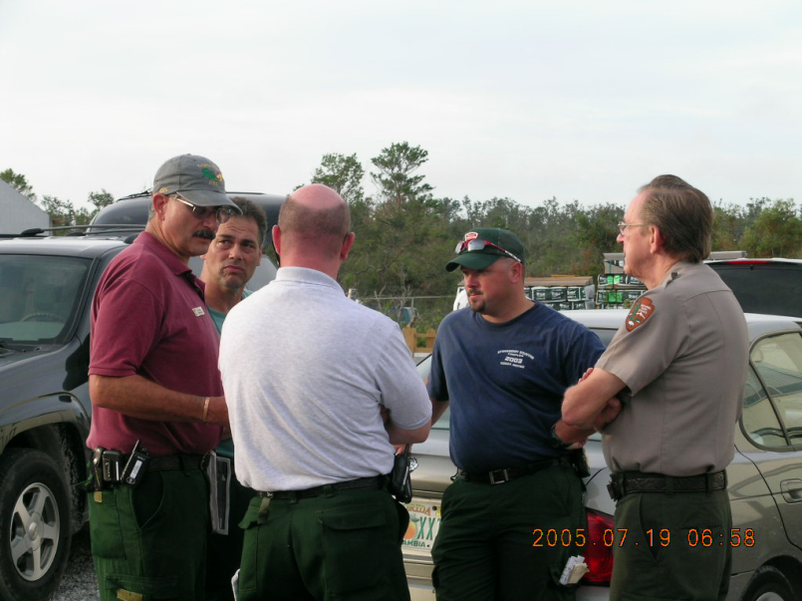
Scope of Authority
An Incident Commander’s scope of authority is derived:
From existing laws, agency policies, and procedures, and/or
Through a delegation of authority from the agency administrator or elected official.

Slide 6


Delegation of Authority
Grants authority to carry out specific functions.
Is issued by chief elected official, chief executive officer, or agency administrator in writing or verbally.
Allows the Incident Commander to assume command.
Does NOT relieve the granting authority of ultimate responsibility for the incident.
It is basically a Contract for a job
Agency Executive
Incident Commander

Slide 7
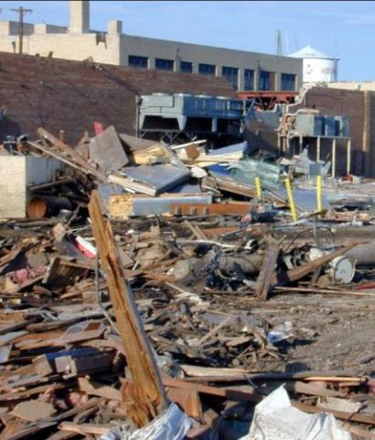
Delegation of Authority: When Needed
When the incident is outside the Incident Commander’s jurisdiction.
When the incident scope is complex or beyond existing authorities.
When required by law or procedures.

Slide 8
Discussion Question
When would an Incident Commander in your jurisdiction or agency need a delegation of authority?

Slide 9
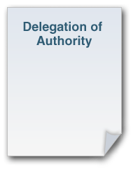
Delegation of Authority: Elements
Should include:
Legal authorities and restrictions.
Financial authorities and restrictions.
Reporting requirements.
Demographic issues.
Political implications.
Agency or jurisdictional priorities.
Plan for public information management.
Process for communications.
Plan for ongoing incident evaluation.

Slide 10
October 6, 2003
To: , Incident Commander
From: Director
Subject: Delegation of Authority, Hurricane Isabel Response
I hereby delegate to you and your Incident Management Team the authority and responsibility to manage the response
to the consequences of Hurricane Isabel, particularly at Colonial National Historical Park, Fredericksburg and
Spotsylvania National Military Park, Richmond and Petersburg National Battlefields. You may be assigned
responsibilities at other NPS units, as the need arises. You have full authority and responsibility for managing this
incident within the framework of law, regulation, NPS policy and direction provided by me and the Superintendents of
each park. This delegation is effective at 0600 hours, October 7, 2003.
Specific management considerations for this incident are:
1. Ensure that safety and the protection of human life is the first priority.
2. Work closely with the effected Regions and Superintendents (and assigned staff) to manage the incident in a
manner that meets their expectations, the expectations of involved partners and the elements of this delegation.
The Superintendents will serve as the Agency Administrator to the Incident Management Team, representing
their respective park’s interest, coordinating use of local resources and providing a liaison with local agencies.
3. Manage the emergency restoration and essential clean-up of damaged resources and infrastructure.
4. Coordinate and complete a professional condition assessment of damaged park assets, utilizing the FMSS, for
all NPS units sustaining damage during Hurricane Isabel.
5. Maintain cost at a level commensurate with the needs of the incident.
6. Provide situation updates daily. Please send Incident Status Summary reports (ICS 209) via NWCG’s
“FAMWEB” internet-based program, by 1800 hours each operational period.
7. Order resources and equipment through EICC.
8. Coordinate with park staff to manage local media and public information needs. Coordinate National
information needs with the WASO Public Affairs Office.
9. Please provide a final report, which includes a summary of incident actions and recommendations for future
incidents.
10. Schedule a close-out meeting with me prior to your team’s demobilization from the incident.
My designated representative for this incident will be the Associate Director for Visitor and Resource Protection,
Karen Taylor-Goodrich.

Slide 11
Discussion Question
How do you ensure that the delegating authority remains an active part of the incident response?

Slide 12
Activity: Delegating Authority
Instructions: Working with your team . . .
Read the case study in your Student Manual.
Identify the steps you would take to keep the agency executives involved in this incident.
List the steps on chart paper.
Choose a spokesperson. Be prepared to present your findings to the class in 10 minutes.

Slide 13
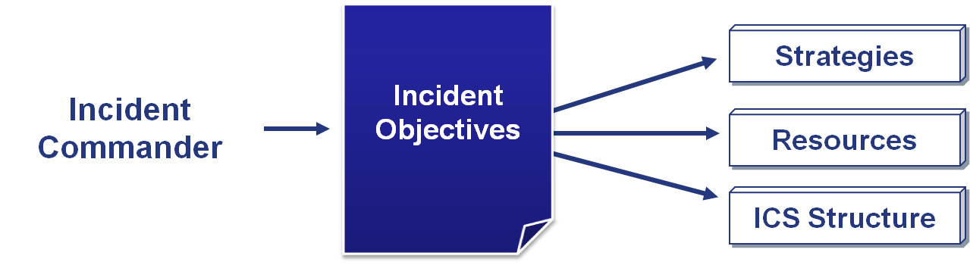
Implementing Authorities
Within his or her scope of authority, the Incident Commander establishes incident objectives, then determines strategies, resources, and ICS structure.

Slide 14
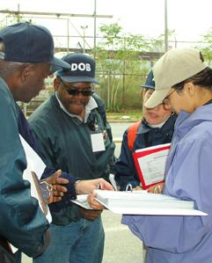
Management by Objectives
ICS is managed by objectives.
Objectives are communicated throughout the entire ICS organization through the incident planning process.

Slide 15
Establishing and Implementing Objectives
Step 1: Understand agency policy and direction.
Step 2: Assess incident situation.
Step 3: Establish incident objectives.
Step 4: Select appropriate strategy or strategies to achieve objectives.
Step 5: (Identify and) Perform tactical direction.
Step 6: Provide necessary followup.

Slide 16
Initial Response: Conduct a Size-Up
The first responder must determine:
Nature and magnitude of the incident.
Hazards and safety concerns.
Initial priorities and immediate resource requirements.
The location of the Incident Command Post and Staging Area.
Entrance and exit routes for responders.

Slide 17
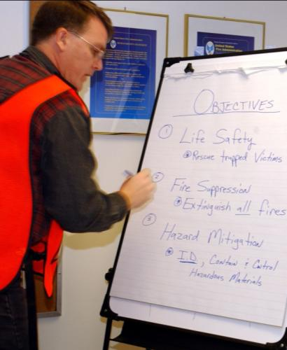
Overall Priorities
Throughout the incident, objectives are established based on the following priorities:
#1: Life Safety
#2: Incident Stabilization
#3: Property Preservation

Slide 18
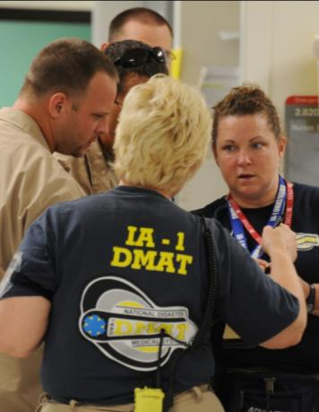
SMART Incident Objectives
Effective incident objectives are:
Specific.
Measurable.
Action oriented.
Realistic
Time sensitive.

Slide 19
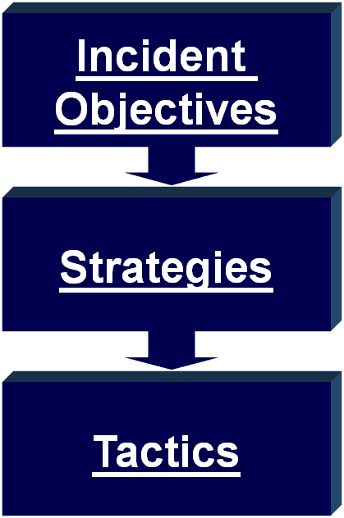
Objectives, Strategies, and Tactics
State what will be accomplished.
Establish the general plan or direction for accomplishing the incident objectives.
Specify how the strategies will be executed.

Slide 20
Objectives, Strategies, and Tactics
Get the Cat safely out of the tree.
A: Cut the tree down.
B:Pull the Cat out of the tree
C:Let the Cat climb out of the tree on its own (selected strategy)
Put a can of tuna at the base of the tree and the Cat will climb down to get it.

Slide 21
Activity: Adding Incident Objectives
Instructions: Working with your team . . .
Review the scenario and incident objectives described in your Student Manual.
Determine what other incident objectives you would add.
Write your answers on chart paper.
Select a team spokesperson and be prepared to share your answers with the class in 5 minutes.

Slide 22
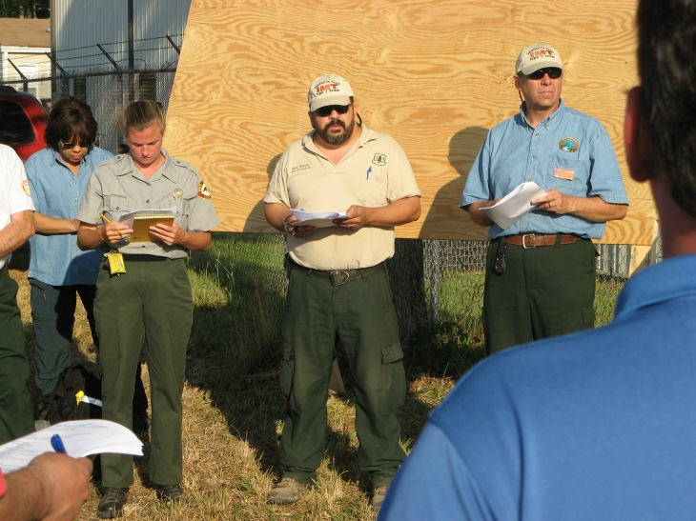
Elements of an Incident Action Plan
Every IAP must have four elements:
What do we want to do?
Who is responsible for doing it?
How do we communicate with each other?
What is the procedure if someone is injured?

Slide 23
Preparedness Plans and Agreements
The most common preparedness plans are:
Federal, State, or local Emergency Operations Plans (EOPs).
Standard operating guidelines (SOGs).
Standard operating procedures (SOPs).
Jurisdictional or agency policies.

Slide 24
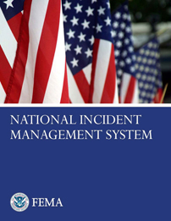
Emergency Operations Plans (EOPs)
EOPs are developed at the Federal, State, and local levels to provide a uniform response to all hazards.
EOPs written after October 2005 must be consistent with NIMS.

Slide 25
Mutual Aid and Assistance Agreements (1 of 2)
NIMS states that:
Mutual aid and assistance agreements are agreements between organizations that provide a mechanism to quickly obtain emergency assistance.
Jurisdictions should be party to agreements with the appropriate organizations from which they expect to receive, or to which they expect to provide, assistance.

Slide 26
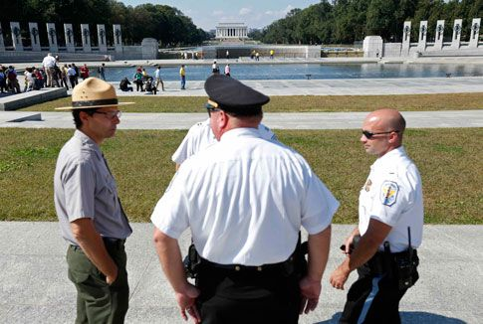
Mutual Aid and Assistance Agreements (2 of 2)
Mutual aid:
Is the voluntary provision of resources by organizations to assist each other.
Allows jurisdictions to share resources among mutual aid partners.

Slide 27
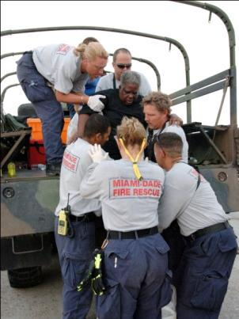
Mutual Aid and Assistance: All Levels
Local jurisdictions participate in mutual aid through agreements with neighboring jurisdictions.
States can participate in mutual aid through the Emergency Management Assistance Compact (EMAC).
Federal agencies offer mutual aid to each other and to States, tribes, and territories under the National Planning Frameworks.

Slide 28

Information Derived From Plans
Plans may include:
Hazards and risks.
Resources in the area.
Other formal agreements.
Contact information for agency administrators and response personnel.

Slide 29
Discussion Question
What preparedness plans, agreements, and standard operating procedures must you follow in responding to incidents?

Slide 30
Activity: Developing Incident Objectives
Instructions: Working in your team . . .
Review the scenario, scenario map for the Kenilworth Aquatic Gardens & Park “Lotus and Water Lily Festival”
Develop incident objectives for the next 12 hours.
Next, identify your general strategy for accomplishing these objectives.
Select a spokesperson and be prepared to present your work in 30 minutes.

Slide 31
Summary
Are you now able to:
Describe the delegation of authority process?
Describe scope of authority?
Define management by objectives?
Explain the importance of preparedness plans and agreements?

