Slide 1
Panko’s Little Area Command Additional Slides

Slide 3
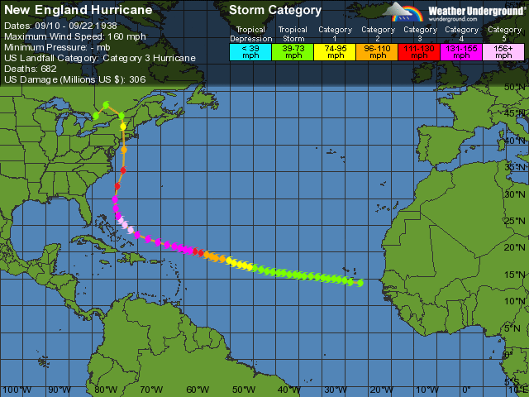

Slide 4
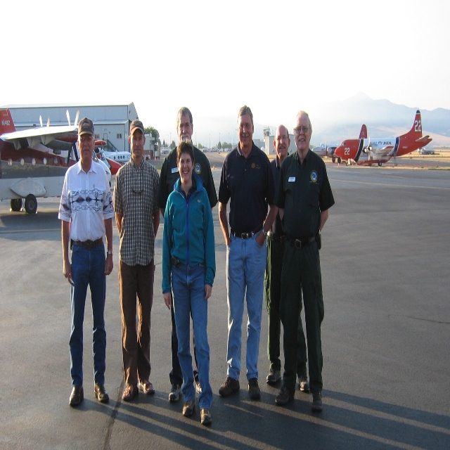
Area Command Team One

Slide 5
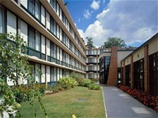
Area Command: Location Considerations
  Close to incidents
  Not collocated with an ICP
  Sufficient size
  Capable of continuous operation
  Adequate communications
  capabilities
  Backup power
  Adequate and secure parking
  Near commercial food and
  lodging
Hint: This is
kinda like “it”

Slide 6
Katrina Area Command Team 1
Daily Team Schedule – AC Zimmerman
Area Command Team Schedule
Time Activity Participants Call Number
0700 JOC Senior Staff Meeting JOC/AC 800.320.4330
0800 Area Command Staff mtg ACT#1
0900 Region-AC-IC Conference Call AC-ICs-Region 866.769.2334
1100 Finance Conference Call IBA 877.710.5722
1200 Logistics Conference Call AC & IMT’S 866.769.2334
1300 Area Command Staff mtg AC
1600 FEMA Planning meeting
1600 Information Officer conference Call AC/IMT IOF 866.769.2334
1700 AC-AC-SACC AC’S -SACC 877.972.6038
1800 AC/IC Conference Call AC/ICs 866.769.2334
1800 IBA Conference Call IBAs
1830 Area Command Planning mtg AC

