Slide 1
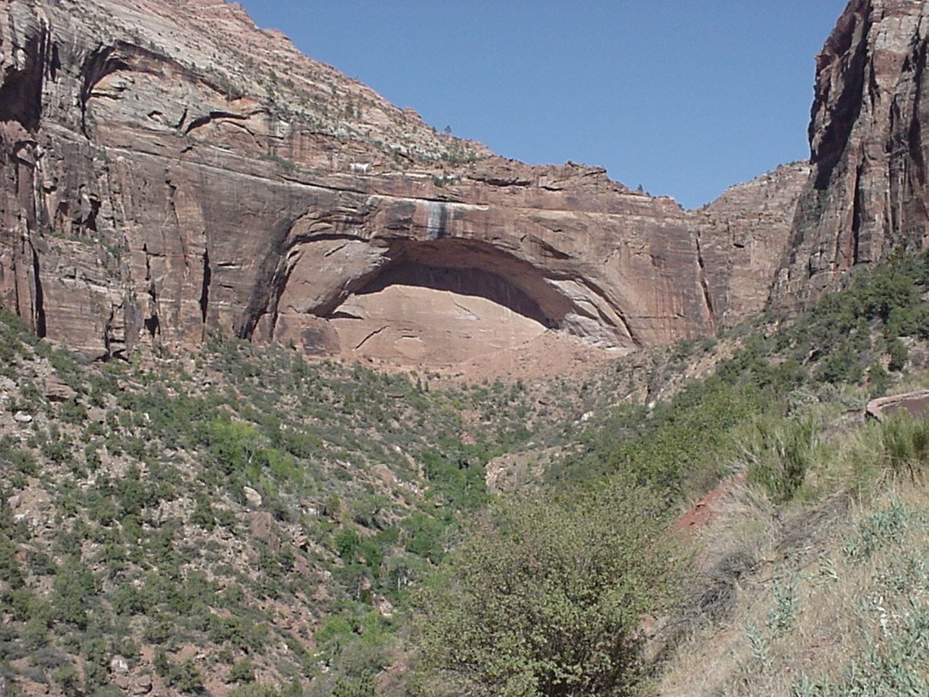
This Presentation Will Cover 3 Topics
Careers in the US National Park Service
US National Park Service Science Based Management of Wildland Fire
Use of Prescribed Burning to Achieve Management Objectives locally

Slide 2

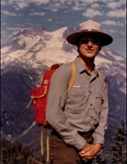
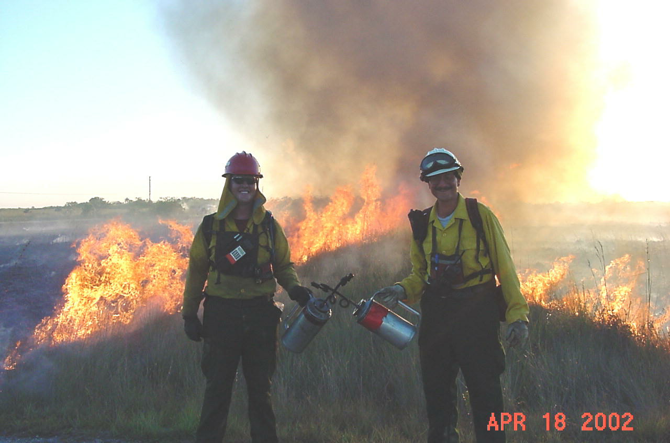
Bob Panko
United States National Park Service 36 Year Career (1971-2007)
Mt. Rainier NP / Everglades NP / Shenandoah NP / Statue of Liberty-Ellis Island NM / Biscayne NP / Everglades NP
Park Ranger / Supervisory Park Ranger 1971-1996
Fire & Aviation Management Officer Everglades NP 1996-2007
Post USNPS Career “Risky Business Incident Management LLC”

Slide 3
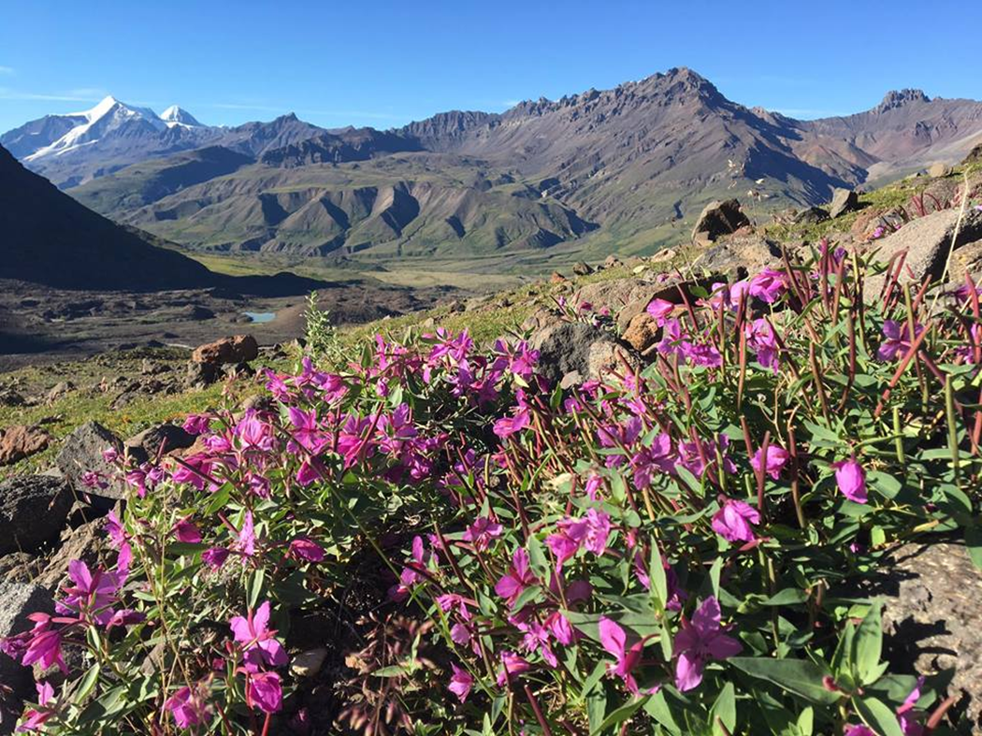
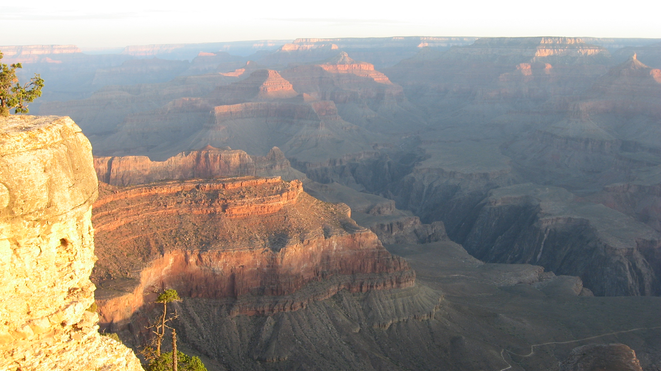
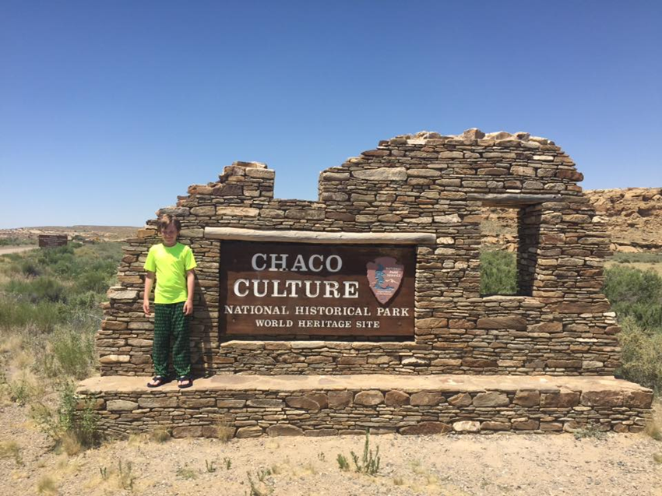
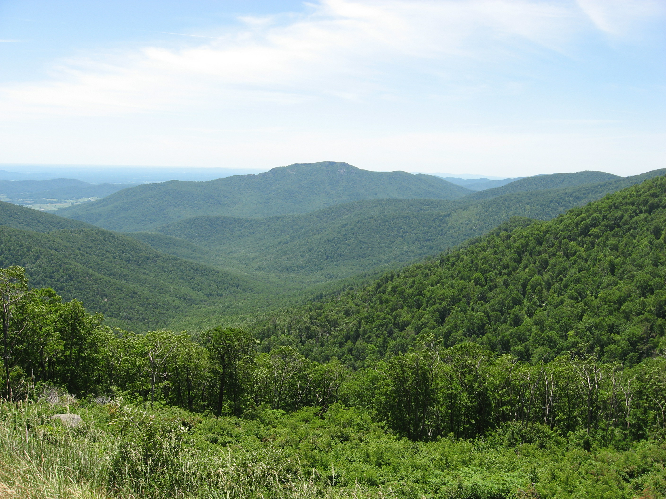
There are 418 Units in the USNPS
National Parks (60)
National Parkways (4)
National Preserves (19)
National Reserves (2)
National Recreation Areas (18)
National Rivers (5)
National Wild and Scenic Rivers and Riverways (10)
National Scenic Trails (3)
National Seashores (10)
Other Designations (11)
National Historic Sites (77)
International Historic Sites (1)
National Lakeshores (4)
National Memorials (29)
National Monuments (87)
National Battlefields (11)
National Battlefield Parks (4)
National Battlefield Sites (1)
National Military Parks (9)
National Historical Parks (52)

Slide 4
US National Park Service – US & US Territories

Slide 5
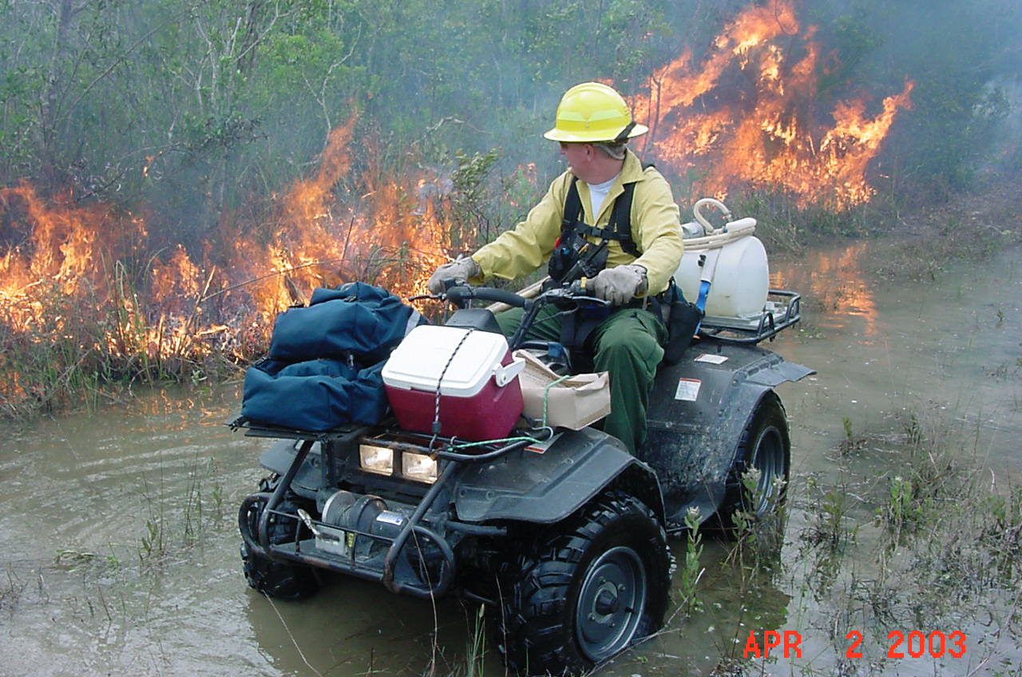
Careers In USNPS
Administration / Business Practices, Commercial Services
Cultural Resources Stewardship
Facilities Maintenance
Fire & Aviation Management
Historic Preservation Skills
Information Management
Interpretation and Education
Law Enforcement
Legislative Affairs
Natural Resources Stewardship
Organizational Development
Public Affairs and International Affairs
Partnerships
Planning, Design & Construction
Recreation & Conservation Programs
Risk Management
Supervision, Management & Leadership
Visitor Resource Protection
20,000 employees
315,000 volunteers

Slide 6
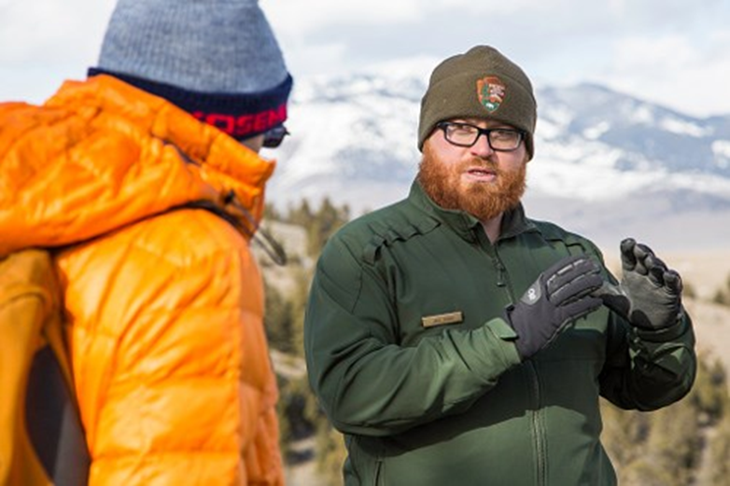
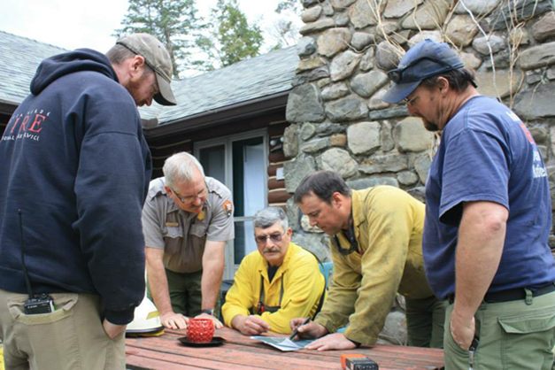
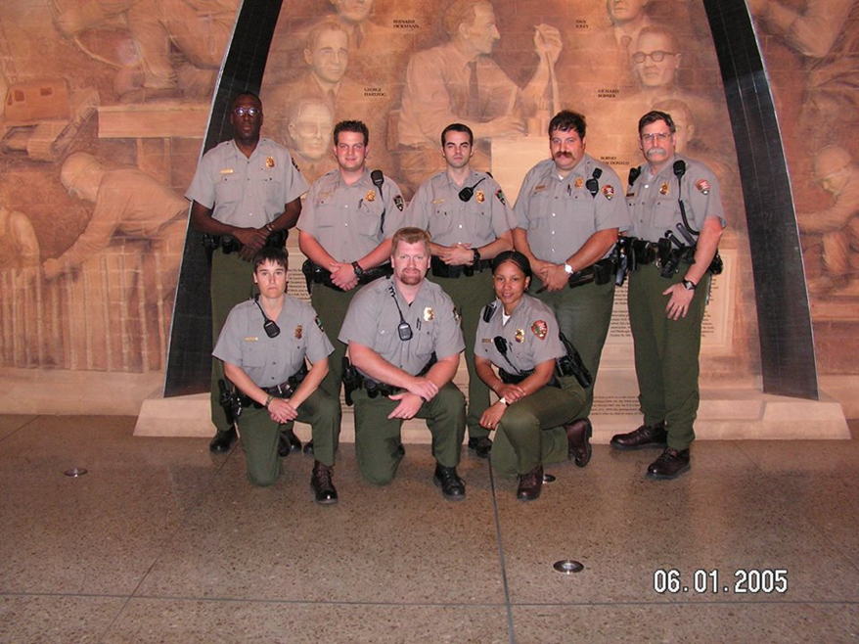
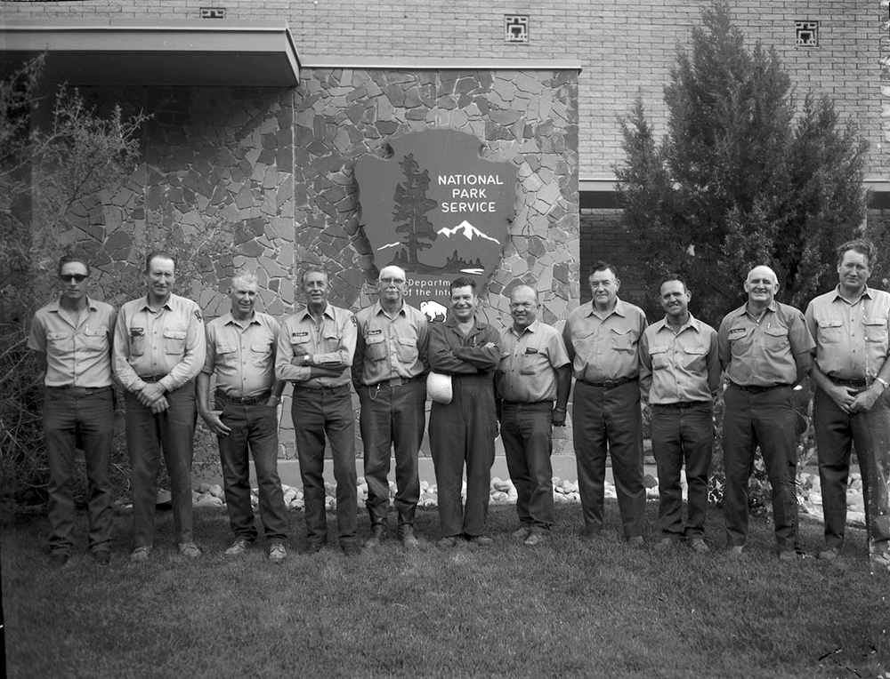
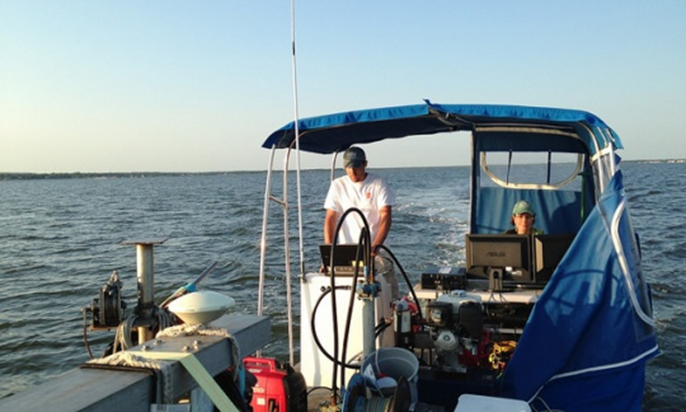
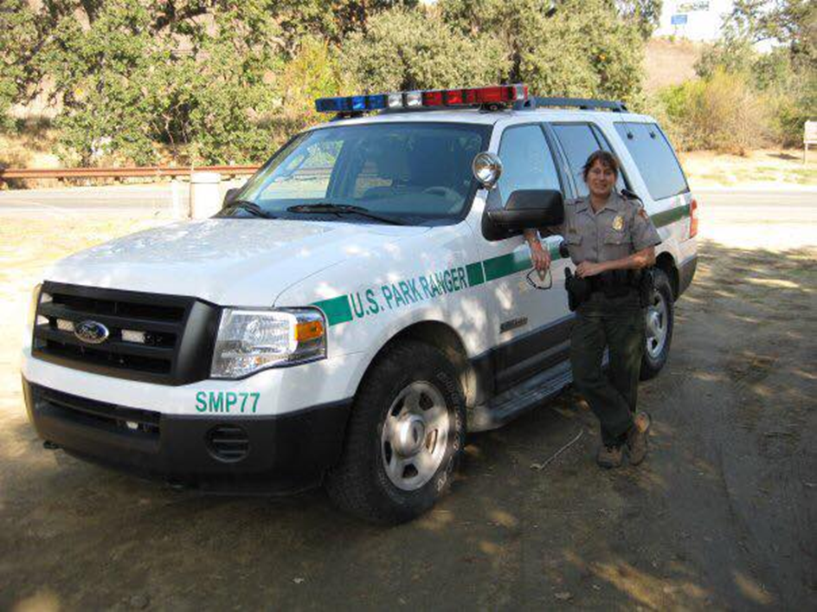
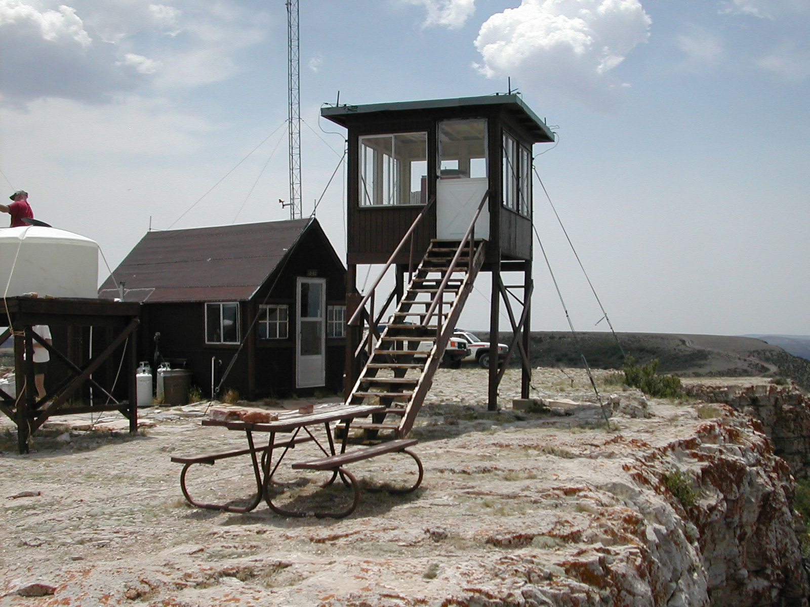
Pictures of NPS careers

Slide 7
US National Park Service Science Based Management of Wildland Fire
The USNPS has been a pioneer in the evolution of wildland fire management nationwide
In order to understand this evolution of policy we need to discuss some simple topics about “Disturbance” in ecosystems.

Slide 8
Climax vs Transitional Ecosystems
Climax Ecosystem
“The climax forest came to be seen as an endpoint of the successional sequence. It was the final stage; once attained, it maintained itself forever.”
Michael Snyder Chittenden (Vermont) County Forester.
Many people picture that the National Parks should be maintained as Climax Communities.
As USNPS management policies evolved to understand and direct that natural disturbances need to play their role to maintain and sustain healthy ecosystems.
But Aren’t there Disturbances that Impact Ecosytem Succession?
Generally We Can Place them in Three Categories:
Cultural (Human) Disturbances
Natural Disturbances
Combination Disturbances: Natural Disturbances caused by Humans

Slide 9
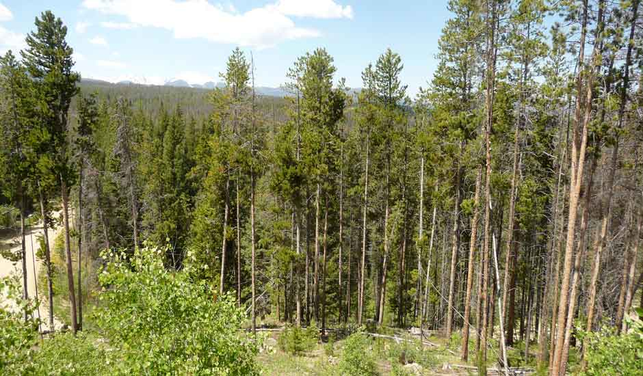
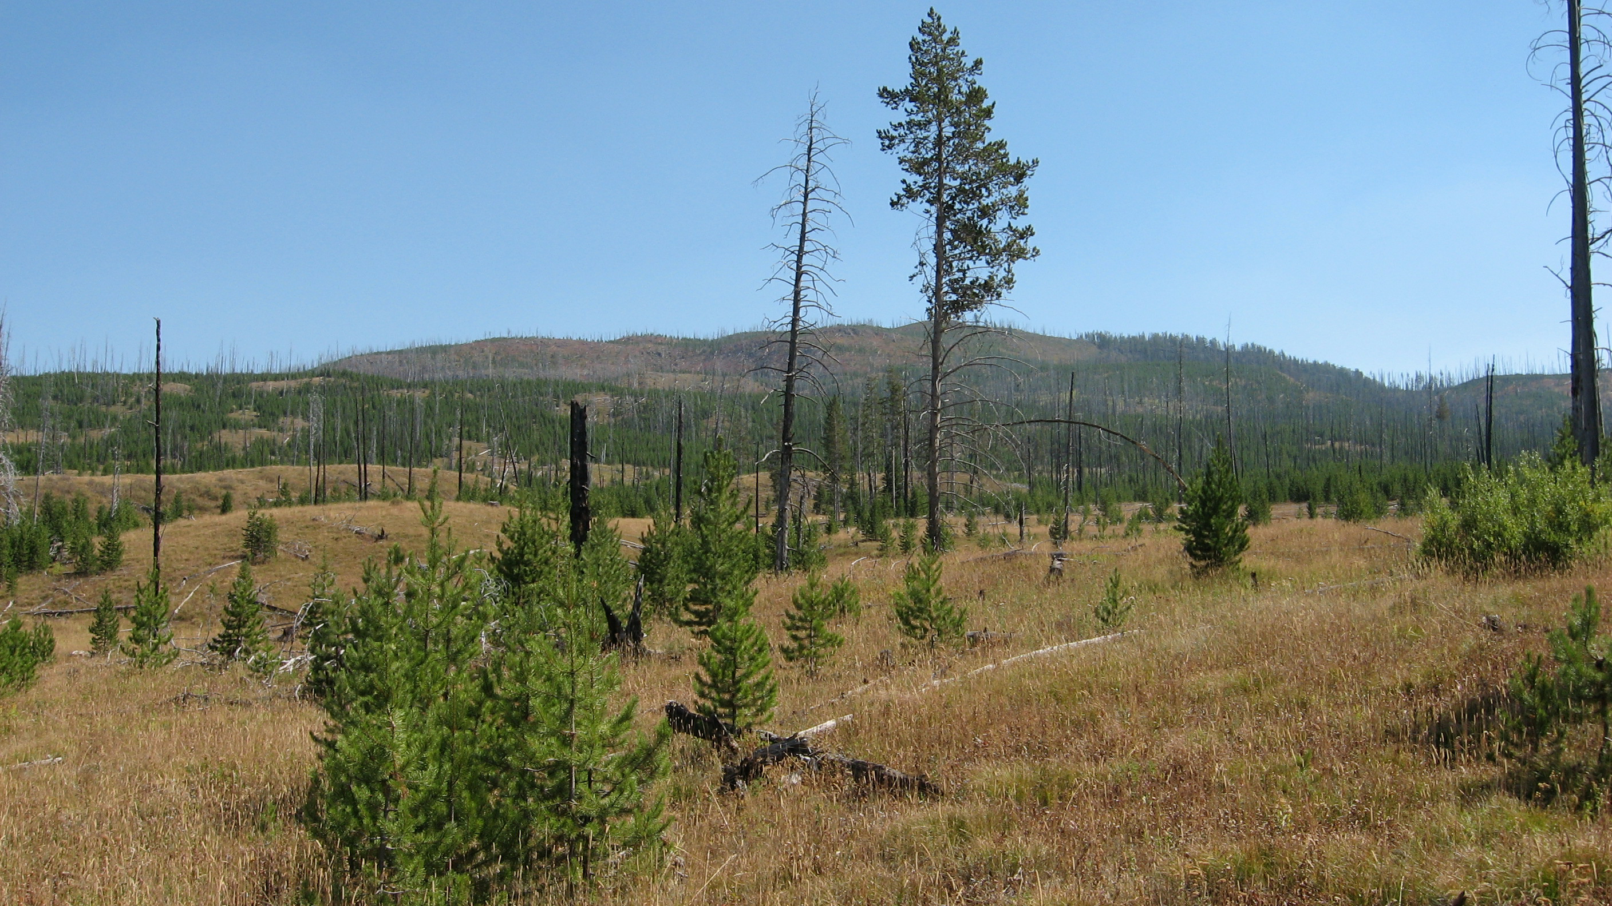
Climax Lodgepole Pine vs. Fire Disturbed Yellowstone National Park
In our world most ecotones climb their way through succession as they await the next disturbance

Slide 10
Disturbances to Natural Ecosystems
  Cultural Disturbances
  Logging
  Land Clearing / Farming
  Construction / Road Building
  Herbicide / Pesticide application
  Climate Change
Natural Disturbances
Flood
Drought
Severe Weather Events (hurricane, tornado, NE’s)
Infestations
Volcanic/Seismic Activity
Wildfire
Climate Change
Combination Disturbances
Human caused wildfire
Human introduction of non-native species (eg. Gypsy Moth)
Fragmentation / Compartmentilization
Climate Change

Slide 11
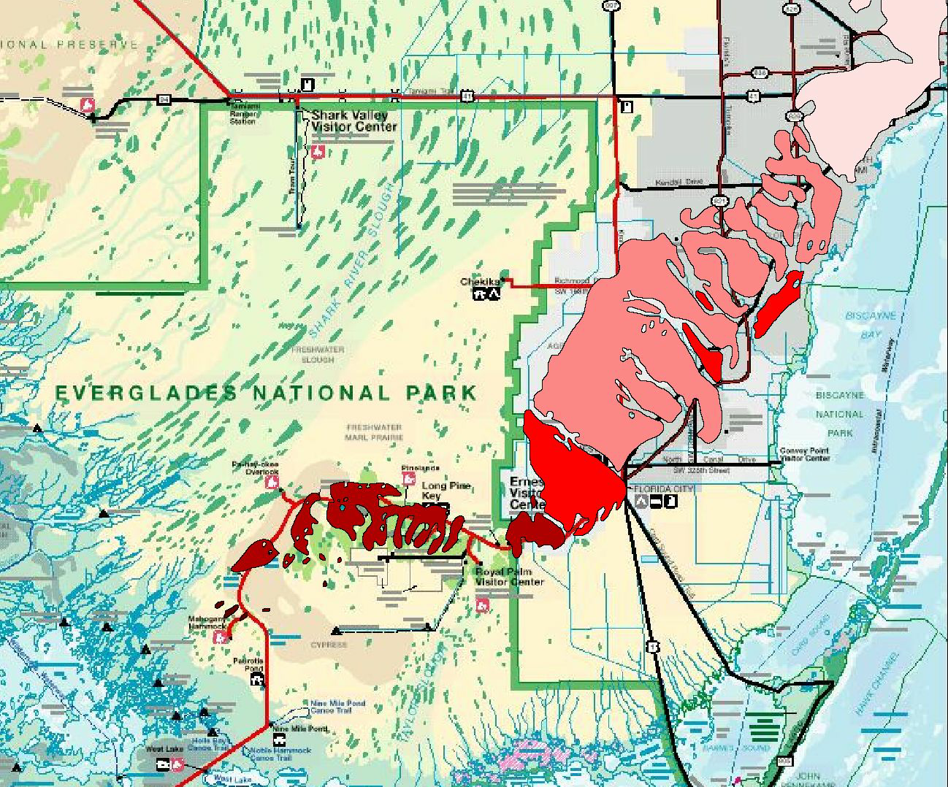

Lets Look at these Disturbances in the Everglades Ecosystem
THE PINE ROCKLANDS OF SOUTH FLORIDA
Notes:
Jeff discusses: the pinelands as an extremely rare ecosystem that has largely been exterpated outside of Everglades NP

Slide 12
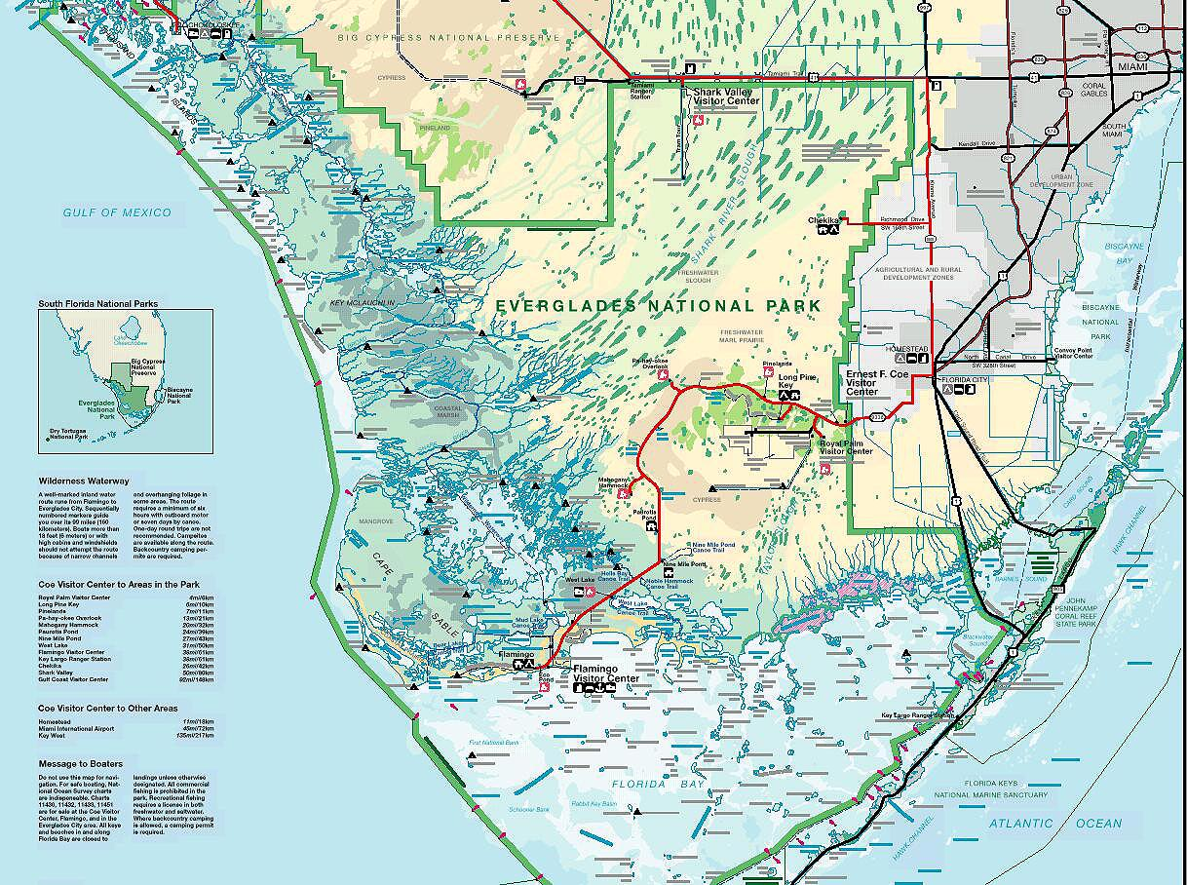
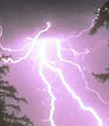

Natural Lightning Fires will never come out of this area into Everglades NP again
Prevailing Wind
Prevailing Wind
Notes:
Bob discusses how the natural fire regimes have been altered
natural fire strikes in grass prairies and is wind driven

Slide 13
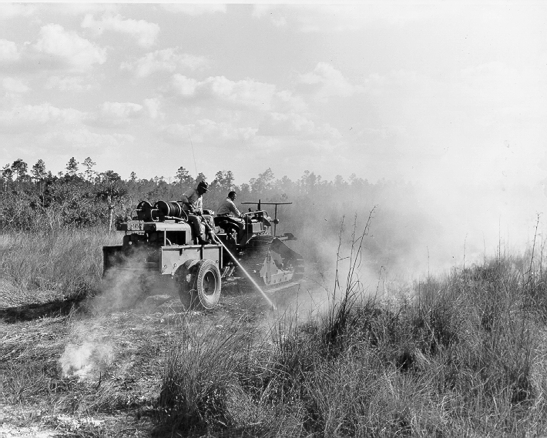
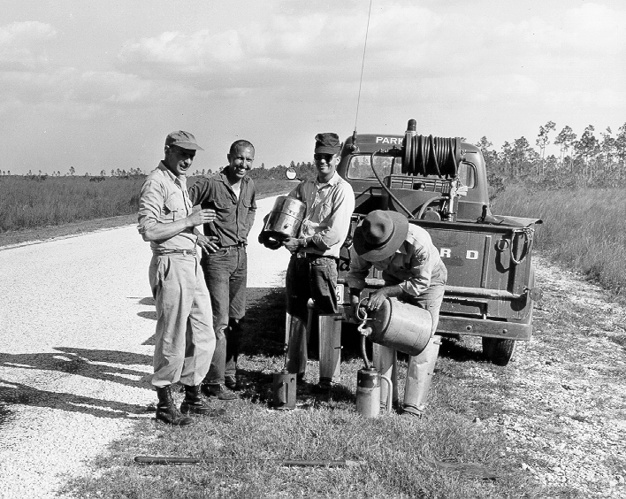
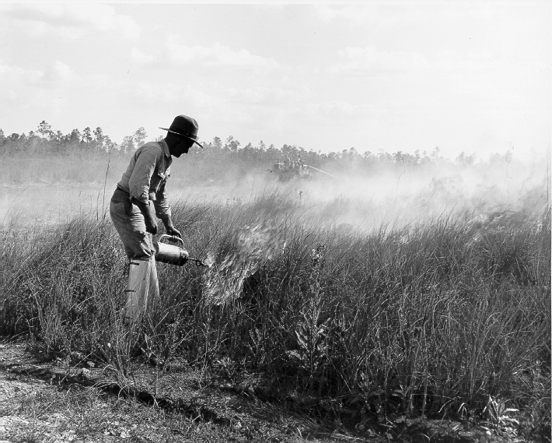
History of Fire Management in Everglades
This same process was also occurring in National Parks like Sequoia/Kings Canyon, Yosemite & other USNPS areas
Perhaps the first “scientific based” fire program- based on research started in 1953
First Prescribed Burn on NPS Lands-1958
“In House Rule” as early as 1956 that many lightning caused fires would not be suppressed
“Fire Management Plan” vs. “Fire Control Plan” implemented in 1973
70 years of hard copy individual fire report records
By late 20th Century Fully implementing all dimensions of federal fire management

Slide 14
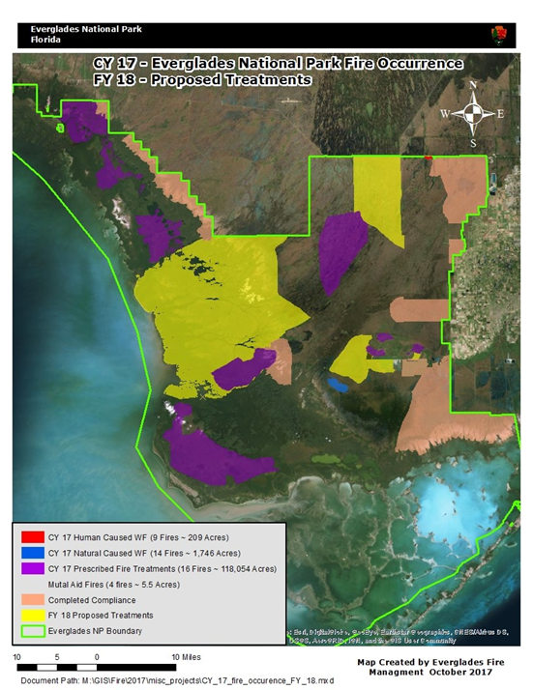
Everglades Fire Management 2017-2018

Slide 15
Why Consider Using Prescribed Burning
What resource management goals you are trying to achieve or maintain?
  Are you trying to restore or maintain natural conditions?
  Are you trying to eliminate or reduce invasive non-native plants?
  Do you wish to perform “site prep” for reforestation projects?
Fragmentation / compartmentalization interrupts natural fire disturbances
Prescribed Fire can be used to mimic natural conditions on small fragments for restoration of native habitats
Prescribed Fire can be used to reduce/eliminate certain non-native invasive species
Prescribed Fire can sometimes be used instead of the mower or other equipment for site prep or maintenance.

Slide 17
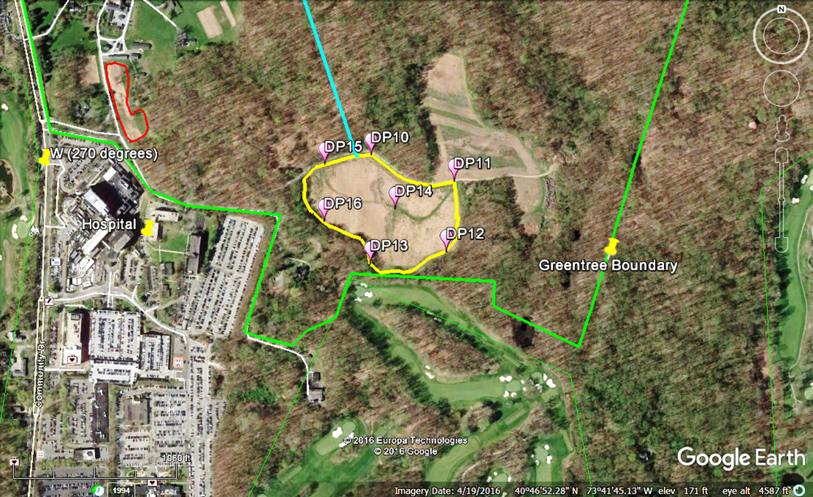
Prescribed Burn April 13, 2017 Greentree Foundation, Long Island NY
https://vimeo.com/216598614

Slide 18
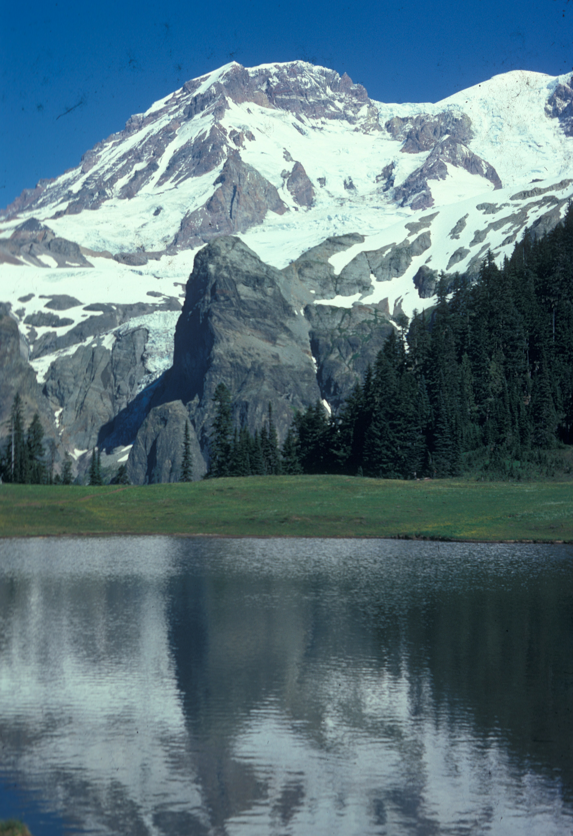
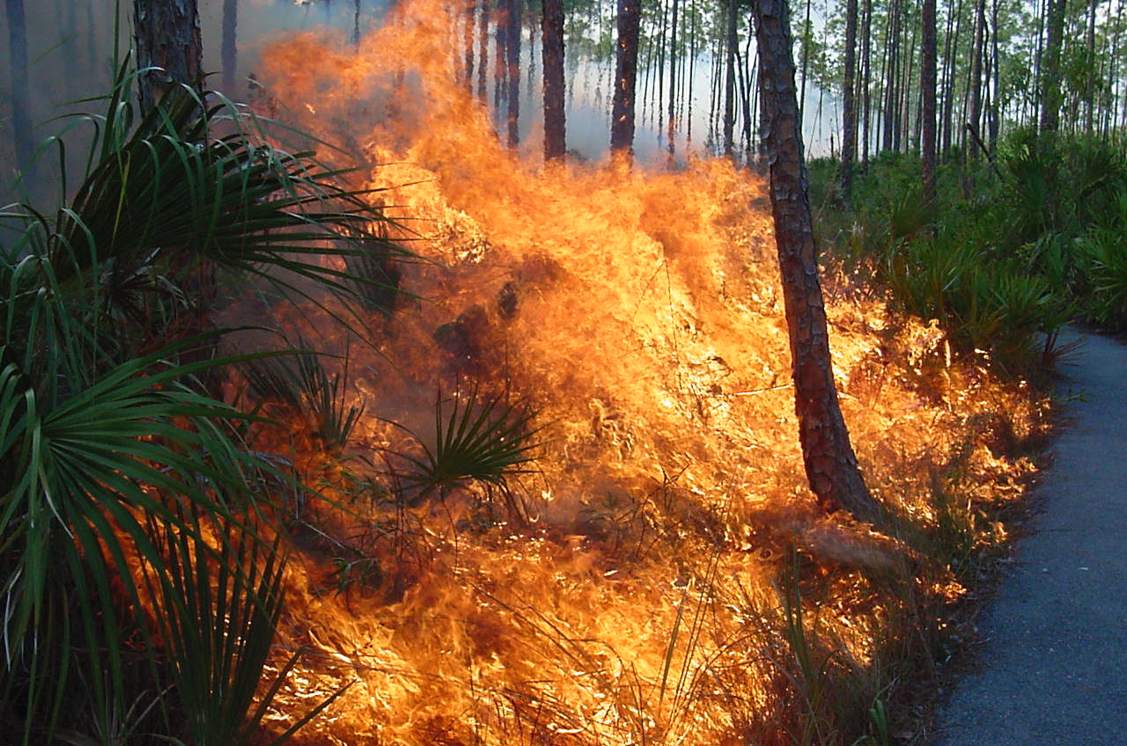
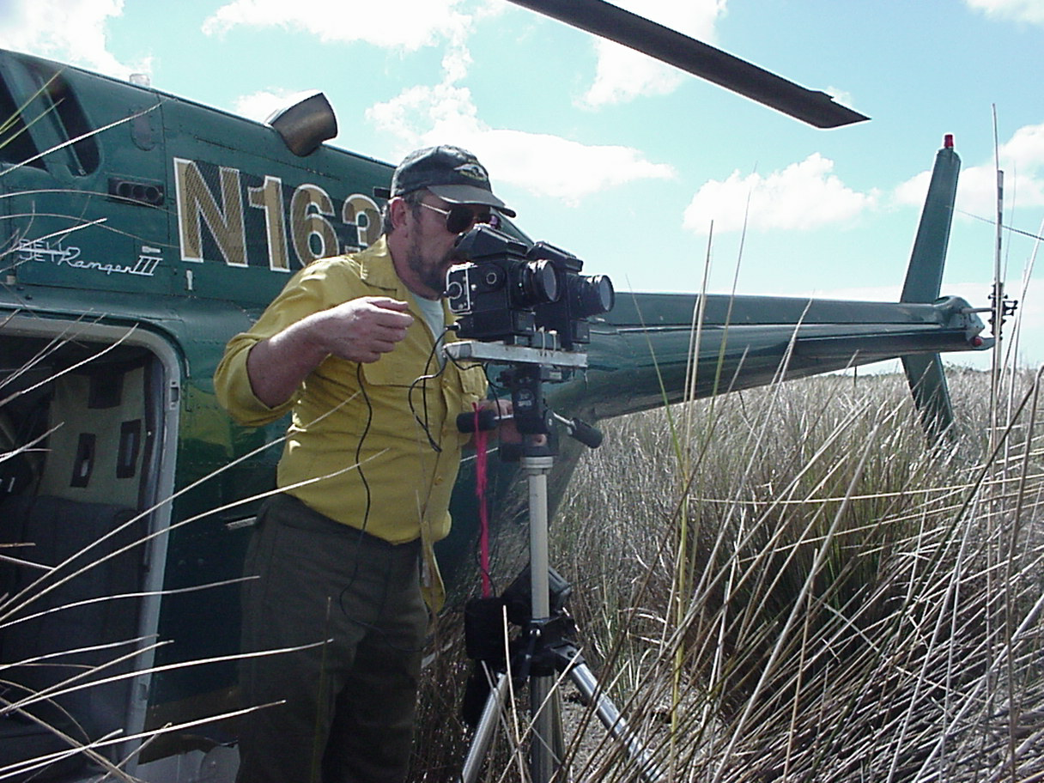
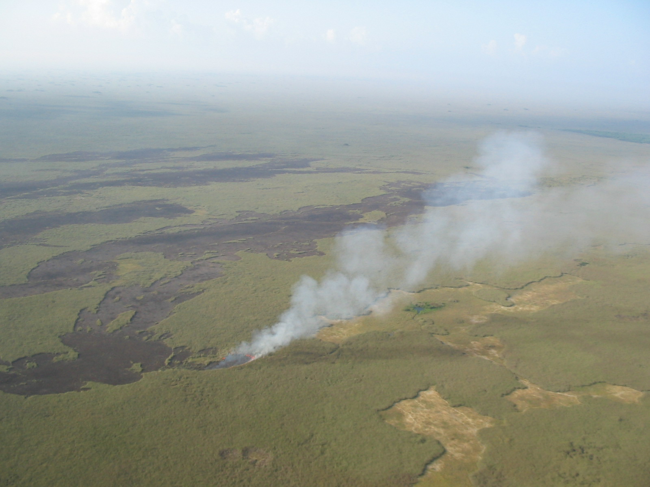
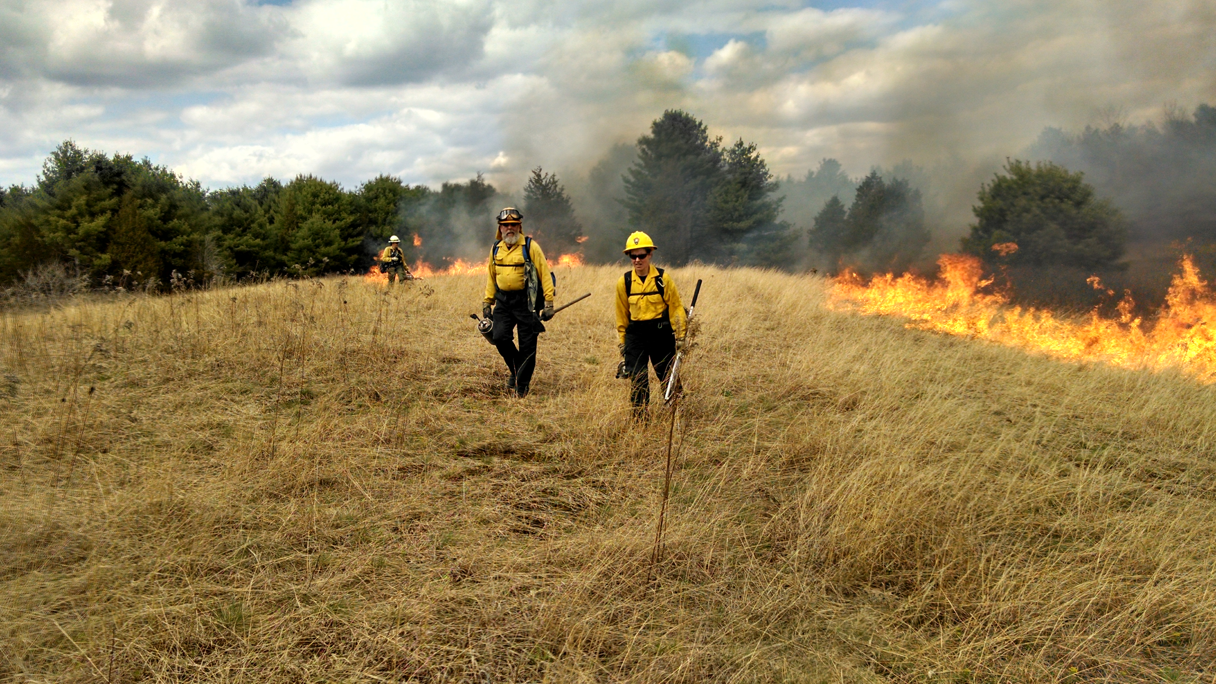
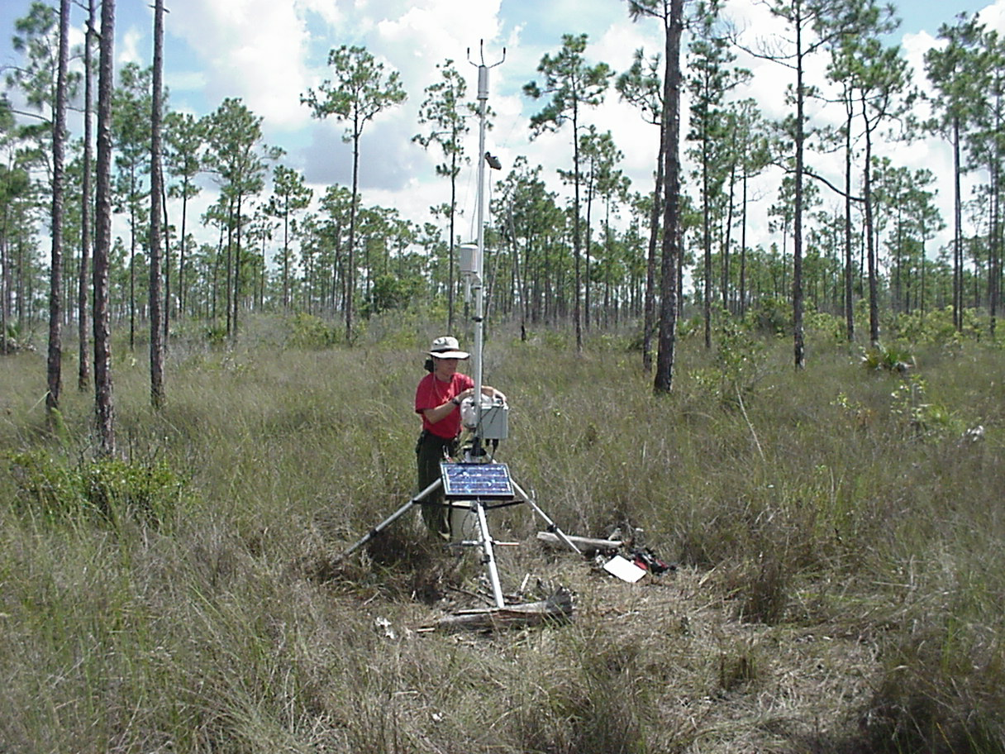
Time for Questions…….

